Slide 1
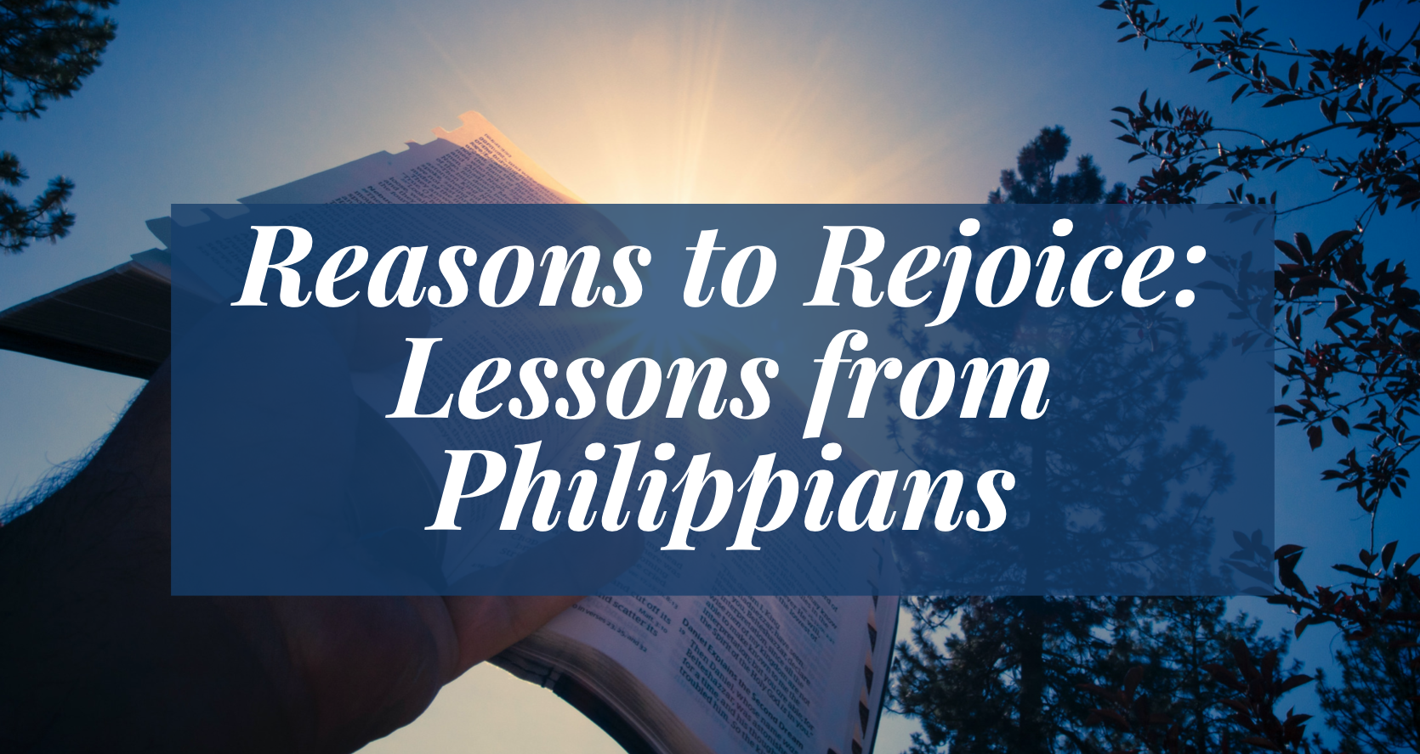

Slide 2
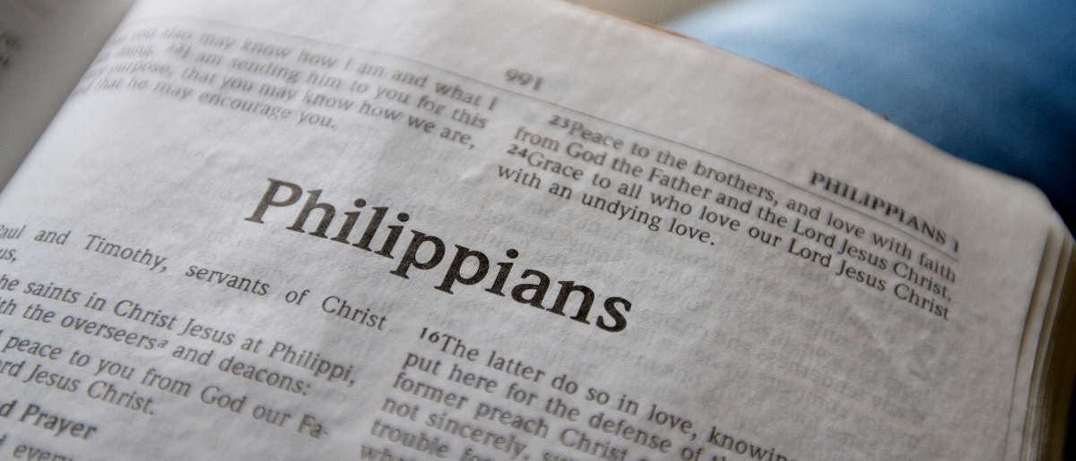
Remembering Good Friends
Philippians 1:1-11

Slide 3
I. Paul Thanked God for Them
I thank my God upon every remembrance of you,
always in every prayer of mine making request for you all with joy,
for your fellowship in the gospel from the first day until now,

Slide 4
2. Paul Had Confidence in Their Spiritual Progress
being confident of this very thing, that He who has begun a good work in you will complete it until the day of Jesus Christ;

Slide 5
3. Paul Loved Them
just as it is right for me to think this of you all, because I have you in my heart, inasmuch as both in my chains and in the defense and confirmation of the gospel, you all are partakers with me of grace.
For God is my witness, how greatly I long for you all with the affection of Jesus Christ.

Slide 6
4. Paul Prayed for Them
And this I pray, that your love may abound still more and more in knowledge and all discernment,
that you may approve the things that are excellent, that you may be sincere and without offense till the day of Christ,
being filled with the fruits of righteousness which are by Jesus Christ, to the glory and praise of God.

Slide 7
Paul Rejoiced in His Friends
Thanked God for Them
Had Confidence in Their Progress
Loved Them Dearly
Prayed for Them Always
“Rejoice in the Lord always, Again I will say, rejoice!”

