Slide 2
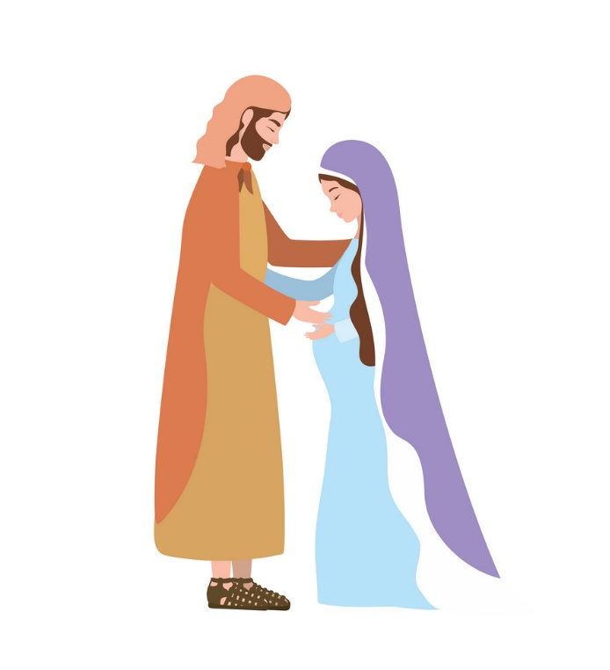
Joseph the Husband of Mary
Matthew 1:18-25

Slide 3
1. He Was a Just Man
“righteous, observing divine and human laws”
“One whose way of thinking, feeling, and acting is wholly conformed to the will of God.”

Slide 4
2. He Was a Merciful Man
He didn’t rush into action (v. 20).
“…not wanting to make her a public example, was minded to put her away secretly” (v. 19).

Slide 5
3. He Was an Obedient Man
Then Joseph, being aroused from sleep, did as the angel of the Lord commanded him and took to him his wife,
and did not know her till she had brought forth her firstborn Son. And he called His name Jesus.

Slide 6
What Made Joseph a Good Father?
He was Just.
He was Merciful.
He was Obedient.
He has shown you, O man, what is good;
And what does the Lord require of you
But to do justly,
To love mercy,
And to walk humbly with your God?
Micah 6:8

