Slide 2
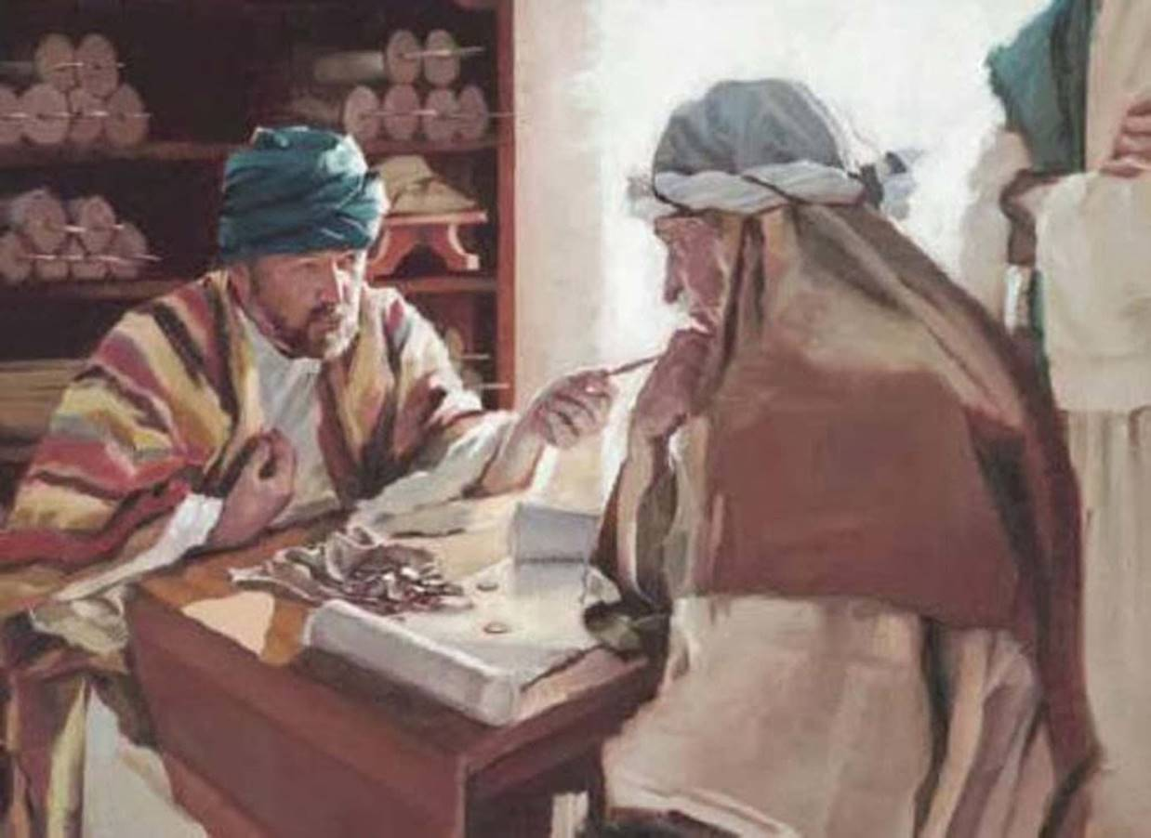
The Parable of the Unjust Steward
Luke 16:1-13

Slide 3
Understanding This Parable
Keep it in its context in Luke.
Don’t try to identify the characters.
Understand the words.
Note the commendation comes from the steward’s master, not from Jesus.
Pay attention to the lessons at the end.

Slide 4
The Parable vs. 1-8
A steward is caught wasting his master’s goods.
He thinks about his future.
He offers to help the debtors in hope of gaining their help.
“So the master commended the unjust steward because he had dealt shrewdly” (v. 8).

Slide 5
The Steward’s Foresight
The Prodigal Son lived for the moment (vs. 13-14).
The Unjust Steward lived in light of the future.
He saw what was ahead of him, devised a plan, and worked to make it possible.
“For the sons of this world are more shrewd in their generation than the sons of light” (v. 8).

Slide 6
The Christian’s Foresight
“And I say to you, make friends for yourselves by unrighteous mammon, that when you fail, they may receive you into an everlasting home” (v. 9).

Slide 7
The Christian’s Foresight
“And I say to you, make friends for yourselves by unrighteous mammon, that when you fail, they may receive you into an everlasting home” (v. 9).

Slide 8
The Christian’s Foresight
“And I say to you, make friends for yourselves by unrighteous mammon, that when you fail, they may receive you into an everlasting home” (v. 9).

Slide 9
The Christian’s Foresight
“And I say to you, make friends for yourselves by unrighteous mammon, that when you fail, they may receive you into an everlasting home” (v. 9).
We are to make proper use of our material possessions in this world so that our reward will be in the next world (Matt. 6:19-20).

Slide 10
The Christian’s Faithfulness
He who is faithful in what is least is faithful also in much; and he who is unjust in what is least is unjust also in much.
Therefore if you have not been faithful in the unrighteous mammon, who will commit to your trust the true riches?
And if you have not been faithful in what is another man's, who will give you what is your own?

Slide 11
The Christian’s Faithfulness
He who is faithful in what is least is faithful also in much; and he who is unjust in what is least is unjust also in much.
Therefore if you have not been faithful in the unrighteous mammon, who will commit to your trust the true riches?
And if you have not been faithful in what is another man's, who will give you what is your own?

Slide 12
The Christian’s Faithfulness
He who is faithful in what is least is faithful also in much; and he who is unjust in what is least is unjust also in much.
Therefore if you have not been faithful in the unrighteous mammon, who will commit to your trust the true riches?
And if you have not been faithful in what is another man's, who will give you what is your own?

Slide 13
The Christian’s Faithfulness
He who is faithful in what is least is faithful also in much; and he who is unjust in what is least is unjust also in much.
Therefore if you have not been faithful in the unrighteous mammon, who will commit to your trust the true riches?
And if you have not been faithful in what is another man's, who will give you what is your own?

Slide 14
The Christian’s Priority
No servant can serve two masters; for either he will hate the one and love the other, or else he will be loyal to the one and despise the other. You cannot serve God and mammon.

Slide 15
The Parable of the Unjust Steward
Luke 16:1-13

