Slide 2
Making the Connection

Slide 3
A connection must be made.
Romans 10:9-13 – God is rich with His grace and mercy, saving all who want to be saved.
Romans 10:14-17 – however, no one can be saved unless they hear the gospel.

Slide 4
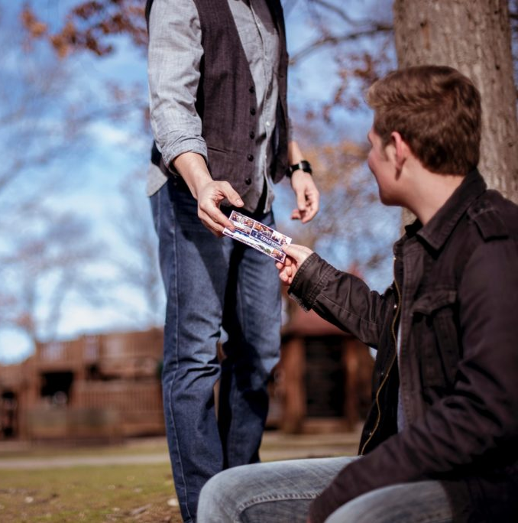
1. Invite People to Church
Easiest and most effective way to save souls.
Use cards.
Use special events: Gospel Meetings, VBS, Singings, etc.

Slide 5
2. One-On-One Bible Study
Evaluate the prospect.
Agree to time and location.

Slide 6
3. Small Group Study
On-going study with some members once or twice a month.
Helps members who aren’t ready to conduct personal studies.
Helps with prospects who aren’t willing to attend our worship services.

Slide 7
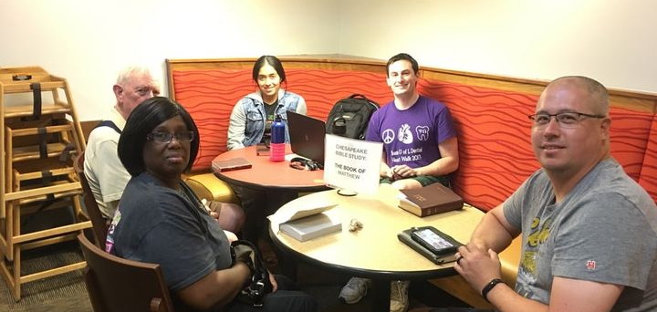
4. Meet-Up Bible Studies
Use social media to announce a weekly Bible study in a public location.

Slide 8
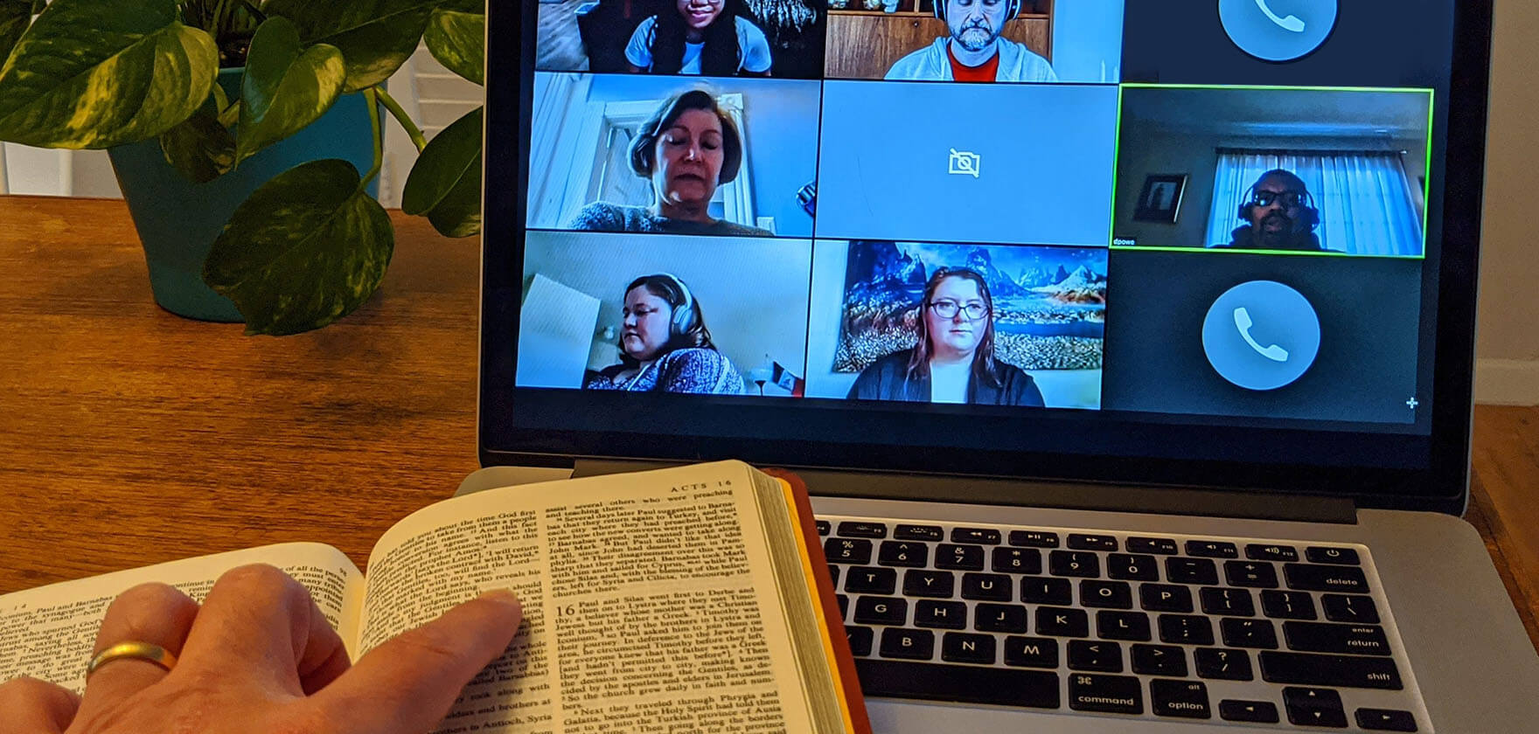
5. Online Bible Studies
Use Zoom, Google Meet, Facetime, etc., to have virtual Bible studies.
Allows us to have studies with people in other locations.

Slide 9
6. Bible Reading
Ask if someone would like to join you once a week to read the Bible together.
Bible journaling.

Slide 10
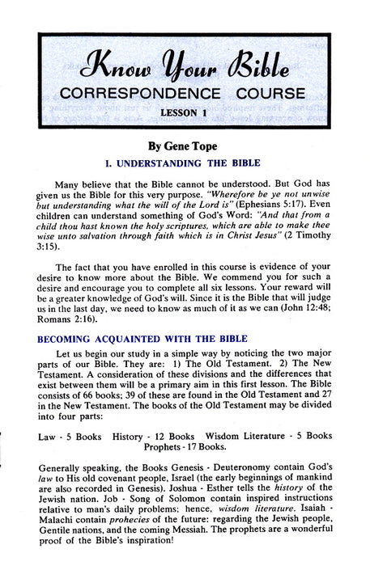
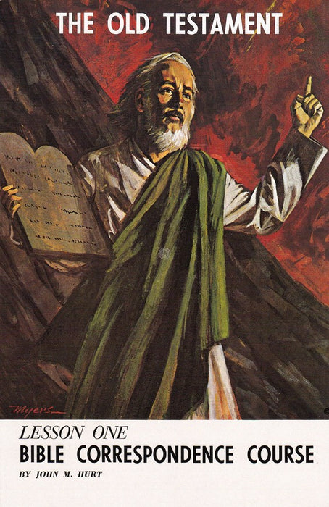
7. Correspondence Course
Ask if interested, put up flier.
Grade the lesson and mail next lesson.
Hopefully will lead to Bible study.

Slide 11
“What can I do?”
Invite people to church.
Study the Bible with someone.
Host a small group study.
Participate in a meet-up study.
Conduct a virtual study.
Offer to read the Bible with someone.
Grade and mail out correspondence courses.
Any other ideas???

