Slide 2
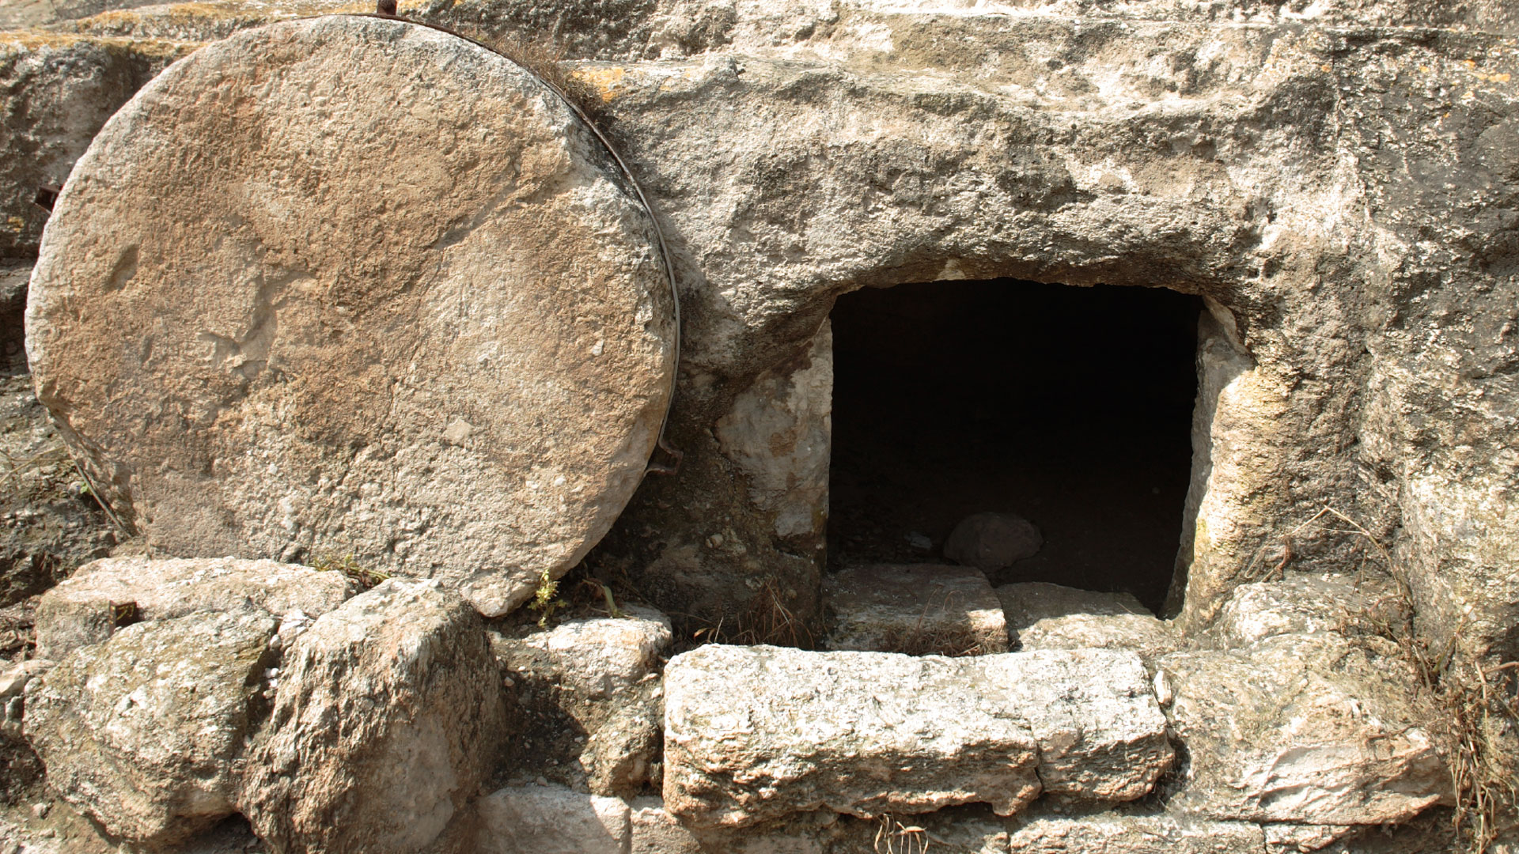
How We Can Know Jesus Rose from the Dead

Slide 3
Then some of the scribes and Pharisees answered, saying, “Teacher, we want to see a sign from You.”
But He answered and said to them, “An evil and adulterous generation seeks after a sign, and no sign will be given to it except the sign of the prophet Jonah.
For as Jonah was three days and three nights in the belly of the great fish, so will the Son of Man be three days and three nights in the heart of the earth.
Matt. 12:38-40

Slide 4
Concerning His Son Jesus Christ our Lord, who was born of the seed of David according to the flesh,
and declared to be the Son of God with power according to the Spirit of holiness, by the resurrection from the dead.
Romans 1:3-4

Slide 5
The Way Jesus Died
No one survived a crucifixion.
Jesus was scourged (Matt. 27:26).
Forced to carry His cross.
Nailed to the cross (John 20:25, 27).
Dislocated shoulders.
Death by asphyxiation.
Side pierced (John 19:34).
Pilate confirmed His death (Mark 15:44-45).

Slide 6
The Way Jesus Was Buried
After this, Joseph of Arimathea, being a disciple of Jesus, but secretly, for fear of the Jews, asked Pilate that he might take away the body of Jesus; and Pilate gave him permission. So he came and took the body of Jesus.
And Nicodemus, who at first came to Jesus by night, also came, bringing a mixture of myrrh and aloes, about a hundred pounds.
Then they took the body of Jesus, and bound it in strips of linen with the spices, as the custom of the Jews is to bury.
John 19:38-40

Slide 7
The Empty Tomb
Matthew 27:59-28:8

Slide 8
The Empty Tomb
This was a new tomb – His was the only body in this tomb.
Hewn out of rock – there wasn’t a back door.
Large stone rolled against the door.
Seal set on the tomb; guard posted to keep it undisturbed.

Slide 9
The Empty Tomb
The women didn’t go to the wrong tomb.
Jesus didn’t survive to move the stone from the inside and walk out alive.
The disciples didn’t steal His body.
Enemies didn’t steal His body.
Jesus rose from the dead!

Slide 10
Post-Resurrection Appearances
John 20:24-28
1 Corinthians 15:5-8

Slide 11
Circumstantial Evidence
Bravery of the disciples.
Beginning place of the church (Acts 2:29, 32).
Conversion of skeptics.
First day of the week (Acts 20:7; Matt. 28:1).

Slide 12
Believe Jesus died and rose from the dead.
Repent of your sins.
Confess your faith.
Be baptized for the remission of your sins.

