Slide 2
Ready To Answer
1 Peter 3:15

Slide 3
1 Peter 3:15 NASU
“But sanctify Christ as Lord in your hearts, always being ready to make a defense to everyone who asks you to give an account for the hope that is in you, yet with gentleness and reverence.”

Slide 4
1 Peter 3:15 NASU
“But sanctify Christ as Lord in your hearts, always being ready to make a defense to everyone who asks you to give an account for the hope that is in you, yet with gentleness and reverence.”

Slide 5
1 Peter 3:15 NASU
“But sanctify Christ as Lord in your hearts, always being ready to make a defense to everyone who asks you to give an account for the hope that is in you, yet with gentleness and reverence.”

Slide 6
1 Peter 3:15 NASU
“But sanctify Christ as Lord in your hearts, always being ready to make a defense to everyone who asks you to give an account for the hope that is in you, yet with gentleness and reverence.”

Slide 7
1 Peter 3:15 NASU
“But sanctify Christ as Lord in your hearts, always being ready to make a defense to everyone who asks you to give an account for the hope that is in you, yet with gentleness and reverence.”

Slide 8
1 Peter 3:15 NASU
“But sanctify Christ as Lord in your hearts, always being ready to make a defense to everyone who asks you to give an account for the hope that is in you, yet with gentleness and reverence.”

Slide 9
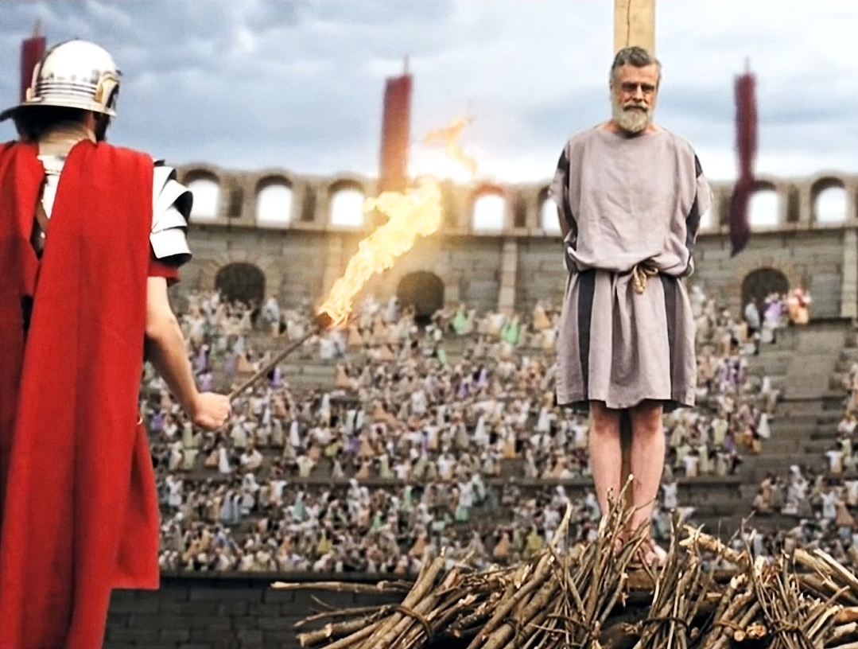
“But sanctify Christ as Lord in your hearts, always being ready to make a defense to everyone who asks you to give an account for the hope that is in you, yet with gentleness and reverence.”
1 Pet. 3:15
NASU

Slide 10
Why We Need to Be Ready
We Are Commanded
Helps Us Learn and Grow
2 Peter 3:18
Strengthens Our Faith
Eph. 4:14-15; Rom. 10:17
Equips Us to Better Defend the Truth
Phil. 1:17; Jude 3
Lead Others to Christ
2 Tim. 2:24-26

