Slide 2
The Book of Life
Exodus 32:30-33

Slide 3
Importance of Being in the Book
Only those names found in the Book of Life can enter Heaven - Rev. 21:27
Those not found in the Book of Life are cast into Hell - Rev. 20:12-15

Slide 4
How Our Names Get Written in the Book of Life
Contains the names of the saved, so we must be saved to be in the book!
Believe - John 8:24
Repent - Luke 13:3
Confess our faith - Rom. 10:9-10
Baptized - Mark 16:16

Slide 5
Names Removed from the Book of Life?
“Yet now, if You will forgive their sin — but if not, I pray, blot me out of Your book which You have written” (Ex. 32:32).
“He who overcomes shall be clothed in white garments, and I will not blot out his name from the Book of Life; but I will confess his name before My Father and before His angels” (Rev. 3:5).

Slide 6
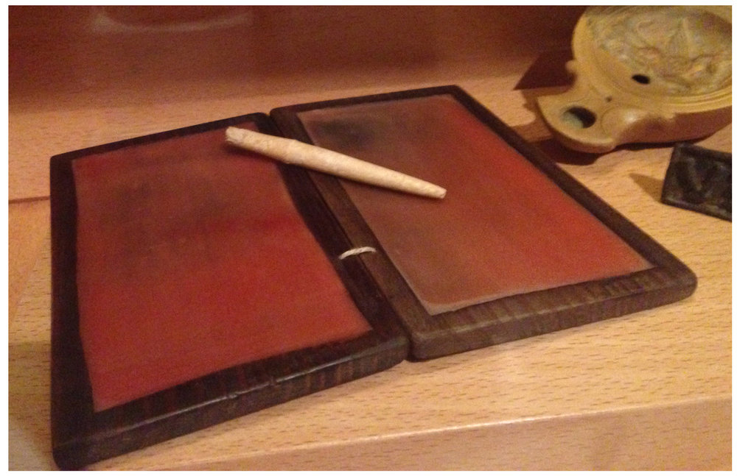
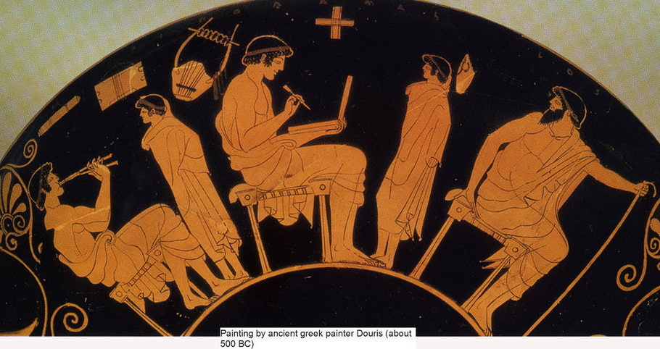
Wax Tablets

Slide 7
Names Removed from the Book of Life?
Crucifying the Lord.
Psalm 69:28; Heb. 6:4-6
Tampering with God’s word.
Rev. 22:18-19
Failing to overcome.
Rev. 3:5

