Slide 2
Zealous for Good Works

Slide 3
Zealous for Good Works
Source for Zeal
Protecting our Zeal
Zealous for the Right Things
The Zeal of Jesus
How Jesus makes us “Zealous for Good Works”
Praising God and Encouraging Others
Evangelism
Helping Others
Prayer
Helping the Sick and Grieving

Slide 4
The Proper Source for Our Zeal
“zealous for good works” Titus 2:14

Slide 5
What is Zeal?
“great energy of enthusiasm in pursuit of a cause or objective”
Translated from Greek word zelos.
“to be hot, or heat”

Slide 6
1. Understanding God’s Word
Romans 10:1-3

Slide 7
1. Understanding God’s Word
“And beginning at Moses and all the Prophets, He expounded to them in all the Scriptures the things concerning Himself” (Luke 24:27).
“And they said to one another, ‘Did not our heart burn within us while He talked with us on the road, and while He opened the Scriptures to us?’” (v. 32)

Slide 8
2. True Repentance
Psalm 32:1-5
2 Corinthians 7:8-11

Slide 9
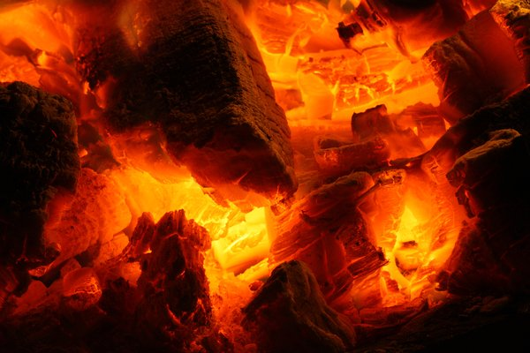
3. Zealous Brethren
2 Corinthians 8:1-5
2 Corinthians 9:1-2

Slide 10
The Proper Source for Our Zeal
Understanding God’s Word
True Repentance
Zealous Brethren

