Slide 1
A Brief Glimpse of The End
Matthew 25:31-46
Revelation 20:11-15

Slide 2
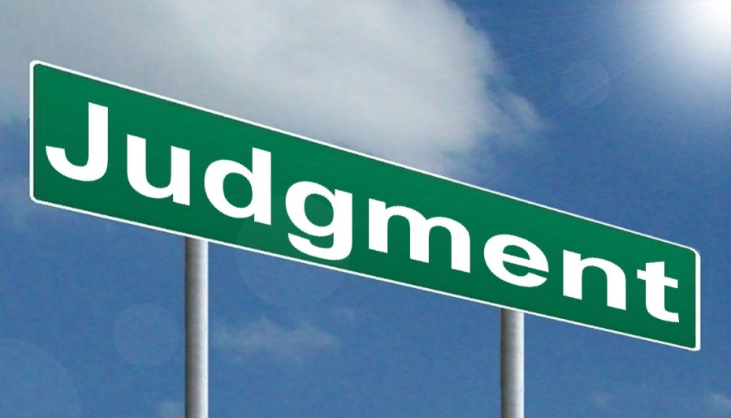
Lifting Veil of the Final Judgment
Revelation 20:11-15
Great White Throne (v.11)
Face of earth and heaven fled away—no place to hide!
Dead—small and great (v.12)
“Books” were opened— ”Book of Life”
Judged according to their works—things written in the “books”
STANDARD

Slide 3
Lifting Veil of the Final Judgment
Revelation 20:11-15
Sea gave up the dead (v.13)
Death and Hades
Judged according to their works
Death and Hades cast into lake of fire—”second death” (v.14)
Death and Hades—cast into lake of fire (vs.15)
“Second Death”

Slide 4
How Many Deaths?
Hebrews 9:27— Physical death
Romans 6:2—Die to Sin
Revelation 20:15— Second Death
Died Twice to Live Eternally!

Slide 5
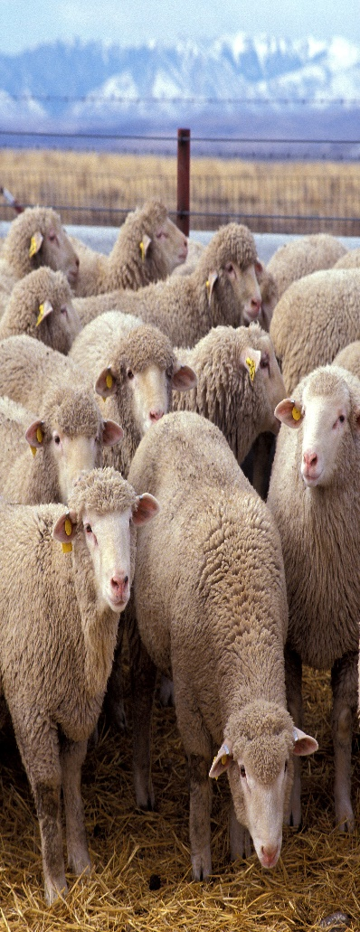
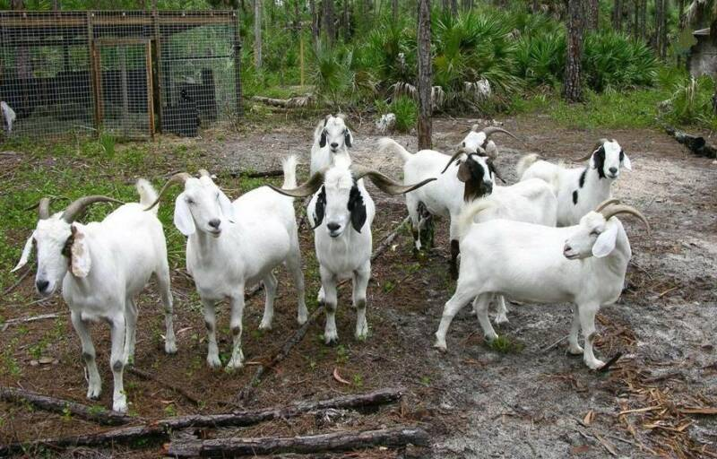
Judge By What “Things”?
Sheep and Goats
Right Hand—Sheep
Left Hand –Goats
“Come blessed of My Father, inherit the kingdom prepared for you from the foundation of the world.” (vs.32-24)

Slide 6
Judge By What “Things”?
Hungry—fed me
Thirsty—gave drink
Stranger—took me in
Naked—clothed me
Sick—visited me
Prison—came to me
“Did to the least – did unto Me.”

Slide 7
Judge By What “Things”?
Hungry—no food
Thirsty—no drink
Stranger—not take in
Naked—not clothed me
Sick—not visited me
Prison—not come to me
“Did not do it to the least – did not unto Me.”

Slide 8
Difference…
Opportunities
Responsibility
Servant’s Heart
Willingness to show compassion
Everlasting punishment
Eternal life

