Slide 4
1. Faith
“Above all, taking the shield of faith with which you will be able to quench all the fiery darts of the wicked one” (Eph. 6:16).

Slide 5
1. Faith
Faith is your unshakable belief and trust in God and His Word.
This will be tested at school!

Slide 6
1. Faith
It is important that you strengthen your faith.
Read your Bible every day.
Attend all the services of the church.

Slide 7
1. Faith
It is also important that you share your faith with others.
Talk about the Bible, Jesus, church.
Invite friends to come to church and Bible class with you.

Slide 8
2. Willingness to Work Hard
“Whatever your hand finds to do, do it with your might…” (Eccl. 9:10).

Slide 9
2. Willingness to Work Hard
“And whatever you do, do it heartily, as to the Lord and not to men” (Col. 3:23).

Slide 10
3. Respect
To hold others in high esteem.
To show others you care about them, their property, and their feelings.

Slide 11
3. Respect
It is important to God that you learn to respect adults.
Your parents (Eph. 6:1-2).
All adults (1 Pet. 5:5; Lev. 19:32).

Slide 12
3. Respect
Pay attention to your teacher.
Do what they tell you, without talking back.
Follow the rules for the classroom.
Say “please” and “thank you.”

Slide 13
4. Kindness
We are to put on kindness (Col. 3:12).
Being helpful, generous, tender, upright, and good to others.

Slide 14
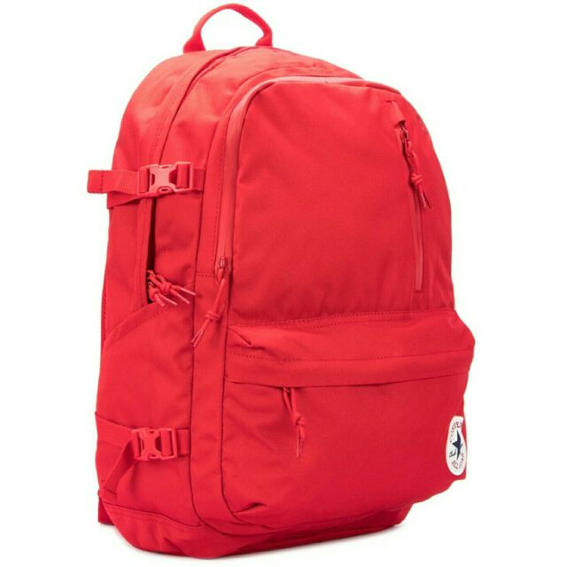
Back To School Supplies
Your Faith
Hard Work
Respect
Kindness

