Slide 2
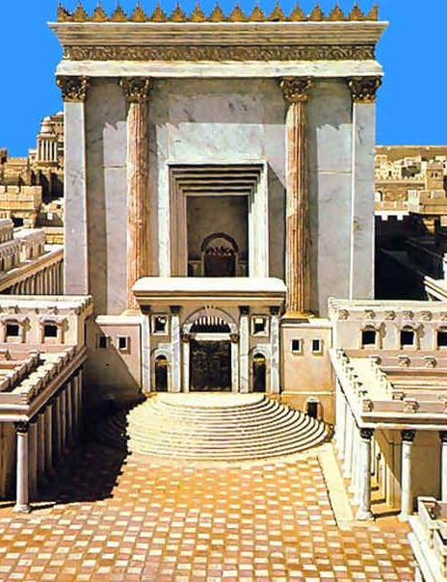
Jesus Cleanses the Temple
Matthew 21:12-17

Slide 3
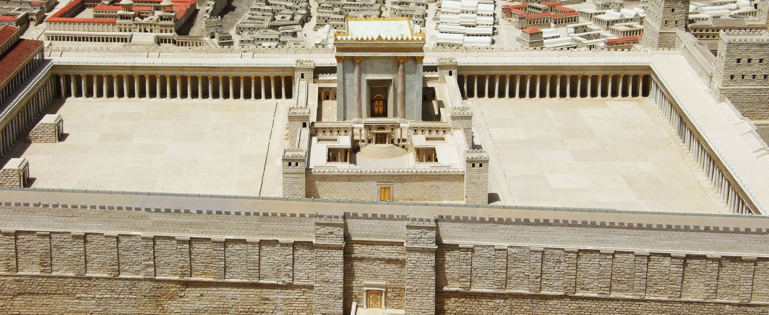
Jesus Cleansed the Temple (vs. 12-13)
Jesus Healed the Blind and Lame (v. 14)
Jesus Was Criticized (vs. 15-16)

Slide 4
1. The Local Church
The local church is a Temple (1 Cor. 3:16-17).
Jesus would cleanse it:
Church discipline (ch. 5)
Members mistreating others (6, 8-10)
Unscriptural worship (11-14)
False doctrine (15)
Matters regarding church’s money (16)

Slide 5
1. The Local Church
The local church is a Temple (1 Cor. 3:16-17).
Jesus would cleanse it:
It could then do good (Matt. 7:21-23).

Slide 6
1. The Local Church
The local church is a Temple (1 Cor. 3:16-17).
Jesus would cleanse it:
It could then do good (Matt. 7:21-23).
It could expect to be criticized.

Slide 7
2. The Believer’s Physical Body
Our body is a Temple (1 Cor. 6:19-20).
Jesus would cleanse it:
Fornication (vs. 12-20)
Things that lead to fornication: immodest dress, dancing, etc.
Drugs, alcohol, tobacco, vaping, etc.
Tattoos, serious body alterations.

Slide 8
2. The Believer’s Physical Body
Our body is a Temple (1 Cor. 6:19-20).
Jesus would cleanse it:
Then it would be a vessel for honor.
2 Tim. 2:20-22; Rom. 12:1

Slide 9
2. The Believer’s Physical Body
Our body is a Temple (1 Cor. 6:19-20).
Jesus would cleanse it:
Then it would be a vessel for honor.
2 Tim. 2:20-22; Rom. 12:1
We can expect criticism.
1 Peter 4:1-4

Slide 10
3. The Believer’s Marriage
Marriage is the joining of two into one.
Paul addresses marriage in 1 Cor. 7.
Jesus would cleanse it:
False ideas and bad attitudes towards the roles and responsibilities of all involved.
Parents will discipline the children.
Spouses will honor marriage vows, foster an atmosphere of love in the home.

Slide 11
3. The Believer’s Marriage
Marriage is the joining of two into one.
Paul addresses marriage in 1 Cor. 7.
Jesus would cleanse it:
Then it would be what God created it to be.
Christians can expect to be criticized for standing up for God’s plan for marriage.

Slide 12
When Jesus cleansed the Temple, it became what God intended it to be.
Does Jesus need to cleanse your local congregation, you, or your marriage?
He can only do so if you will heed His word.

