Slide 2
MICAH
“What Does the Lord Require of You?”

Slide 3
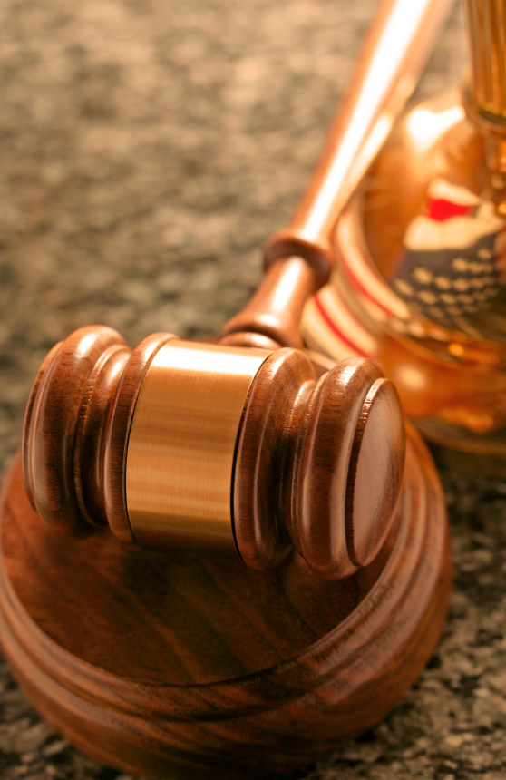
God’s Day in Court
Judah has turned against God, and God demands to know why (vs. 1-3)
God reminds them of His goodness, what He has done for them (vs. 4-5)

Slide 4
God’s Day in Court
Judah’s sins were many:
They turned to idols (5:13-14)
They silenced the prophets (2:6)
They oppressed their own people (2:1-2, 9, 3:1-3, 9-11, 6:10-12, 7:3-4)

Slide 5
God’s Day in Court
The people respond (vs. 6-7)
burnt offerings
calves
thousands of rams
10,000 rivers of oil
firstborn

Slide 6
God’s Day in Court
God’s response (v. 8)
“He has shown you, O man, what is good; and what does the Lord require of you…”

Slide 7
What God Requires of Us
To Do Justly
To Love Mercy
To Walk Humbly With Our God

