Slide 2
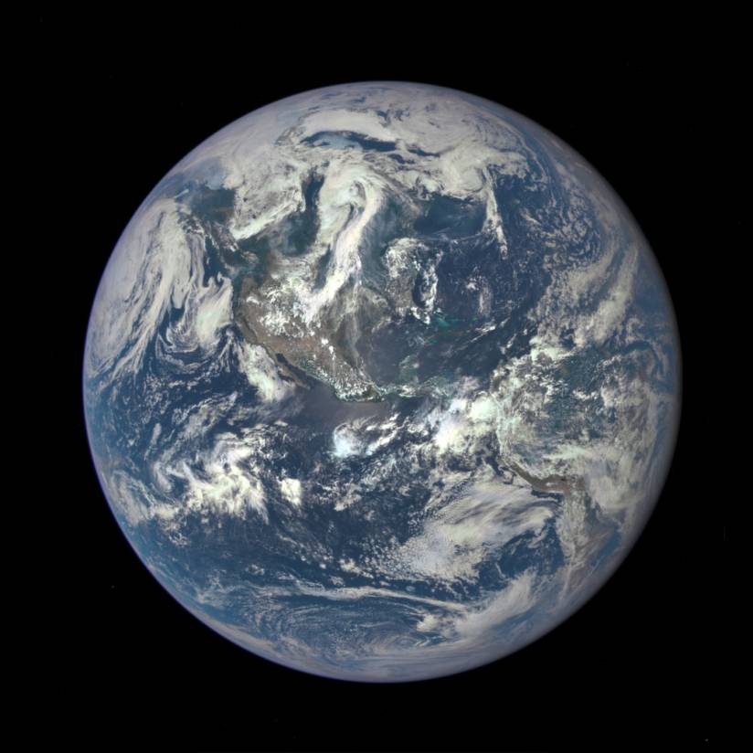
This World is Not Our Home

Slide 3
“For I am the Lord, I do not change; therefore you are not consumed, O sons of Jacob.”
Malachi 3:6

Slide 4
“Forever, O Lord, Your word is settled in heaven.”
Psalm 119:89

Slide 5
God’s Eternal Will is Revealed in the Bible 1 Corinthians 2:9-13

Slide 6
God’s Eternal Will is Revealed in the Bible 1 Corinthians 2:9-13
“Now we have received, not the spirit of the world, but the Spirit who is from God, that we might know the things that have been freely given to us by God.”
1 Cor. 2:12

Slide 7
“We know that we are of God, and the whole world lies under the sway of the wicked one.”
1 John 5:19

Slide 8
Satan attempts to destroy every good thing God has made.
In the Garden (Gen. 3)
In the days of Noah (Gen. 6:5-8)
After the flood (Gen. 9:1; 11:1-4)
In all three cases, God’s will prevailed!

Slide 9
“Beloved, I beg you as sojourners and pilgrims, abstain from fleshly lusts which war against the soul.”
1 Peter 2:11

Slide 10
“Therefore ‘Come out from among them and be separate, says the Lord. Do not touch what is unclean, and I will receive you. I will be a Father to you, and you shall be My sons and daughters, says the Lord Almighty.’”
2 Cor. 6:17-18

Slide 11
“Through Your precepts I get understanding; therefore I hate every false way.”
Psalm 119:104
“Let love be without hypocrisy. Abhor what is evil. Cling to what is good.”
Romans 12:9

Slide 12
Homosexuality is condemned as a sin throughout the Bible.
Patriarchal Age
Law of Moses
New Testament

Slide 13
“Now before they lay down, the men of the city, the men of Sodom, both old and young, all the people from every quarter, surrounded the house. And they called to Lot and said to him, ‘Where are the men who came to you tonight? Bring them out to us that we may know them carnally.’”
Genesis 19:4-5

Slide 14
“As Sodom and Gomorrah, and the cities around them in a similar manner to these, having given themselves over to sexual immorality and gone after strange flesh, are set forth as an example, suffering the vengeance of eternal fire.”
Jude 7

Slide 15
“You shall not lie with a male as with a woman. It is an abomination.”
“If a man lies with a male as he lies with a woman, both of them have committed an abomination. They shall surely be put to death. Their blood shall be upon them.”
Leviticus 18:22; 20:13

Slide 16
“For this reason God gave them up to vile passions. For even their women exchanged the natural use for what is against nature. Likewise also the men, leaving the natural use of the woman, burned in their lust for one another, men with men committing what is shameful, and receiving in themselves the penalty of their error which was due.”
Romans 1:26-27

Slide 17
“Do you not know that the unrighteous will not inherit the kingdom of God? Do not be deceived. Neither fornicators, nor idolaters, nor adulterers, nor homosexuals, nor sodomites, nor thieves, nor covetous, nor drunkards, nor revilers, nor extortioners will inherit the kingdom of God.”
1 Cor. 6:9-10

Slide 18
“Knowing this: that the law is not made for a righteous person, but for the lawless and insubordinate, for the ungodly and for sinners, for the unholy and profane, for murderers of fathers and murderers of mothers, for manslayers, for fornicators, for sodomites, for kidnappers, for liars, for perjurers, and if there is any other thing that is contrary to sound doctrine.”
1 Timothy 1:9-10

Slide 19
Some claim, “Jesus never personally condemned homosexuality.”
Jesus endorsed His Father’s judgment against the sin of homosexuality (Matt. 10:15; 11:23-24).
Jesus upheld His Father’s design for gender identity, sexuality, and sexual fulfillment (Matt. 19:3-6).

Slide 20
The world is telling us that homosexuality is a harmless alternative lifestyle; a different but legitimate expression of love.
The Bible still says homosexuality is an abomination, vile, shameful, against nature, contrary to the doctrine of Christ, worthy of God’s wrath, and will exclude one from the kingdom of God.
Are you a child of God, or are you under the sway of the wicked one?

Slide 21
“Do you not know that the unrighteous will not inherit the kingdom of God? Do not be deceived. Neither fornicators, nor idolaters, nor adulterers, nor homosexuals, nor sodomites,
nor thieves, nor covetous, nor drunkards, nor revilers, nor extortioners will inherit the kingdom of God.
And such were some of you. But you were washed, but you were sanctified, but you were justified in the name of the Lord Jesus and by the Spirit of our God.”
1Corinthians 6:9-11

