Slide 2
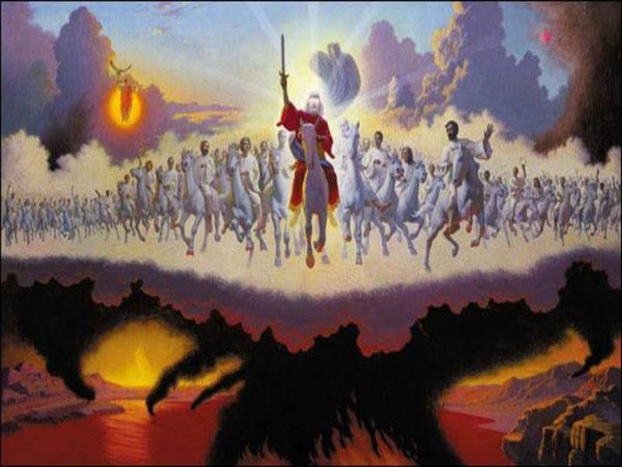
Problems with Premillennialism

Slide 4
Jesus Came to Establish an Earthly Kingdom
Jesus made it abundantly clear that His Kingdom was not of this world.
John 18:36
Luke 17:20-21

Slide 5
Jesus Failed to Establish His Kingdom

Slide 6
Jesus Failed to Establish His Kingdom
“The kingdom was at hand, that is, it came nigh… when Jesus, the King, came. But the Jews rejected it and slew their King. They were not willing to have this man reign over them, and therefore the Kingdom did not immediately appear.”
W.E. Blackstone, “Jesus Is Coming”

Slide 7
Jesus Failed to Establish His Kingdom
“This we believe is the true explanation of this subject. The Kingdom did come (nigh) when Christ came, and had they received him, it would have been manifested, but now it is in abeyance, or waiting until He comes again.”
W.E. Blackstone, “Jesus Is Coming”

Slide 8
Jesus Did Not Fail
“Him, being delivered by the determined purpose and foreknowledge of God, you have taken by lawless hands, have crucified, and put to death.”
“But those things which God foretold by the mouth of all His prophets, that the Christ would suffer, He has thus fulfilled.”
Acts 2:23; 3:18

Slide 9
Jesus Did Not Fail
“I know that You can do everything, and that no purpose of Yours can be withheld from You.”
Job 42:2
“But our God is in heaven; He does whatever He pleases.”
Psalm 115:3

Slide 10
Jesus Did Not Fail
Psalm 2 shows that no nation could thwart God’s purpose regarding His Son reigning as King, not even His own nation.

Slide 11
Jesus Did Not Fail
“And He said to them, ‘Assuredly, I say to you that there are some standing here who will not taste death till they see the kingdom of God present with power.’”
Mark 9:1

Slide 12
Jesus Did Not Fail
“But you shall receive power when the Holy Spirit has come upon you; and you shall be witnesses to Me in Jerusalem, and in all Judea and Samaria, and to the end of the earth.”
Acts 1:8
This occurred in Acts 2:1-4

Slide 13
Jesus Did Not Fail
“He has delivered us from the power of darkness and conveyed us into the kingdom of the Son of His love.”
Colossians 1:13
“I, John, both your brother and companion in the tribulation and kingdom and patience of Jesus Christ…”
Rev. 1:9

Slide 14
The Lord’s Kingdom is here, and you can be a part of it today if you will obey the gospel.
Believe in Jesus - John 8:24
Repent of your sins - Luke 13:3
Confess your faith - Romans 10:9-10
Be baptized - Mark 16:16

