Slide 2
What Paul Committed to the Lord
For this reason I also suffer these things; nevertheless I am not ashamed, for I know whom I have believed and am persuaded that He is able to keep what I have committed to Him until that Day.
2 Timothy 1:12

Slide 3
Paul Trusted in the Lord
“…for I know whom I have believed and am persuaded that He is able…”

Slide 4
Some Trust in… 1. Themselves

Slide 5
Some Trust in… 1. Themselves
“Trust in the Lord with all your heart, and lean not on your own understanding…” (Prov. 3:5).
“O Lord, I know the way of man is not in himself; it is not in man who walks to direct his own steps” (Jer. 10:23).

Slide 6
Some Trust in… 2. Their Advantages

Slide 7
Some Trust in… 2. Their Advantages
“Here is the man who did not make God his strength, but trusted in the abundance of his riches, and strengthened himself in his wickedness” (Ps. 52:7).
“Command those who are rich in this present age not to be haughty, nor to trust in uncertain riches but in the living God, who gives us richly all things to enjoy” (1 Tim. 6:17).

Slide 8
Some Trust in… 2. Their Advantages
“Therefore bear fruits worthy of repentance, and do not think to say to yourselves, 'We have Abraham as our father.' For I say to you that God is able to raise up children to Abraham from these stones” (Matthew 3:8-9).

Slide 9
Some Trust in… 3. Others

Slide 10
Some Trust in… 3. Others
“Do not put your trust in princes, nor in a son of man, in whom there is no help. His spirit departs, he returns to his earth; in that very day his plans perish” (Psalm 146:3-4).

Slide 11
Some Trust in… 3. Others
“Some trust in chariots, and some in horses; but we will remember the name of the Lord our God” (Psalm 20:7).

Slide 12
Some Trust in… 3. Others
“Behold, you trust in lying words that cannot profit” (Jeremiah 7:8).
“Then the prophet Jeremiah said to Hananiah the prophet, "Hear now, Hananiah, the Lord has not sent you, but you make this people trust in a lie” (Jeremiah 28:15).

Slide 13
What Paul Committed to the Lord

Slide 14
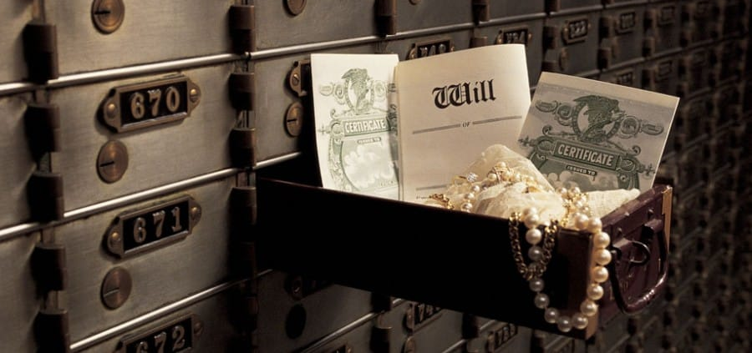
What Paul Committed to the Lord
The phrase “have committed to Him” is from the Greek word paratheke.
“a deposit, a trust or thing consigned to one’s faithful keeping” (Thayer).
To be kept for a time and restored whole and uninjured.

Slide 15
We Can Trust the Lord With… 1. Our Eternal Salvation

Slide 16
We Can Trust the Lord With… 1. Our Eternal Salvation
“Therefore let those who suffer according to the will of God commit their souls to Him in doing good, as to a faithful Creator” (1 Peter 4:19).
“Who are kept by the power of God through faith for salvation ready to be revealed in the last time” (1 Peter 1:5).

Slide 17
We Can Trust the Lord With… 2. Our Physical Lives

Slide 18
We Can Trust the Lord With… 2. Our Physical Lives
“Commit your way to the Lord, trust also in Him, and He shall bring it to pass” (Ps. 37:5).
“Trust in the Lord with all your heart, and lean not on your own understanding; in all your ways acknowledge Him, and He shall direct your paths” (Proverbs 3:5-6).

Slide 19
We Can Trust the Lord With… 3. Our Physical Needs
Matthew 6:25-34

Slide 20
We Can Trust the Lord With… 4. Justice

Slide 21
We Can Trust the Lord With… 4. Justice
“Who, when He was reviled, did not revile in return; when He suffered, He did not threaten, but committed Himself to Him who judges righteously” (1 Peter 2:23).

Slide 22
We Can Trust the Lord With… 5. Our Death

Slide 23
We Can Trust the Lord With… 5. Our Death
“Into Your hand I commit my spirit; You have redeemed me, O Lord God of truth” (Psalm 31:5).
“And when Jesus had cried out with a loud voice, He said, ‘Father, “into Your hands I commit My spirit.”’ Having said this, He breathed His last” (Luke 23:46).

Slide 24
The Lord Can Be Trusted
With our Eternal Salvation
With our Physical Lives
With our Physical Needs
With Righting our Wrongs
At the Time of Our Death
Have you learned to trust the Lord?

