Slide 2
JOEL
“Return to Me with all your heart.”

Slide 4
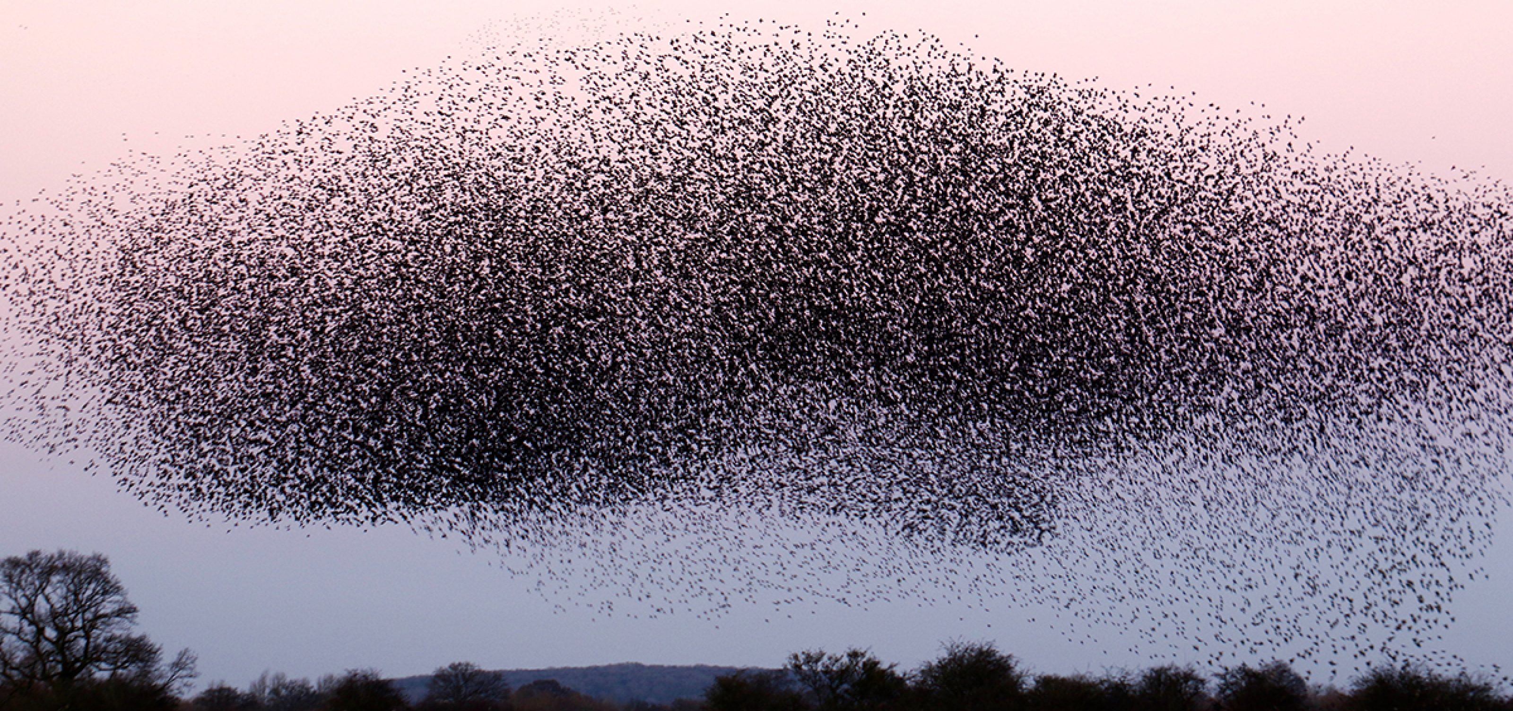
“Let all the inhabitants of the Land tremble, for the day of the Lord is coming, for it is at hand.” Joel 2:1

Slide 5
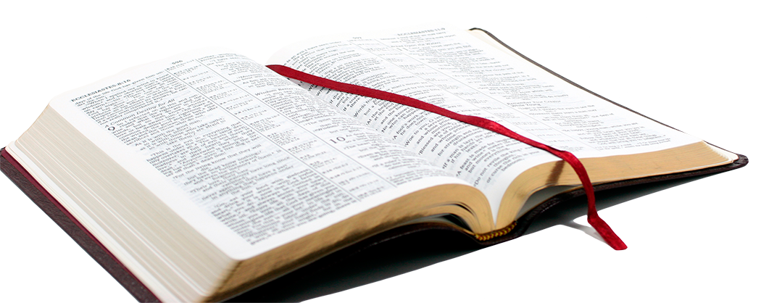
“Yet even now,” declares the Lord, “return to me with all your heart, with fasting, with weeping, and with mourning;
and rend your hearts and not your garments.” Return to the Lord, your God, for he is gracious and merciful, slow to anger, and abounding in steadfast love; and he relents over disaster.
Joel 2:12-13, ESV

Slide 6
True Repentance Involves…
A Sense of Urgency
“‘Yet even now’ declares the Lord”
Action
“return to Me,” “return to the Lord”

Slide 7
3. Genuineness
“with all your heart” (v. 12)

Slide 8
3. Genuineness
“with all your heart” (v. 12)
“You shall love the Lord your God with all your heart, with all your soul, and with all your strength” (Deut. 6:5).
“…to serve the Lord your God with all your heart and with all your soul (Deut. 10:12).
“…therefore you shall be careful to observe them with all your heart and with all your soul” (Deut. 26:16).

Slide 9
3. Genuineness
“with all your heart” (v. 12)
“rend your hearts and not your garments” (v. 13)

Slide 10
3. Genuineness
“with all your heart” (v. 12)
“rend your hearts and not your garments” (v. 13)
“The sacrifices of God are a broken spirit, a broken and a contrite heart - these, O God, You will not despise” (Psalm 51:17).

Slide 11
4. Motivation
Gracious
Merciful
Slow to Anger
Abounding in Steadfast Love
He Relents Over Disaster

Slide 12
4. Motivation
Gracious
Merciful
Slow to Anger
Abounding in Steadfast Love
He Relents Over Disaster
“Or do you despise the riches of His goodness, forbearance, and longsuffering, not knowing that the goodness of God leads you to repentance?” (Romans 2:4)
“But when he came to himself, he said, 'How many of my father's hired servants have bread enough and to spare, and I perish with hunger! I will arise and go to my father…” (Luke 15:17-18).

Slide 13
What do we learn about repentance from the book of Joel?
Repentance requires a specific action – we must turn to God.
God will only accept genuine repentance – from the heart.
Knowing God’s character gives us additional incentive to repent.
The time to repent is NOW!

