Slide 2
Thankful for the Lord’s Church
Special Sermon Series

Slide 3
Thankful for the Distinctive Nature of the Church

Slide 4
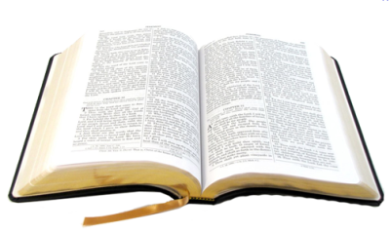
“And I also say to you that you are Peter, and on this rock I will build My church, and the gates of Hades shall not prevail against it.”
Matthew 16:18

Slide 5
“There is one body and one Spirit, just as you were called in one hope of your calling.”
Ephesians 4:4
“For the husband is head of the wife, as also Christ is head of the church; and He is the Savior of the body.”
Ephesians 5:23

Slide 6
“Find the church that is right for you!”

Slide 7
“Which church is right by God?”

Slide 8
“Which church is right by God?”
“Who serve the copy and shadow of the heavenly things, as Moses was divinely instructed when he was about to make the tabernacle. For He said, ‘See that you make all things according to the pattern shown you on the mountain.’”
Hebrews 8:5

Slide 9
1. Christ is the Head of the Church
“And He put all things under His feet, and gave Him to be head over all things to the church, which is His body, the fullness of Him who fills all in all.”
Ephesians 1:22-23

Slide 10
2. His Teaching is the Foundation of the Church
“Now, therefore, you are no longer strangers and foreigners, but fellow citizens with the saints and members of the household of God, having been built on the foundation of the apostles and prophets, Jesus Christ Himself being the chief cornerstone.”
Ephesians 2:19-20

Slide 11
3. The Mission of the Church is Primarily Spiritual
The church is a spiritual body with a spiritual focus.
Ephesians 1:3; 2:22; 3:10; 4:3-4, 11-16; 5:18-19, 22-33; 6:12

Slide 12
3. The Mission of the Church is Primarily Spiritual
“But if I am delayed, I write so that you may know how you ought to conduct yourself in the house of God, which is the church of the living God, the pillar and ground of the truth.”
1 Timothy 3:15

Slide 13
Thankful for the Distinctive Nature of the Church
Jesus is the Head of the Church
His Teachings are the Foundation
The Work is Primarily Spiritual

