Slide 2
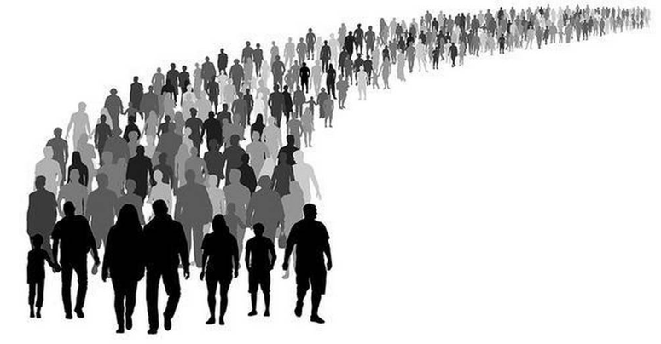
You Can Make A Difference

Slide 3
Sometimes People Need to Be Encouraged to Do the Right Thing
Naaman and his servants - 2 Kings 5:1-14

Slide 4
Sometimes People Need to Be Encouraged to Do the Right Thing
Naaman and his servants - 2 Kings 5:1-14
“And his servants came near and spoke to him, and said, ‘My father, if the prophet had told you to do something great, would you not have done it? How much more then, when he says to you, “Wash, and be clean”?’ So he went down and dipped seven times in the Jordan, according to the saying of the man of God; and his flesh was restored like the flesh of a little child, and he was clean” (vs. 13-14).

Slide 5
Sometimes People Need to Be Kept from Making a Big Mistake
David and Abigail - 1 Samuel 25

Slide 6
Sometimes People Need to Be Kept from Making a Big Mistake
David and Abigail - 1 Samuel 25
“For the Lord will certainly make for my lord an enduring house, because my lord fights the battles of the Lord, and evil is not found in you throughout your days… that this will be no grief to you, nor offense of heart to my lord, either that you have shed blood without cause, or that my lord has avenged himself” (vs. 28, 31).

Slide 7
Sometimes People Need to Be Confronted About Their Mistakes
David and Nathan - 2 Samuel 12

Slide 8
Sometimes People Need to Be Confronted About Their Mistakes
David and Nathan - 2 Samuel 12
“Then Nathan said to David, ‘You are the man!’” (v. 7).

Slide 9
Sometimes People Need to Be Confronted About Their Mistakes
David and Nathan - 2 Samuel 12
“Then Nathan said to David, ‘You are the man!’” (v. 7).
“Brethren, if a man is overtaken in any trespass, you who are spiritual restore such a one in a spirit of gentleness, considering yourself lest you also be tempted” (Gal. 6:1).

Slide 10
Sometimes People Need to Be Given a Chance to Prove Themselves
Saul and Barnabas - Acts 9:26-28

Slide 11
Sometimes People Need to Be Given a Chance to Prove Themselves
Saul and Barnabas - Acts 9:26-28
Saul led the opposition against the church (8:3).
The mention of his name terrified Christians.
The man who baptized him in Damascus was afraid of him (9:13-14).
He was not welcome at the church when he returned to Jerusalem (9:26).

Slide 12
Sometimes People Need to Be Given a Chance to Prove Themselves
Saul and Barnabas - Acts 9:26-28
“But Barnabas took him and brought him to the apostles. And he declared to them how he had seen the Lord on the road, and that He had spoken to him, and how he had preached boldly at Damascus in the name of Jesus. So he was with them at Jerusalem, coming in and going out” (vs. 27-28).

Slide 13
You Can Make A Difference!
Matthew 20:25-28
Greatness in the Kingdom is found in serving others and helping them be the best they can be.
Encouraging them to do right.
Warning them against wrong.
Confronting them in their sin.
Giving them a chance to prove themselves.

