Slide 2
Christ & The Godhead
Hebrews 1.1-2

Slide 10
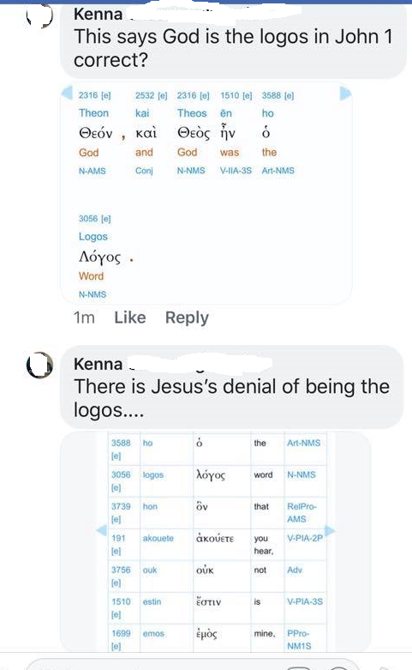

Slide 11
1. Christ / Jesus wasn’t the Word John 1.1
2. Christ / Jesus denies being the Word John 14.24
3. Christ / Jesus can’t be God because no one can see God 1 John 1.18
4. Christ / Jesus ascension was to somewhere but not to God Acts 1.9
Let’s see what the scriptures say about this

Slide 12
Points to consider ….
The Godhead
The relationship between God & Christ
Christ as the word of God
Christ’s ascension - where did he go ??
Christ’s return & judgment

Slide 13
So …. Who is Christ & What’s the relationship between God and Christ ?

Slide 14
The Godhead …
Gen 1.1-2 – In the beginning God created (Elohim plural), Spirit moved upon face of waters
Gen 2.26-27 – Let us make man in our image, after our likeness
Heb 1.1-2 – God … hath in these last days spoken unto us by his son … made the worlds
Col 1.12-16 – The image of the invisible God … all things created by him / for him

Slide 15
For there are three that bear record in heaven, the Father, the Word, and the Holy Ghost: and these three are one. And there are three that bear witness in earth, the Spirit, and the water, and the blood: and these three agree in one. 1 John 5.7-8
If we receive the witness of men, the witness of God is greater: for this is the witness of God which he hath testified of his Son. He that believeth on the Son of God hath the witness in himself: he that believeth not God hath made him a liar; because he believeth not the record that God gave of his Son. 1 John 5.9-10

Slide 16
The Relationship of God & Christ …
John 3.16 – For God so loved the world that he gave ….. Only begotten son
Gen 3.15 – Enmity between serpent and seed of woman
Isa 7.14 – The Lord himself shall give you a sign … virgin shall conceive
Matt 1.20-21 – That which is conceived in her is of the Holy Ghost
Matt 3.16-17 – This is my beloved son in whom I am well pleased
Luke 9.33-35 – This is my beloved son: hear him
John 8.42-43 – I proceeded forth and came from God
John 17.1-5 – Glorify thou me with the glory which I had with thee before the world

Slide 17
The Relationship of God & Christ …
Matt 28.19 – All power is given unto me in heaven and in earth
Col 1.18-19 – It pleased the Father that in him should all fulness dwell
Phil 2.9-11 – God also hath highly exalted him …. Every knee should bow
1 Cor 15.27-28 – Then shall the son … be subject unto him … that God may be all in all

Slide 18
Christ as the word of God ….
John 1.1 – In the beginning was the word, and the word was with God
John 14.24 – The word which ye hear is not mine but the Father’s

Slide 19
Christ as the word of God ….
John 14.24 – He that loveth me not keepeth not my sayings: and the word which ye hear is not mine, but the Father's which sent me.
Does this passage contradict or constitute a denial of John 1.1-2

Slide 20
Christ as the word of God ….
John 17.4,8 – Work which thou gavest me … believed that thou didst send me
John 1.10-14 – Word was made flesh and dwelt among us and we beheld his glory as of the only begotten of the Father
John 17.7-8 – I have given unto them the words that thou gavest me … and have known surely that I came out from thee … thou didst send me

Slide 21
Christ as the word of God ….
Delegation & agency aren’t inconsistent with
Christ’s role as the Word of God
And without controversy great is the mystery of godliness: God was manifest in the flesh, justified in the Spirit, seen of angels, preached unto the Gentiles, believed on in the world, received up into glory. 1 Tim 3.16

Slide 22
Christ couldn’t be God because no one can see God …
No man hath seen God at any time … the Son hath declared him 1 John 1.18
He that hath seen me hath seen the Father; and how sayest thou then, Shew us the Father? John 14.8-10

Slide 23
Who did Jesus ascend to … ???
I ascend unto my Father / your Father - my God /your God. John 20.17
God gave his only begotten son John 3.16
The Father that sent me beareth witness of me John 8.18
One body, spirit, Lord, faith, baptism, Father of all Eph 4.4-6
Cloud received him out of their sight Acts 1.9
Therefore being by the right hand of God Acts 2.31-36
Jesus standing on the right hand of God Acts 7.54-56
Who is set on the right hand of the throne Heb 8.1-2
Set down at the right hand of the throne of God Heb 12.1-2

Slide 24
Some other things Christ didn’t say, but ….
Assemble / Lord’s supper 1st day Acts 20.7
Lay by in store on 1st day 1 Cor 16.1-2
Sing psalms & spiritual songs Col 3.16
Never gave qualifications for elders etc. 1 Tim 3.1-14
There are many areas of doctrine that Christ didn’t speak about … does that make them invalid ???
I have yet many things to say unto you, but ye cannot bear them now. Howbeit when he, the Spirit of truth, is come, he will guide you into all truth: for he shall not speak of himself; but whatsoever he shall hear, that shall he speak: and he will shew you things to come. John 16.12-13

Slide 25
Summary
1. Christ was with God before time began
2. Christ was the agent through whom God created the worlds
3. Christ was sanctified / set apart by God as the perfect sacrifice before world
4. Christ came into the world in a physical body created to house him
5. Christ came into the world to deliver God’s message to all humanity
6. Christ died and was raised by the Father, ascended to him
7. Christ is the only way that we can be reconciled to the father
8. Christ has all authority over the church but is subject to God
9. Rejecting or denying Christ is to deny God and is therefore to be lost
10. Christ is the Word of God, the son of God and the head of the church
11. Christ will judge the world and deliver the church to God

Slide 26
And the times of this ignorance God winked at; but now commandeth all men every where to repent: Because he hath appointed a day, in the which he will judge the world in righteousness by that man whom he hath ordained; whereof he hath given assurance unto all men, in that he hath raised him from the dead. Acts 17.30-31

