Slide 2
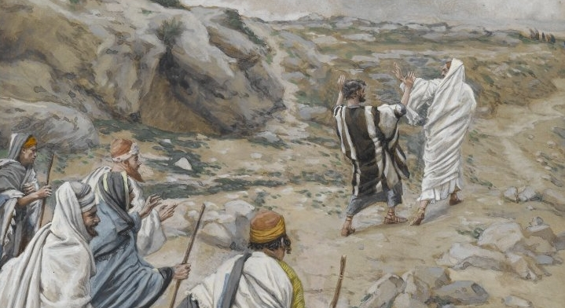
Trying to Prove Jesus Wrong

Slide 3
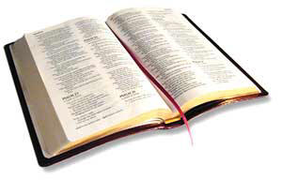
From that time Jesus began to show to His disciples that He must go to Jerusalem, and suffer many things from the elders and chief priests and scribes, and be killed, and be raised the third day.
Matthew 16:21

Slide 4
Then Peter took Him aside and began to rebuke Him, saying, “Far be it from You, Lord; this shall not happen to You!”
But He turned and said to Peter, “Get behind Me, Satan! You are an offense to Me, for you are not mindful of the things of God, but the things of men.”
Matthew 16:22-23

Slide 5
1. The Time of the Lord’s Return
But of that day and hour no one knows, not even the angels of heaven, but My Father only (Matt. 24:36).
But of that day and hour no one knows, not even the angels in heaven, nor the Son, but only the Father (Mark 13:32).

Slide 6
2. The Age of the Earth
Old Earth - 4.5 billion years
The History of the Earth
Young Earth - 6 thousand years

Slide 7
2. The Age of the Earth
Naturalistic science says man is a newcomer, a recent development of evolution.
Old Earth - 4.5 billion years
The History of the Earth
Young Earth - 6 thousand years

Slide 8
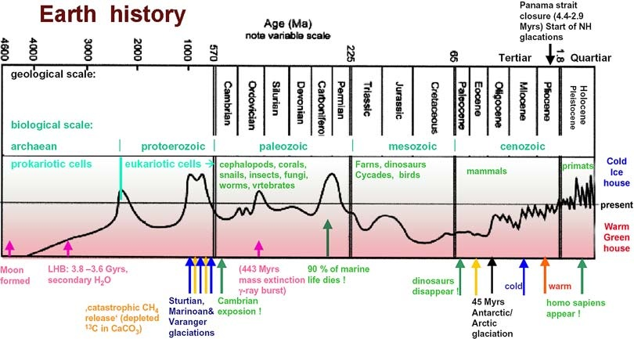

Slide 9
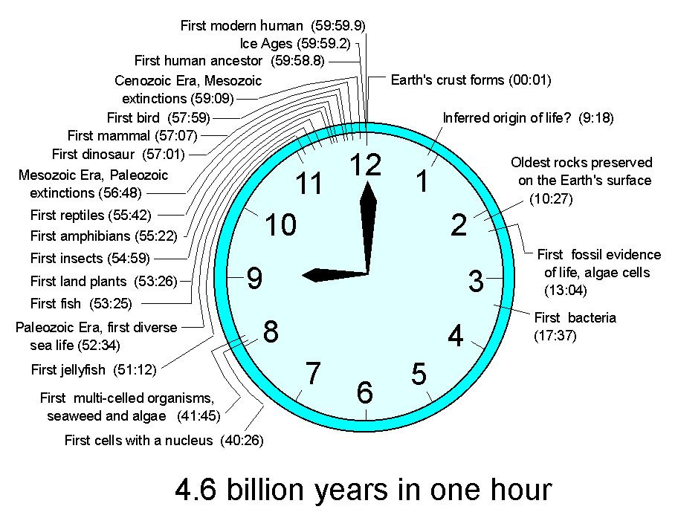

Slide 10
2. The Age of the Earth
Naturalistic science says man is a newcomer, a recent development of evolution.
Old Earth - 4.5 billion years
The History of the Earth
Young Earth - 6 thousand years

Slide 11
2. The Age of the Earth
Naturalistic science says man is a newcomer, a recent development of evolution.
Old Earth - 4.5 billion years
The History of the Earth
Young Earth - 6 thousand years
Jesus says man was made at the beginning. Matthew 19:4

Slide 12
3. Divorce and Remarriage
And I say to you, whoever divorces his wife, except for sexual immorality, and marries another, commits adultery; and whoever marries her who is divorced commits adultery.
Matthew 19:9

Slide 13
4. Serving Two Masters
No one can serve two masters; for either he will hate the one and love the other, or else he will be loyal to the one and despise the other. You cannot serve God and mammon.
Matthew 6:24

Slide 14
4. Serving Two Masters
No one can serve two masters; for either he will hate the one and love the other, or else he will be loyal to the one and despise the other. You cannot serve God and mammon.
Matthew 6:24
Money is a terrible master.
Riches are deceptive (Matt. 13:22).
They promise happiness, then make themselves wings and fly away (Prov. 23:5).
The love of money is a root of all kinds of evil, causing some to stray from the faith and pierce themselves with many sorrows (1 Tim. 6:9-10).

Slide 15
5. Identifying Ourselves as the Lord’s Disciples
Luke 14:25-33
We must put Christ before family (v. 26).
We must bear our cross and follow Jesus (v. 27).
We must forsake all that we have (v. 33).

