Slide 2
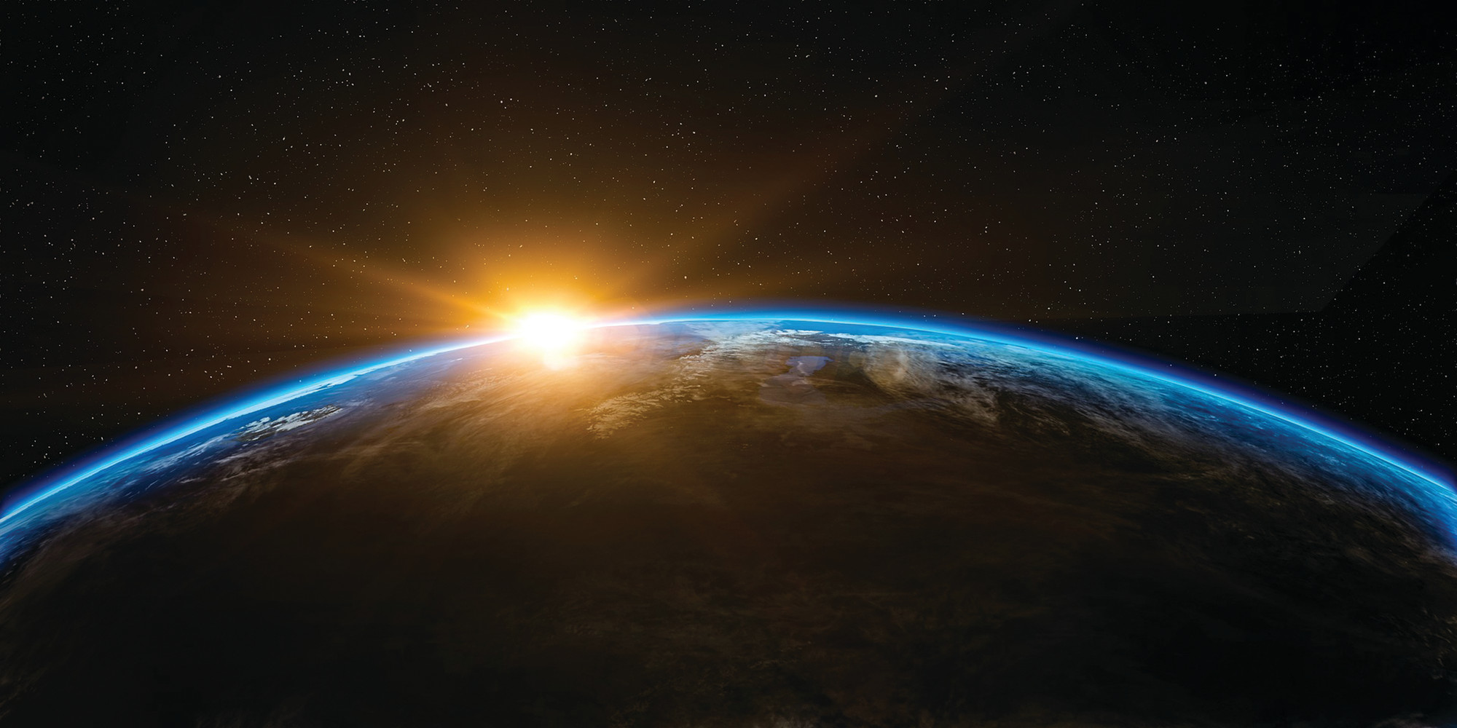
The New Heavens and the New Earth

Slide 3
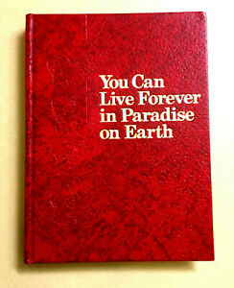
Jehovah’s Witness Error
Only 144,000 will be in Heaven.
The rest of the saved will live in paradise on earth.

Slide 4
New Creation Theology Error
Heaven is a renewed Earth.
“an updated, deluxe model of the orb on which we now dwell. This new earth will be our literal home for all eternity” (p. 565).
No darkness, discomfort, death.
We will enjoy all the things that bring us pleasure.
“We do not ‘go to heaven,’ but heaven comes to us” (p. 571).

Slide 5
The Meaning of “New Heavens and the New Earth”
This phrase is found four times in the Bible.
Isaiah 65:17
Isaiah 66:22
2 Peter 3:13
Revelation 21:1

Slide 6
The Meaning of “New Heavens and the New Earth”
Isaiah’s use of the phrase is not literal.
God is promising a new order of things during the reign of the Messiah.
Redemption, peace, spiritual prosperity are all realized more fully in the Lord’s church.
Since Isaiah’s use of this phrase is figurative and not literal, we should approach the New Testament’s use of this phrase as figurative.

Slide 7
The Meaning of “New Heavens and the New Earth”
In the New Testament, Peter and John are speaking of something different than the new order prophesied by Isaiah.
They are using a familiar figure to speak of yet another era, order, or dispensation.
Their New Heavens and New Earth are that order to come after Final Judgment.

Slide 8
2 Peter 3
Peter is addressing those of his day who were mocking the idea of the Lord’s return.
They have forgotten that God created the world and flooded it with water. All of this was controlled by God’s word (vs. 3-6).
The same word of God reserves this world for fire until the day of judgment (v. 7).
The Lord keeps His promise - but extends His patience (vs. 8-9).

Slide 9
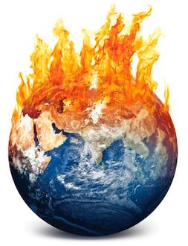
2 Peter 3:10-12
The Day of the Lord will bring the destruction of the physical universe, not a purging or renewal.
“the heavens will pass away”
“elements will melt with fervent heat”
“the earth and the works that are in it will be burned up”

Slide 10
2 Peter 3:13
“Nevertheless we, according to His promise”
John 14:1-4; 1 Thess. 4:17
“look for new heavens and a new earth”
Gen. 8:22; Matt. 24:35
Rev. 20:11-21:1
“in which righteousness dwells”
2 Pet. 1:4; Rev. 21:27; 22:15

Slide 11
The New Heavens and New Earth
Isaiah’s New Heavens and New Earth have been realized in the present dispensation of Christ. We are currently living in it and enjoying its spiritual blessings.
Peter and John’s New Heavens and New Earth are to be realized beyond the return of Christ. It will be our eternal place of residence after the judgment.
Beware of those who twist the scriptures to their own destruction (2 Pet. 3:16-18).

