Slide 2
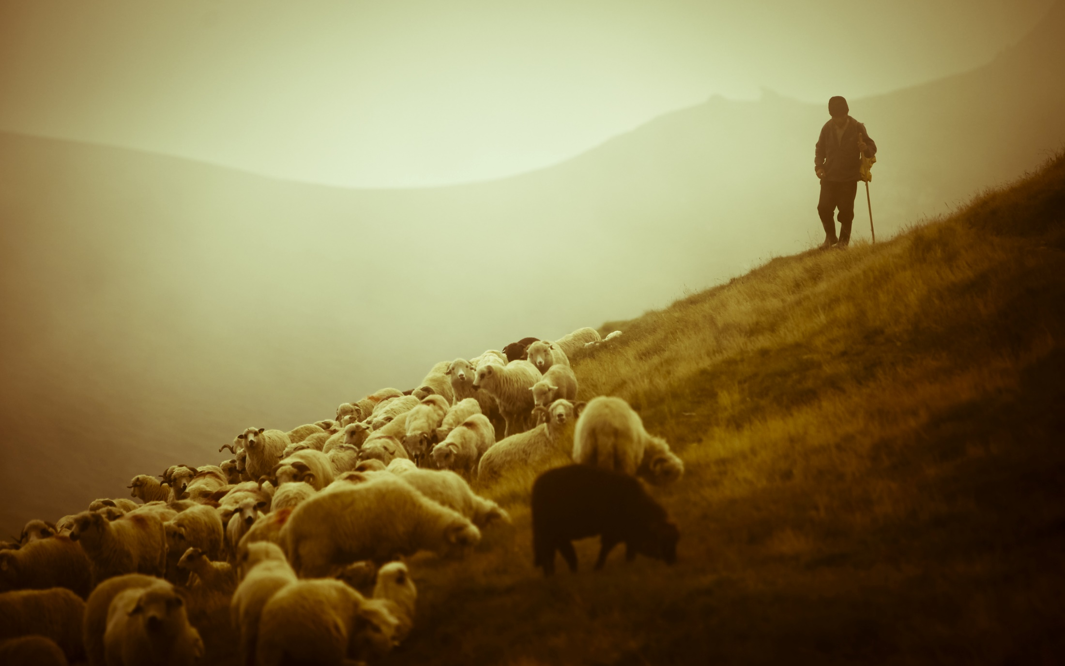
The Work of Elders

Slide 3
Paul commanded Titus to appoint elders in every city (Titus 1:5).
“And we urge you, brethren, to recognize those who labor among you, and are over you in the Lord and admonish you, and to esteem them very highly in love for their work’s sake. Be at peace among yourselves” (1 Thess. 5:12-13).
“This is a faithful saying: If a man desires the position of a bishop, he desires a good work” (1 Tim. 3:1).

Slide 4
1. Examine Themselves
Therefore take heed to yourselves and to all the flock, among which the Holy Spirit has made you overseers, to shepherd the church of God which He purchased with His own blood.
Acts 20:28

Slide 5
1. Examine Themselves
Elders must honestly evaluate…
Their relationship with God.
Their faults and weaknesses.
Their attitude towards their work, the brethren, God’s word, etc.

Slide 6
2. Shepherd the Church
Therefore take heed to yourselves and to all the flock, among which the Holy Spirit has made you overseers, to shepherd the church of God which He purchased with His own blood.
Acts 20:28

Slide 7
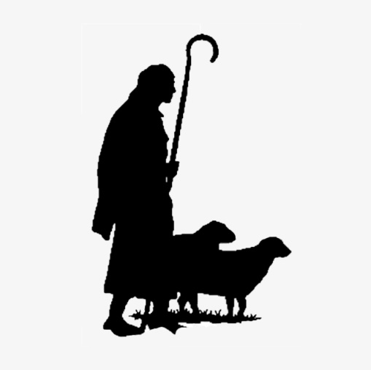
2. Shepherd the Church
Feed the Flock
Eph. 4:11-12; 1 Tim. 3:2
Protect the Flock
Acts 20:28-31; Titus 1:9-11
Keep Sheep from Straying
Heb. 13:17; 1 Thess. 5:12

Slide 8
3. Oversee the Church
Therefore take heed to yourselves and to all the flock, among which the Holy Spirit has made you overseers, to shepherd the church of God which He purchased with His own blood.
Acts 20:28

Slide 9
3. Oversee the Church
“A man charged with the duty of seeing that things to be done by others are done rightly; curator, guardian or superintendent” (Thayer).
Responsible for planning and managing the work of the church.
The elders do “rule” the church (1 Thess. 5:12; Heb. 13:17), not by making rules contrary to the doctrine of Christ, but by exercising authority given to them by Christ to make final decisions.

Slide 10
4. Be an Example
Shepherd the flock of God which is among you, serving as overseers, not by compulsion but willingly, not for dishonest gain but eagerly; nor as being lords over those entrusted to you, but being examples to the flock.
1 Peter 5:2-3

Slide 11
4. Be an Example
“an example to be imitated”
His faith is to be followed (Heb. 13:7).
His qualifications show he is to be an example of a good Christian, husband, father, teacher, neighbor, co-worker, etc. (1 Tim. 3:1-7; Titus 1:5-9).

Slide 12
The Work of Elders
Examine Themselves
Shepherd the Church
Oversee the Church
Be Examples
“And we urge you, brethren, to recognize those who labor among you, and are over you in the Lord and admonish you, and to esteem them very highly in love for their work’s sake...” (1 Thess. 5:12-13)

