Slide 2
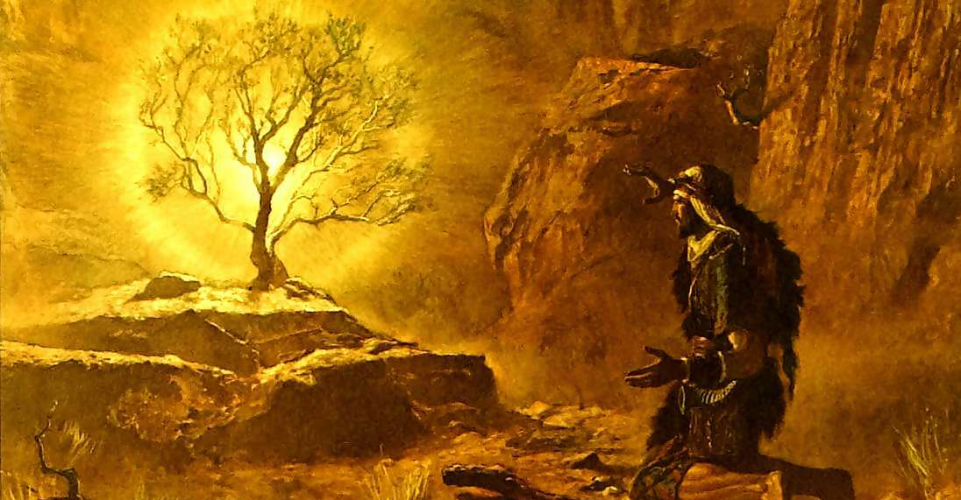
Proper Worship Requires Preparation

Slide 3
To Prepare
from Latin praeparare
prae – before
parae – to set in order, get ready
“to make ready, usually for a specific purpose”
“to equip or furnish with necessary provisions”
“to put together or make out of materials, ingredients, parts, etc.”

Slide 4
Approaching God Acceptably Always Requires Preparation
Moses was not prepared to be in God’s holy presence (Ex. 3:1-6).
Abraham made preparations to worship God (Gen. 22:1-7).
The children of Israel had to prepare for three days before they met with God on Mount Sinai (Ex. 19:10-15).

Slide 5
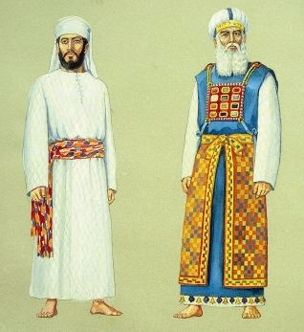
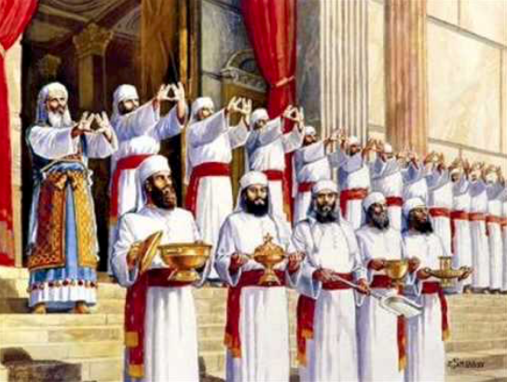
- Under the Law of Moses -
The dress of the priests was regulated.
Exodus 28

Slide 6
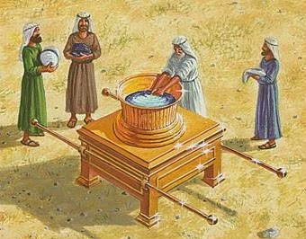
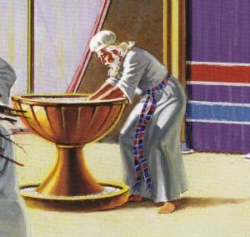
- Under the Law of Moses -
The priests had to wash themselves before they served.
Exodus 30:17-21

Slide 7
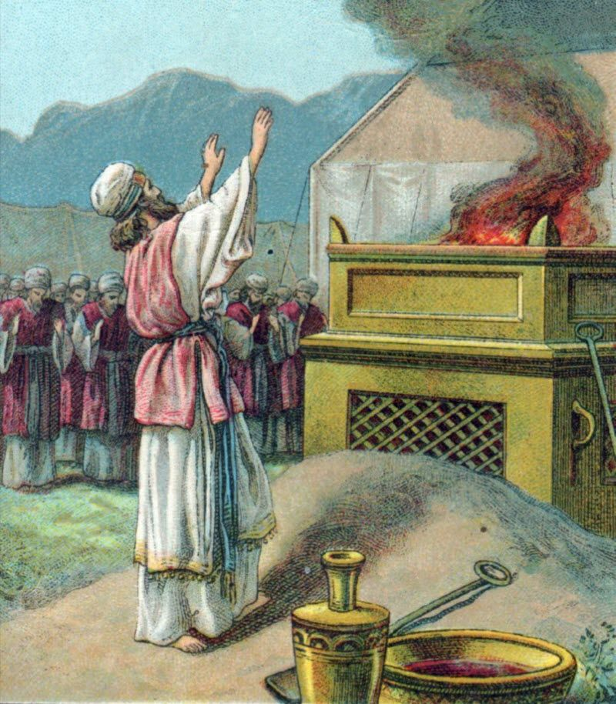
- Under the Law of Moses -
Proper sacrifices had to be made before the High Priest could enter the Holy of Holies.
Leviticus 16

Slide 8
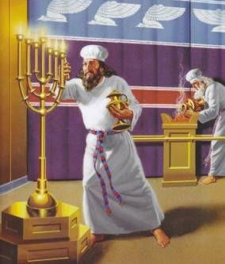
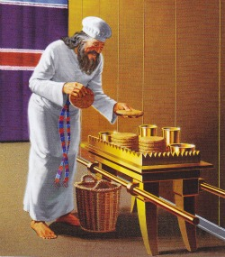
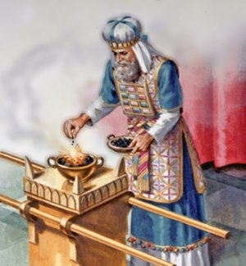
- Under the Law of Moses -
“Now when these things had been thus prepared, the priests always went into the first part of the tabernacle, performing the services” (Heb. 9:6).

Slide 9
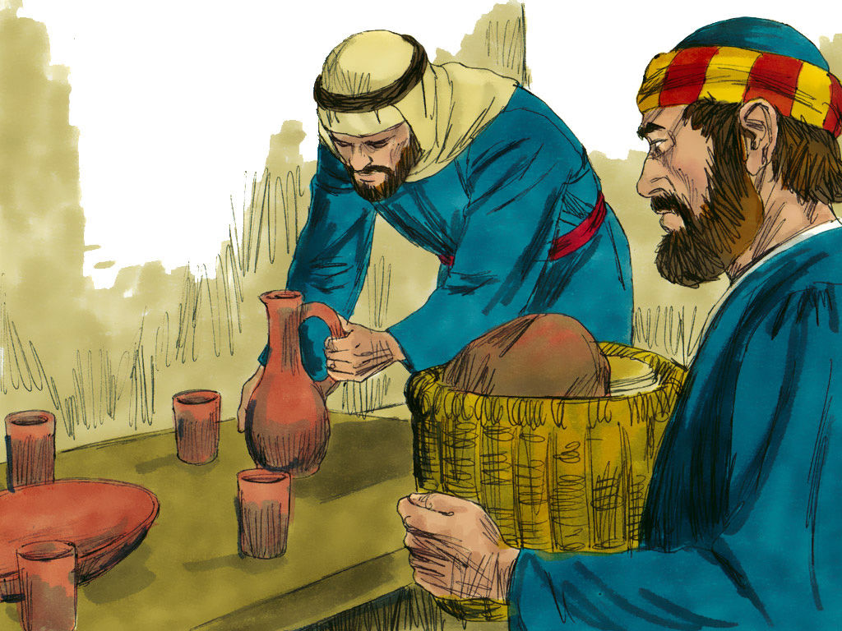
- Under the Law of Moses -
Israel made preparations to observe the Passover.
2 Chron. 35:1-6, 10-19
Jesus sent disciples to make preparations to observe the Passover.
Matt. 26:17

Slide 10
What Do I Learn?

Slide 11
What Do I Learn?
Who serve the copy and shadow of the heavenly things, as Moses was divinely instructed when he was about to make the tabernacle. For He said, “See that you make all things according to the pattern shown you on the mountain.”
But now He has obtained a more excellent ministry, inasmuch as He is also Mediator of a better covenant, which was established on better promises.
Hebrews 8:5-6

Slide 12
What Do I Learn?
We have not come to Mt. Sinai (Heb. 12:18-21).
We have come to Mt. Zion (vs. 22-29).
We are to be more careful than they were (v. 25).
We are to “serve God acceptably with reverence and godly fear” (v. 28).

Slide 13
Applications
We must dress appropriately.
Rom. 13:14; Eph. 4:22-24
We must cleanse ourselves.
Psalm 24:3-4
We must prepare ourselves to enter God’s presence.
Heb. 12:28-29

