Slide 2
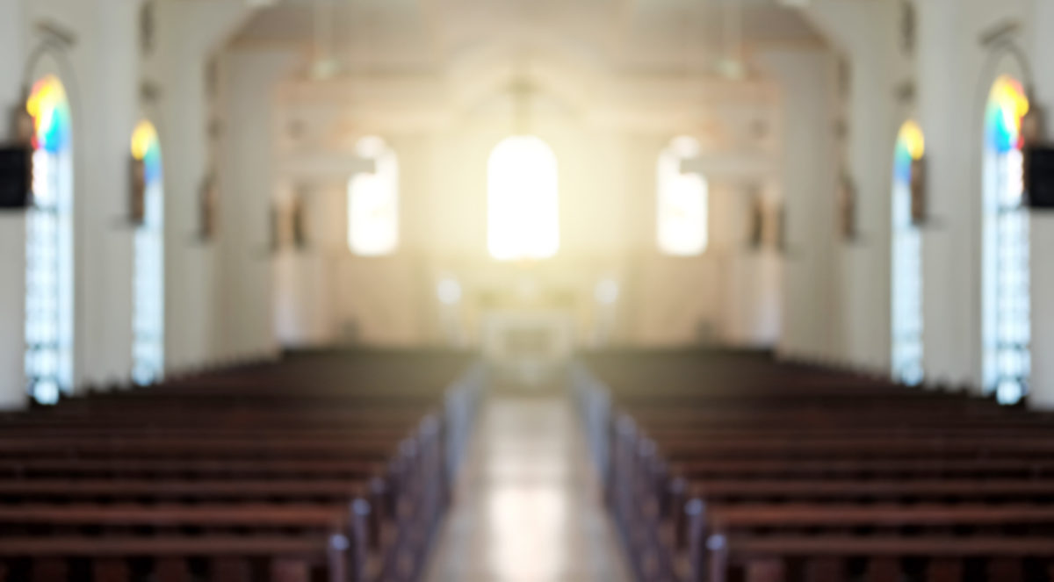
God is to Be Feared in the Assembly of the Saints
Psalm 89:5-7

Slide 3
How We Approach God in Worship
We walk by faith, not by sight (2 Cor. 5:7).
God is greatly feared and held in reverence by those assembled before Him (Ps. 89:5-7).
John saw this in Revelation 4.
We can have boldness as we approach God (Heb. 4:16), but we must approach Him acceptably, with reverence and godly fear (Heb. 12:28-29).

Slide 4
What is Reverence?
reverence - “a feeling or attitude of deep respect, love, and awe, as for something sacred”
“Reverence” and “godly fear” convey a profound sense of respect or fear in the presence of greatness.
They also convey a sense of caution.

Slide 5
Reverencing God in our worship is everyone’s responsibility.
“God is greatly to be feared in the assembly of the saints, and to be held in reverence by all those around Him.”
Psalm 89:7

Slide 6
Signs We Are Lacking Reverence in Our Worship
Lack of Commitment to Worship
We will be here when we can (Ps. 122:1).
We will be here on time.
We will show up prepared.

Slide 7
Signs We Are Lacking Reverence in Our Worship
Lack of Seriousness in Our Assembly
“Oh come, let us worship and bow down; let us kneel before the Lord our Maker” (Ps. 95:6).
We will participate in worship and pay attention (James 1:21)
We will avoid unnecessary distractions and stay off social media.
How would you feel if people were doing this at your wedding or at your loved one’s funeral?

Slide 8
Signs We Are Lacking Reverence in Our Worship
Lack of Zeal and Enthusiasm
“Serve the Lord with fear, and rejoice with trembling” (Ps. 2:11)
Our heart must be involved (Matt. 15:8)
We can lose our first love (Rev. 2:4), become lukewarm (3:15-16), or dead (3:1).

Slide 9
Are we reverencing God in our worship assemblies?
“God is greatly to be feared in the assembly of the saints, and to be held in reverence by all those around Him.”
Psalm 89:7

