Slide 2
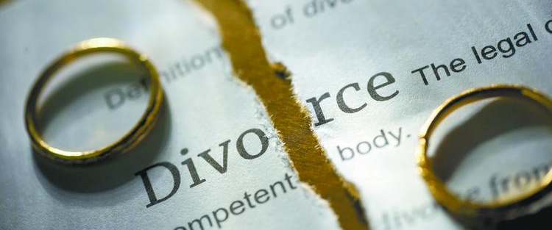
Why God Hates Divorce
Malachi 2:13-16

Slide 3
1. Divorce Violates A Covenant
A covenant is a solemn mutual agreement.
A marriage is a covenant in which each spouse promises to take the other as an exclusive companion.
God’s marriage covenant is one man joined to one woman for life (Gen. 2:24; Rom. 7:2-3).
Only one exception – fornication (Matt. 19:9).

Slide 4
1. Divorce Violates A Covenant
A divorce is an effort to go back on one’s word, to violate a solemn promise or agreement.
God takes this very seriously.
“The Lord has been witness between you and the wife of your youth” (v. 14).
“with whom you have dealt treacherously”
To act covertly, to be unfaithful, to be a traitor.

Slide 5
2. Divorce Attempts to Separate What God Has Joined Together
“did He not make them one” (v. 15)
“and be joined to his wife, and they shall become one flesh” (Gen. 2:24)
“So then, they are no longer two but one flesh. Therefore what God has joined together, let not man separate” (Matt. 19:6).
That marriage bond still exists. A remarriage is adultery.

Slide 6
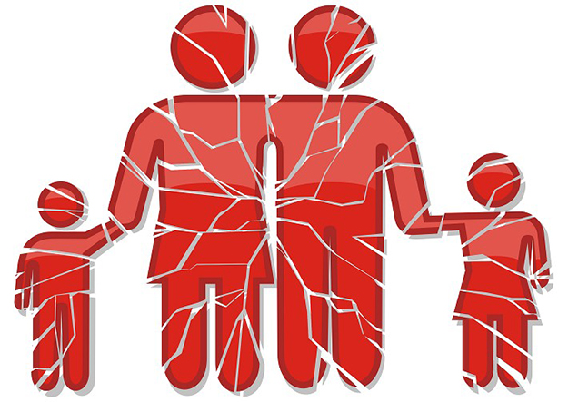
3. Divorce Destroys A Family
“He seeks godly offspring” (v. 15)
The family, which starts with a marriage, is the institution God designed and created for the raising of children.
The father and mother living together provide the stability for the children.
This arrangement is the foundation upon which they build their lives, their character, and their trust.

Slide 7
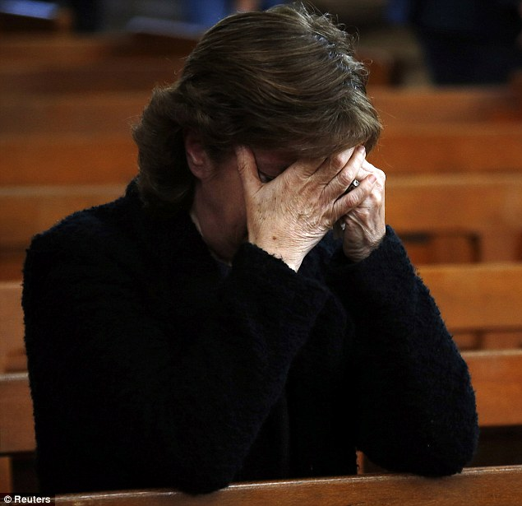
4. Divorce Brings Pain and Misery to Innocent Victims
“it covers one’s garment with violence” (v. 16)
“You cover the altar of the Lord with tears, with weeping and crying” (v. 13)

Slide 8
“For the Lord God of Israel says that He hates divorce” (Mal. 2:16)
Violates a covenant.
Attempts to destroy what God has made.
Destroys the stability, foundation children need.
Does violence to innocent people.

Slide 9
“For the Lord God of Israel says that He hates divorce” (Mal. 2:16)
Violates a covenant.
Attempts to destroy what God has made.
Destroys the stability, foundation children need.
Does violence to innocent people.
Often results in adultery.
Destroys the most basic building block of society.
Brings sin and trouble into the Lord’s church.
Will condemn souls to an eternal Hell.

