Slide 2
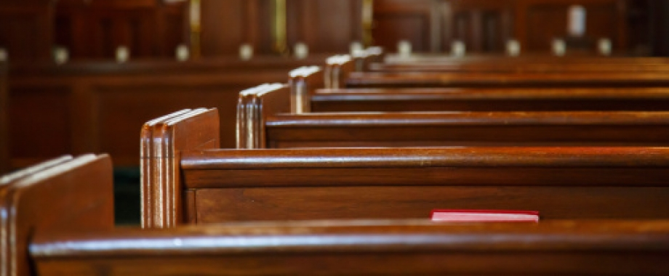
A Generation Who Did Not Know the Lord
Judges 2:10

Slide 3
How Did This Happen?
The priests allowed it to happen.
  Deut. 31:9-13
The elders allowed it to happen.
  Deut. 31:9
The parents allowed it to happen.
  Deut. 4:9-10; 6:4-9
The nation allowed it to happen.

Slide 4

For whatever things were written before were written for our learning, that we through the patience and comfort of the Scriptures might have hope.
Romans 15:4

Slide 5
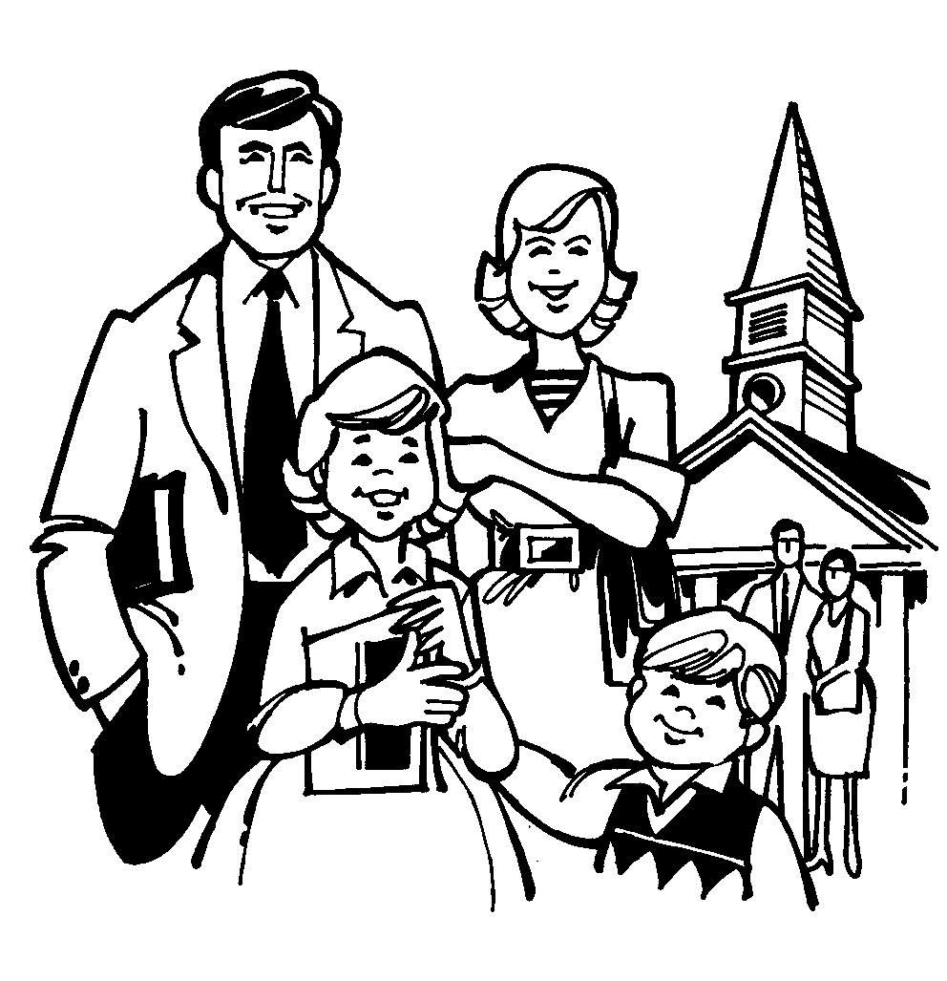
How Can This Happen Today?
The priests allow it to happen.
  All Christians are priests - 1 Peter 2:9-10
The elders allow it to happen.
  Acts 20:28-32; 1 Thess. 5:12-13; Heb. 13:17
The parents allow it to happen.
  Eph. 6:4

Slide 6
Are our children getting enough spiritual education?
Public school (K-12) – 1,225 hrs/yr = 15,925 hours
Church attendance (18 years) –
4 hrs/wk x 52 wks = 3,744 hours
Church-only spiritual education = 2nd grade level

Slide 7
How Can This Happen Today?
The priests allow it to happen.
  All Christians are priests - 1 Peter 2:9-10
The elders allow it to happen.
  Acts 20:28-32; 1 Thess. 5:12-13; Heb. 13:17
The parents allow it to happen.
  Eph. 6:4
The church allows it to happen.

