Slide 2
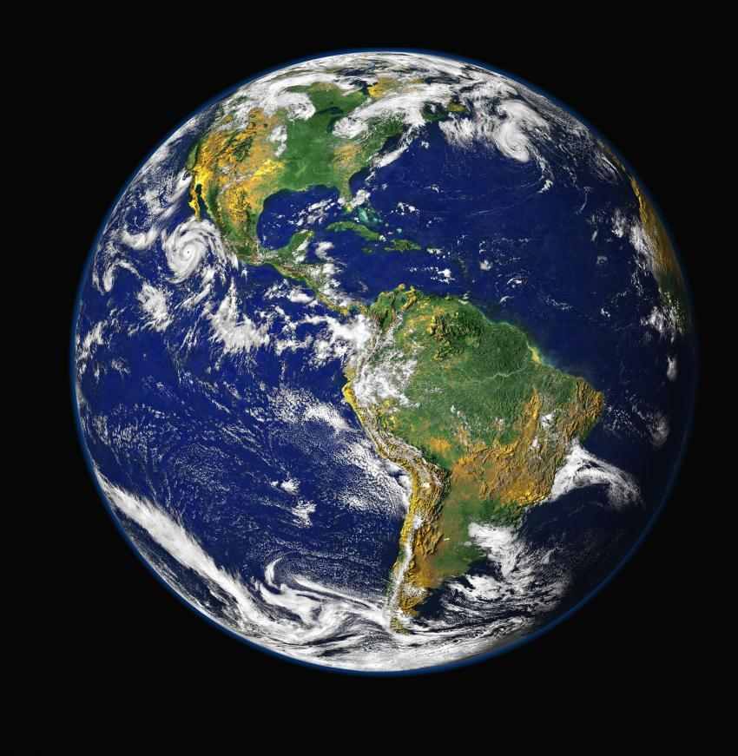
Overcoming Worldliness
Drugs & Alcohol Materialism
Fornication Stealing
Homosexuality Gambling
Pornography Dancing
Immodest Dress
Sinful Entertainment
Sinful Speech

Slide 3
The Christian and the World

Slide 4
We Are Called to Be Holy
1 Peter 1:13-16
hagios - to be “set apart for God”
“in a moral sense, pure, sinless, upright, holy”
To be holy means to be separated from the sin of the world and consecrated to God for His use and His glory.

Slide 5
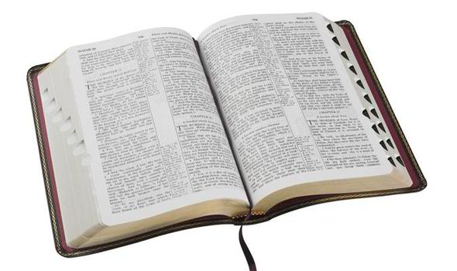
We Are Called to Be Holy
“Therefore, having these promises, beloved, let us cleanse ourselves from all filthiness of the flesh and spirit, perfecting holiness in the fear of God.”
2 Cor. 7:1, NKJV
“…bringing holiness to completion in the fear of God” (ESV)

Slide 6
We Are Called to Be Holy
“So that He may establish your hearts blameless in holiness before our God and Father at the coming of our Lord Jesus Christ with all His saints.”
1 Thess. 3:13

Slide 7
The World
“Do not love the world or the things in the world. If anyone loves the world, the love of the Father is not in him.
For all that is in the world — the lust of the flesh, the lust of the eyes, and the pride of life — is not of the Father but is of the world.
And the world is passing away, and the lust of it; but he who does the will of God abides forever.”
1 John 2:15-17

Slide 8
The World
The physical earth.
Acts 17:24; Mark 16:15
The inhabitants of the earth.
John 3:16; 1 Cor. 4:9
The sinful things that oppose God’s holiness.
1 John 2:16

Slide 9
The World
The world is the source of moral and spiritual corruption (2 Pet. 1:4) and pollutions (2:20).
The evil dispositions and aims of sinful men.
The immoral tendencies and pursuits which oppose God, His word, and His ways.
These things exist because the world lies under the influence of Satan (1 John 4:4; 5:19).

Slide 10
The World
We cannot leave this world – this realm of sinful influence (1 Cor. 5:10).
We must make a choice between the two. We cannot love God and the world (James 4:4).
We must see ourselves and conduct ourselves as sojourners and pilgrims in this world (1 Pet. 2:11).
Our victory over this world is our faith (1 John 5:4), but this faith must be put into practice in order for us to be victorious.

Slide 11
The Christian and the World
The Christian is in one of three possible situations regarding the sinful things of the world:
Innocent of them.
Involved in them.
Victorious over them.

Slide 12
1. Avoid Them
It is best, ideal if we have never committed the sin in the first place.
Solomon warned his sons to avoid the pitfalls of life (Prov. 3:21-23; 4:15).
We are to abstain from…
“voluntarily hold oneself back or away from”
Fornication (1 Thess. 4:3).
Every form of evil (1 Thess. 5:22-23; Rom. 12:9).
Fleshly lusts (1 Pet. 2:11).

Slide 13
2. Overcome Them
Overcome (nikaoo) “to conquer; to carry off the victory, come off victorious.”
It is taken from the Greek word nike – “victory”
We do not overcome the world by surrendering, but by subduing and conquering the sin in our life.
We must truly repent of the sin – turn from it, do it no more (Acts 8:22-23).
We must put on the whole armor of God to be able to stand against and resist the wiles of the devil (Eph. 6:10-17).

Slide 14
3. Don’t Go Back to Them

Slide 15
3. Don’t Go Back to Them
“Pure and undefiled religion before God and the Father is this: to visit orphans and widows in their trouble, and to keep oneself unspotted from the world.”
James 1:27

Slide 16
3. Don’t Go Back to Them
“As obedient children, not conforming yourselves to the former lusts, as in your ignorance; but as He who called you is holy, you also be holy in all your conduct.”
1 Peter 1:14-15

Slide 17
3. Don’t Go Back to Them
“My little children, these things I write to you, so that you may not sin. And if anyone sins, we have an Advocate with the Father, Jesus Christ the righteous.”
1 John 2:1

Slide 18
3. Don’t Go Back to Them
“For the grace of God that brings salvation has appeared to all men, teaching us that, denying ungodliness and worldly lusts, we should live soberly, righteously, and godly in the present age.”
Titus 2:11-12

Slide 19
The Christian and the World
The Christian must come out from the world and remain separate to be holy before God.
If we have never committed a specific sin, we must avoid it.
If we are involved in a specific sin, we must overcome it.
If we have overcome it, we must stay away from it, lest we become entangled in it again.

