Slide 2
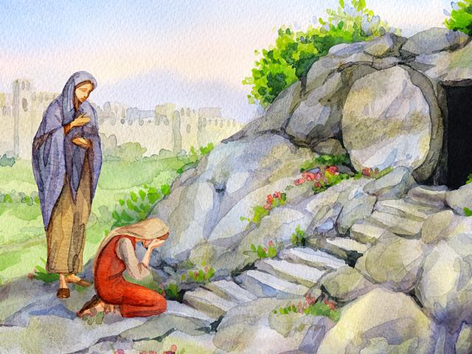
Mary Magdalene

Slide 3
Mary Magdalene…
Was a woman with a past
Luke 8:1-3; Mark 16:9
Was a devoted disciple of the Lord
Luke 18:1-3; Mark 15:40-41
Was an eyewitness of the death, burial, and resurrection of the Lord
John 19:25; Mark 15:40, 46-47; 16:1-9
Clung to the Lord
John 20:11-18

Slide 4
Mary Magdalene challenges us today!
We should not allow our past to keep us from following the Lord.
Our gratitude for God’s mercy and blessings should motivate us to be devoted disciples.
We should have the same love for Christ that Mary Magdalene showed at His crucifixion, burial, and resurrection.
We should cling to the Lord.

