Slide 2
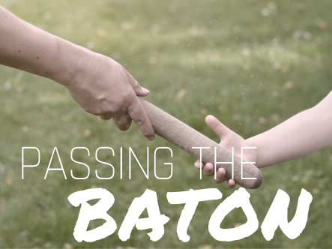
Passing on the Baton of Faith:

Slide 3
Judges 10:16 NIV
Then they got rid of the foreign gods among them and served the Lord. And he could bear Israel’s misery no longer.

Slide 4
The cycle continues when God’s commands are left undone

Slide 5
Judges 2:10 NIV
After that whole generation had been gathered to their ancestors, another generation grew up who knew neither the Lord nor what he had done for Israel.

Slide 6
Passing on the Baton of Faith Involves:
Being committed ourselves
Being honest about our own sin
Saturating our children with the word of God
Praying for and with our children

