Slide 2
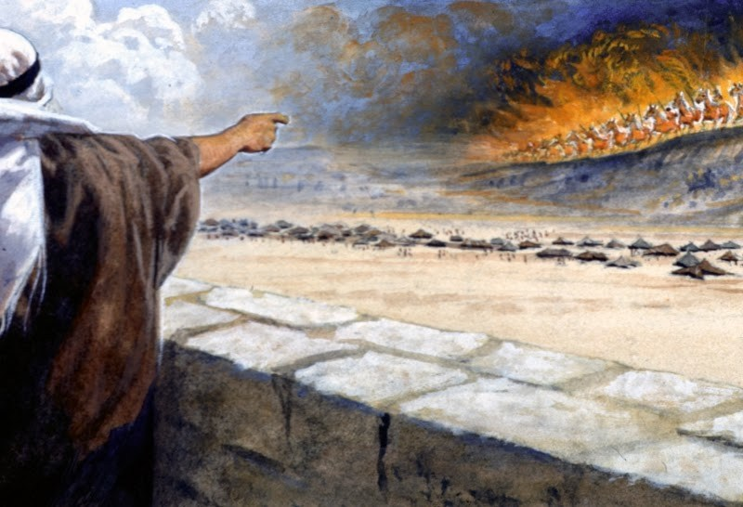
Elisha vs. the Syrian Army 2 Kings 6:8-23

Slide 3
1. Elisha’s Power vs. 8-12
Elisha was able to reveal the plans of the Syrian army to the king of Israel.
Through the power of God, Elisha knew the things the king said to himself in secret.
We serve a God who sees, hears, and knows all things (Ps. 33:13-15).
God has revealed His secrets to us through His word (1 Cor. 2:9-12; Eph. 3:3-5).

Slide 4
2. Elisha’s Faith vs. 13-17
Elisha’s servant was distressed. “Alas, my master! What shall we do?”
Elisha was calm. “Those who are with us are more than those who are with them.”
The servant’s eyes were opened to see the unseen and to know what the prophet already knew.
Which one are we? Do we have faith in the unseen or do we need reassurance?

Slide 5
Things our eyes need to be able to see.
God on His throne - Hab. 2:20; Psalm 119:89, 160
Jesus reigning as King with all authority - Rev. 19:11-16
Jesus serving as High Priest - Heb. 7:24-25; 9:24
Jesus holding all things together - Heb. 1:3
Angels ministering to God’s people - Heb. 1:14
Spiritual condition of others - Matt. 9:36; Acts 8:23; 2 Tim. 2:24-26
Heaven and Hell - Matt. 25:46

Slide 6
3. Elisha’s Compassion vs. 18-23
Elisha could have prayed that the Syrians be struck dead (2 Kings. 19:35).
Elisha did not allow the king to kill them. He spared their lives.
They were fed and released.
The eyes of these Syrians were opened to see the mercy and compassion of God.

Slide 7
We need to show compassion.
Mercy, compassion, kindness and love have a much greater influence for the advancement of God’s kingdom than anger or unrestrained force (James 1:19-20).
Matthew 5:44-45
Romans 12:17-21

