Slide 2
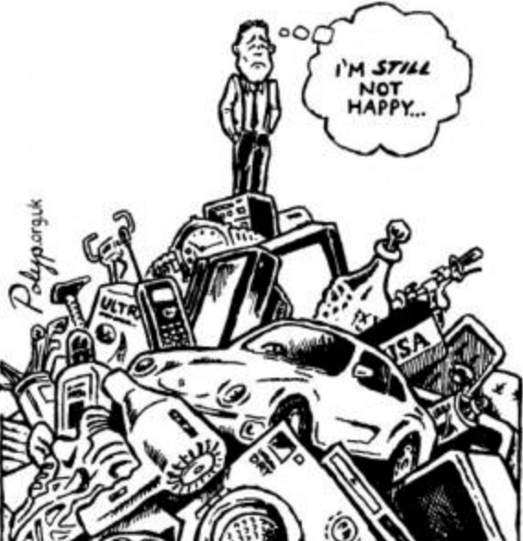
Materialism, Humanism & Modernism
Jeremiah 17:5-10

Slide 4
Good for you?
Bad for you?
Depends on the year!

Slide 5
Evolution is a Lie!

Slide 6
Materialism
Definition
The theory that physical matter is the only reality and that everything, including
thought, feeling, mind, and will, can be explained in terms of matter and physical
phenomena. (AHD)

Slide 7
Materialism
Definition
Material success and progress are the highest values of life.

Slide 8
What You Need to Know about Materialism
Job 1:21
Material Blessings Come from God

Slide 9
What You Need to Know about Materialism
1 Timothy 6:9-10
Things Do Not Satisfy

Slide 10
What You Need to Know about Materialism
Godliness with Contentment is Great Gain
1 Timothy 6:7

Slide 11
What You Need to Know about Materialism
Fear God and Keep His Commandments
Ecclesiastes
12:13

Slide 12
Humanism
Definition
A system of thought that centers on human beings and their values, capacities, and worth.
It focuses on solving human problems.

Slide 14
What You Need to Know about Humanism
Jeremiah 17:5
You Cannot Place Your Trust in Man

Slide 15
What You Need to Know about Humanism
John 17:17
Right & Wrong Comes from God

Slide 16
What You Need to Know about Humanism
It is Not Within You to Direct Your Own Footsteps
Jeremiah 10:23

Slide 17
Modernism
Definition
The deliberate departure from tradition and the use of innovative forms of expression (AHD)

Slide 18
Modernism
Definition
“a movement toward modifying traditional beliefs in accordance with modern ideas.”
Dictionary (Google search)

Slide 19
What You Need to Know about Modernism
Wrong is Always Wrong and Right is Always Right
Acts 23:1
“We ought to obey God rather than men” Acts 5:29

Slide 20
What You Need to Know about Modernism
Colossians 2:8
Beware

Slide 21
What You Need to Know about Modernism
You Faith Should Not be in the Wisdom of Men but in the Power of God
I Corinthians 2:1-5

Slide 22
What You Need to Know about Modernism
Psalm 119:160
The Entirety of God’s Word is Truth

Slide 23
Mark 16:16
Jesus said…
“He who believes and is baptized will be saved; but he who does not believe will be condemned. ”

