Slide 2
How Shall The Young Secure Their Hearts?
Psalm 119:9-16

Slide 3
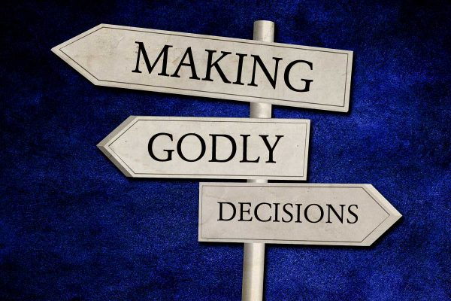
Decisions
determine
your

Slide 4
Saul & David and Peter & Judas
A case study of two types of believers.

Slide 5
Definitions
A. Compliant - made or done according to requirements or instructions.
B. Commitment - devotion or dedication, for example, to a cause, person or relationship.

Slide 6
Compliant & Committed
Saul
Judas
David
Peter

Slide 7
Similarities & Differences
Were the committed less sinful than the compliant from a human vantage point?
- No!
Did the committed have an easier life?
- No!

Slide 8
Similarities & Differences
The real difference that is seen in the committed, while neither sinless, nor wise in all their choices, remained committed to God and ultimately relied on Him in faith.

Slide 9
Application
How do we view God & His Word?
An Obstacle?
A List Of Rules To Obey?
An Opportunity To Have Fellowship With God?

Slide 10
Conclusion
Are we the type of people (spiritually) that do what we do out of fear and to avoid punishment?
Do we obey because we know we'll be punished if we don't - but would really rather be somewhere else?

Slide 11
Conclusion
Or, are we the type of Christians that has a view of our service to God as an opportunity - a blessing to serve the God who loves us and longs for us to be with Him?
It may be that the real difference may not be see until Judgment Day – but it will be seen!

