Slide 2
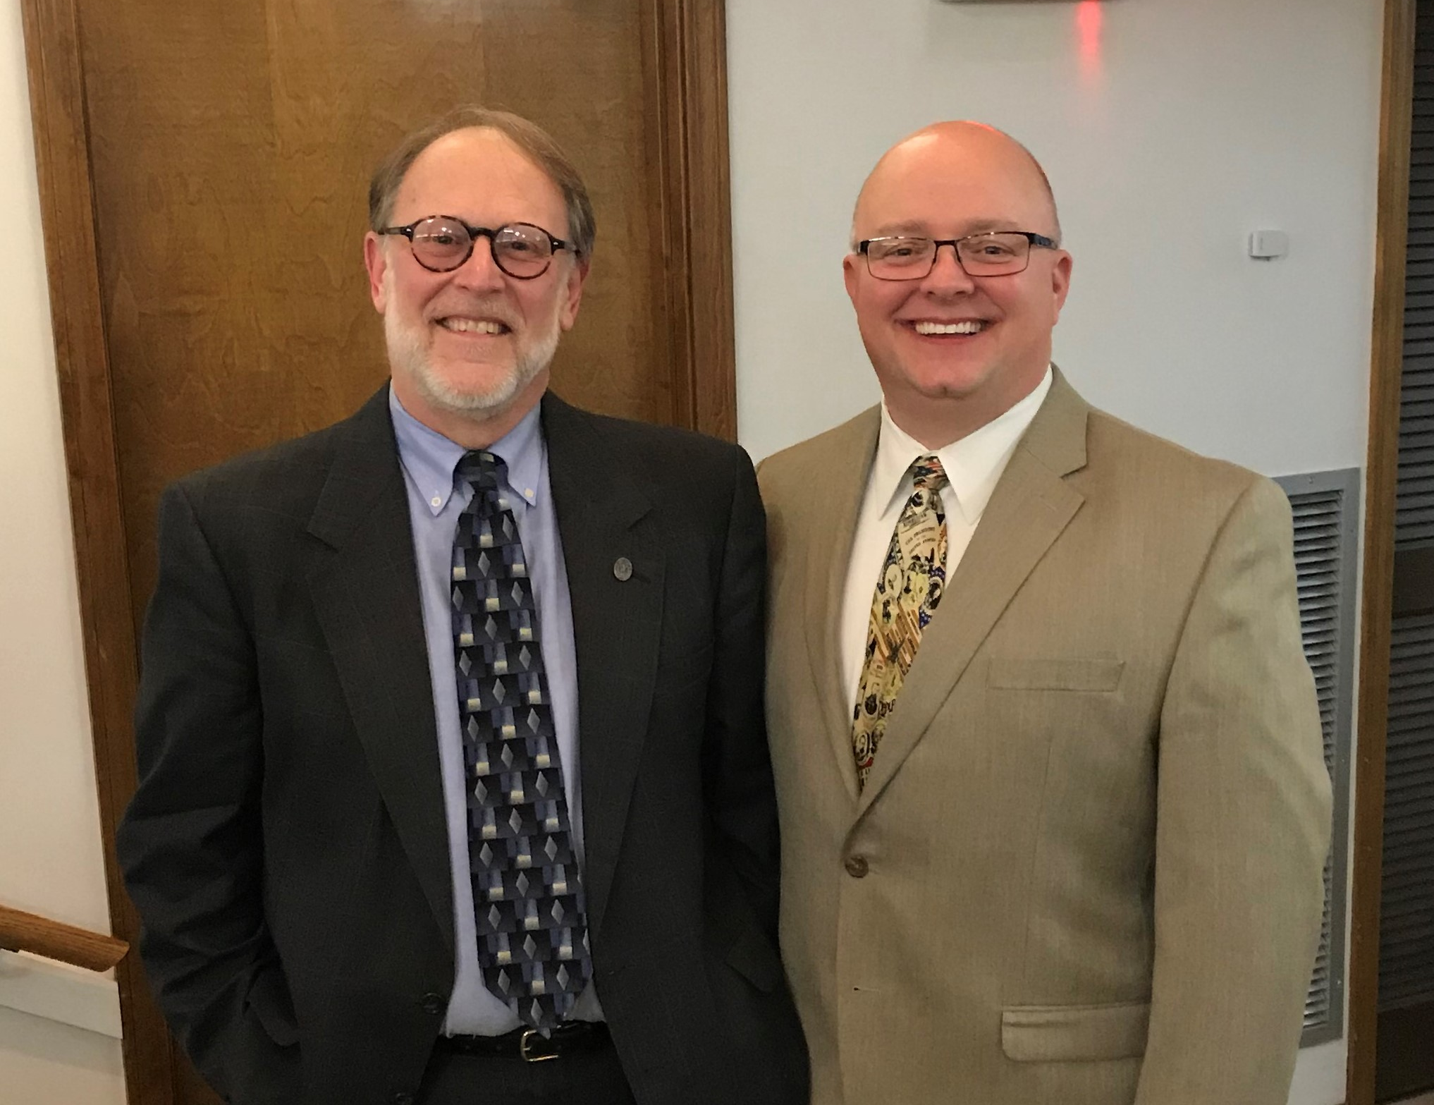

Slide 3
Phoebe A Servant of the Church
Romans 16:1-2

Slide 4
What do we know about Phoebe? Romans 16:1-2
She was a sister in Christ; a Christian.
She was a servant of the church in Cenchrea.
She had helped many, including Paul.
This is ALL we are told about Phoebe.

Slide 5
Role of Women in the Church

Slide 6
Role of Women in the Church
When it comes to leadership and exercising authority in the church, God has placed the man over the woman.
1 Corinthians 11:3
God
⬇
Christ
⬇
man
⬇
woman

Slide 7
Role of Women in the Church
1 Timothy 2:8-15
A woman is to be in submission; not allowed to teach or exercise authority over a man.
The order of creation (v. 13)
The entrance of sin (v. 14)
Honoring the role God has given (v. 15)

Slide 8
Role of Women in the Church
1 Corinthians 14:34-35
A woman is not allowed to address or disrupt the assembly of the church.
Such would be shameful.

Slide 9
Was Phoebe a Deaconess?
“I commend to you our sister Phoebe, a deaconess of the church at Cenchreae.”
Romans 16:1, Revised Standard Version

Slide 10
Was Phoebe a Deaconess?
diakonos
translated “deacon” in Phil. 1:1; 1 Tim. 3:8, 12
“an attendant, a waiter” (Strong’s)
“one who executes the commands of another, especially of a master; a sergeant, attendant, minister” (Thayer’s)
“primarily denotes a servant” (Vine’s)

Slide 11
Was Phoebe a Deaconess?
Deacons are men (1 Tim. 3:8-13)
There are no qualifications for deaconesses in the Bible, only deacons.
Paul does not address deaconesses in Phil. 1:1.
Seven men were chosen to serve the church in Jerusalem (Acts 6:3), not women.

Slide 12
What Can A Woman Do?
She can serve the church and individuals.
Matt. 20:25-28; Acts 9:39
She can teach.
Titus 2:3-5
She can be a godly wife and mother.
1 Tim. 3:11; 2 Tim. 1:5

