Slide 2
When It’s Good To Be Liberal

Slide 3
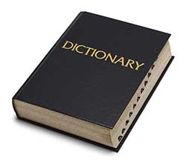
Liberal

Slide 4
Liberal
open to new behavior or opinions and willing to discard traditional values
not bound by authoritarianism, orthodoxy, or traditional forms
not literal or strict; loose
lacking moral restraint

Slide 5
Liberal
open to new behavior or opinions and willing to discard traditional values
not bound by authoritarianism, orthodoxy, or traditional forms
not literal or strict; loose
lacking moral restraint
provided or occurring in generous amounts

Slide 6
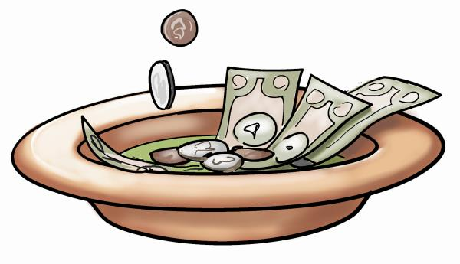
1. Giving and Sharing
They were to give:
As they prospered (1 Cor. 16:2)
As they purposed in their hearts (2 Cor. 9:7)
Generously (v. 5)
Bountifully (v. 6)
Cheerfully (v. 7)
Liberally (vs. 11, 13)

Slide 7
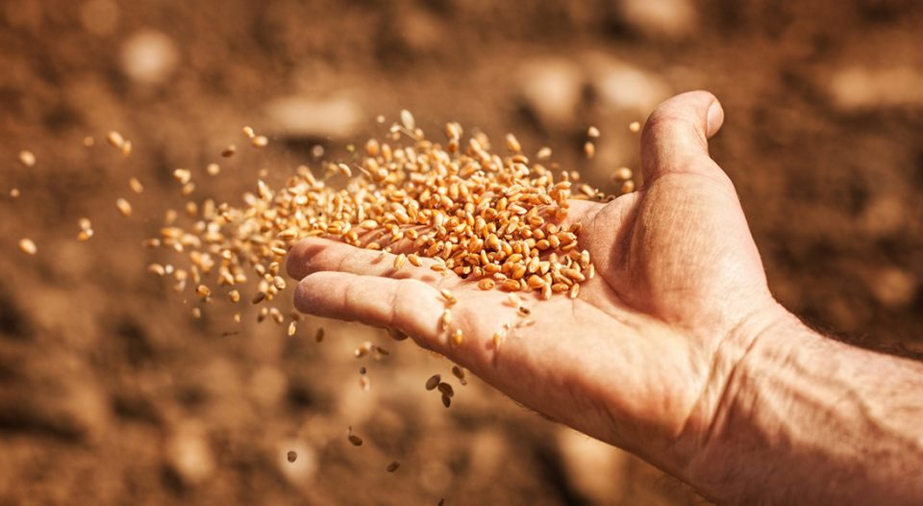
2. Sowing the Seed
“A sower went out to sow his seed. And as he sowed, some fell by the wayside…” (Luke 8:5)

Slide 8
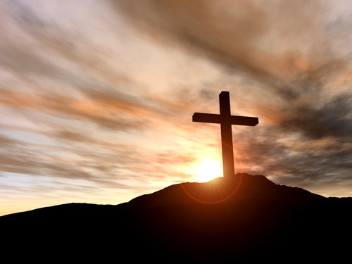
3. Loving Others
“Owe no one anything except to love one another, for he who loves another has fulfilled the law” (Rom. 13:8)
1 Corinthians 13:4-7
1 John 3:17-18

Slide 9
3. Loving Others
We are “taught by God” how to love one another (1 Thess. 4:9)
God loves liberally (John 3:16)
Although governed by His righteousness, His love knows no bounds (Rom. 5:8)

Slide 10
4. Forgiving Others
Then Peter came to Him and said, “Lord, how often shall my brother sin against me, and I forgive him? Up to seven times?”
Jesus said to him, “I do not say to you, up to seven times, but up to seventy times seven.”
Matthew 18:21-22

Slide 11
4. Forgiving Others
Take heed to yourselves. If your brother sins against you, rebuke him; and if he repents, forgive him.
And if he sins against you seven times in a day, and seven times in a day returns to you, saying, “I repent,” you shall forgive him.
Luke 17:3-4

Slide 12
4. Forgiving Others
Therefore, as the elect of God, holy and beloved, put on tender mercies, kindness, humility, meekness, longsuffering;
bearing with one another, and forgiving one another, if anyone has a complaint against another; even as Christ forgave you, so you also must do.
Colossians 3:12-13

Slide 13
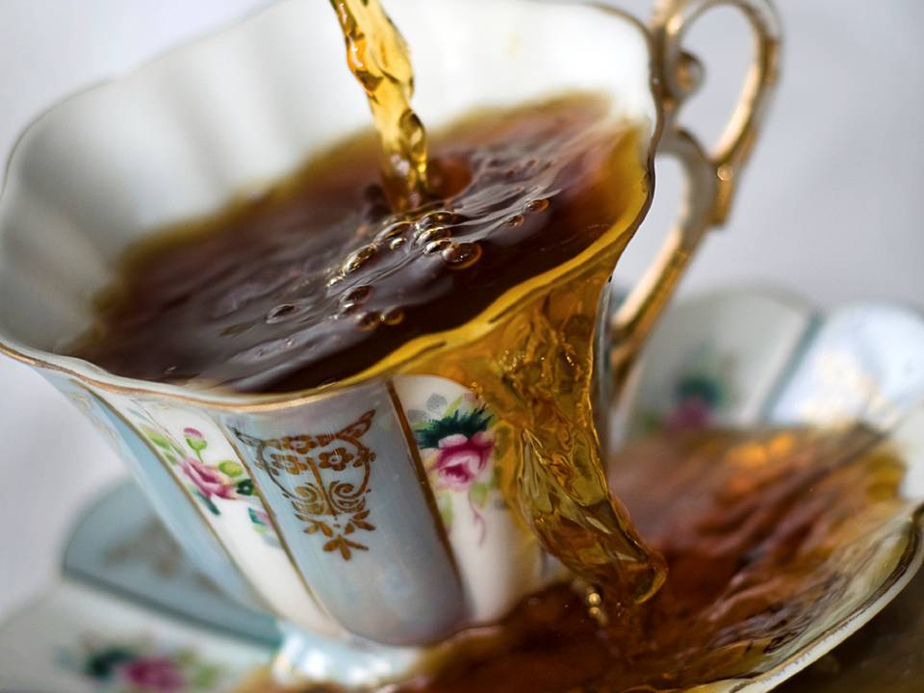
4. Forgiving Others
Judge not, and you shall not be judged. Condemn not, and you shall not be condemned. Forgive, and you will be forgiven.
Give, and it will be given to you: good measure, pressed down, shaken together, and running over will be put into your bosom. For with the same measure that you use, it will be measured back to you.
Luke 6:37-38

Slide 14
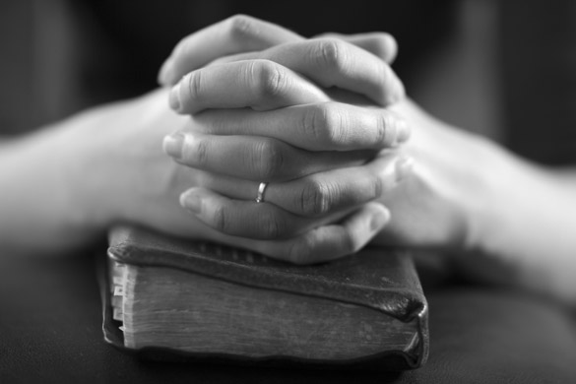
5. Praying
“pray without ceasing” (1 Thess. 5:17)
“…men always ought to pray and not lose heart” (Luke 18:1)

Slide 15
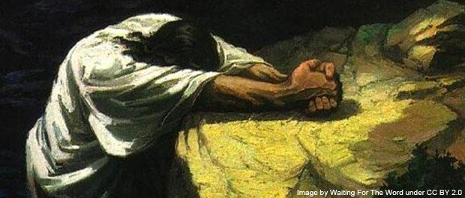
Our Lord’s Example
Jesus prayed by Himself on the mountain well into the night (Matt. 14:23).
Jesus woke up early to go and pray alone (Mark 1:35).
Jesus prayed all night before selecting His apostles (Luke 6:12-16).

Slide 16
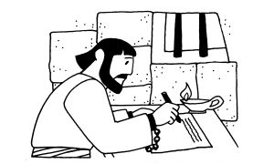
Paul’s Example
“without ceasing I make mention of you always in my prayers” (Rom. 1:9)
“I thank my God always concerning you” (1 Cor. 1:4)
“do not cease to give thanks for you, making mention of you in my prayers” (Eph. 1:16)
“I thank my God upon every remembrance of you, always in every prayer of mine making request for you all with joy” (Phil. 1:3-4)

Slide 17
Paul’s Example
“We give thanks to the God and Father of our Lord Jesus Christ, praying always for you” (Col. 1:3)
“We give thanks to God always for you all, making mention of you in our prayers” (1 Thess. 1:2)
“I thank God, whom I serve with a pure conscience, as my forefathers did, as without ceasing I remember you in my prayers night and day” (2 Tim. 1:3)
“I thank my God, making mention of you always in my prayers” (Philemon 4)

Slide 18
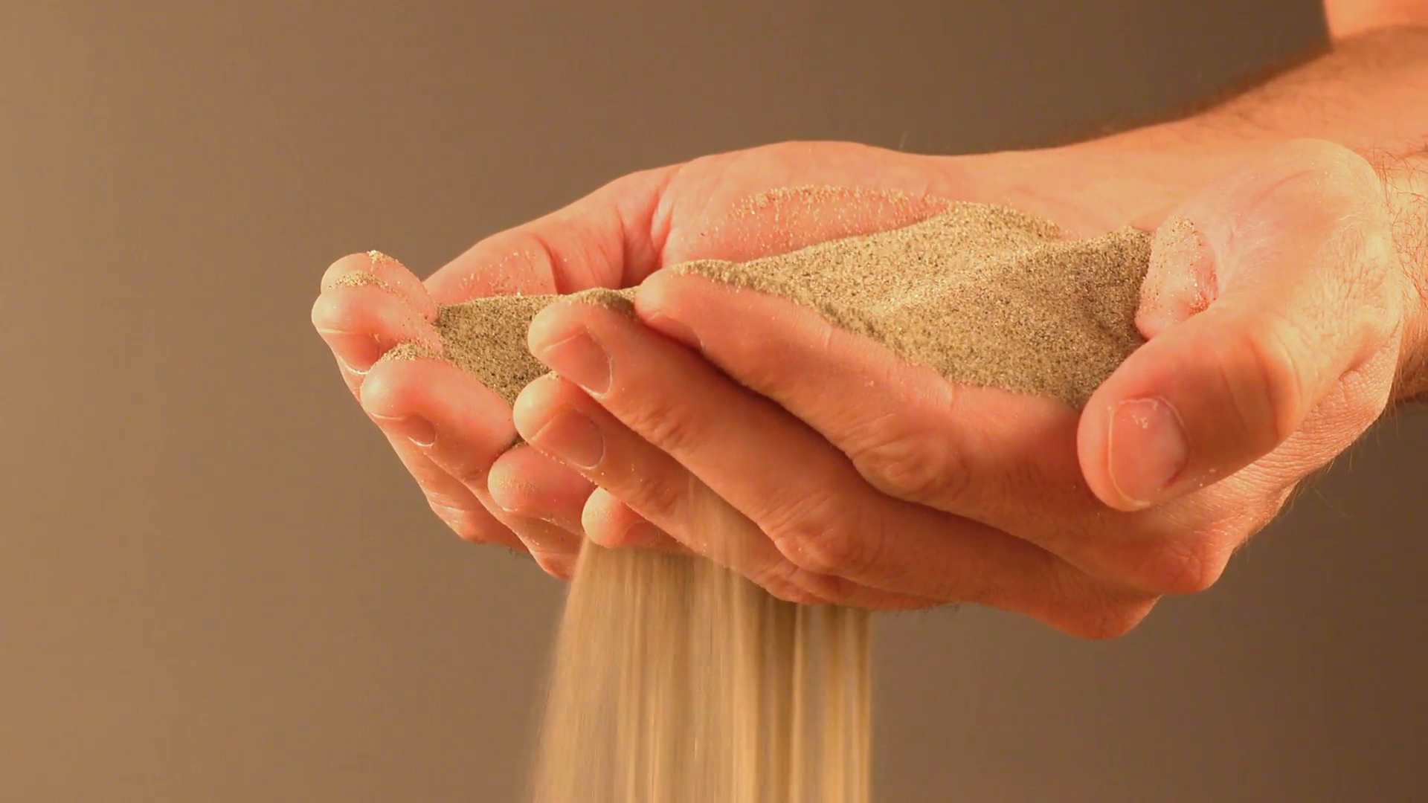
When It’s Good To Be Liberal
Giving and Sharing
Sowing the Seed
Loving Others
Forgiving Others
Praying

