Slide 2
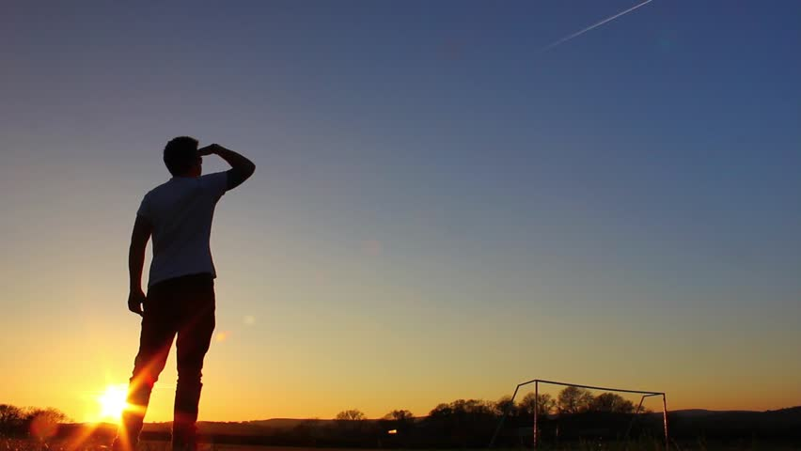
“Know the Lord”

Slide 3
Man is not capable of knowing and understanding God.
Job’s friends challenged him with this fact (Job 36:26-33).
Job acknowledged this himself (Job 26:14).

Slide 4
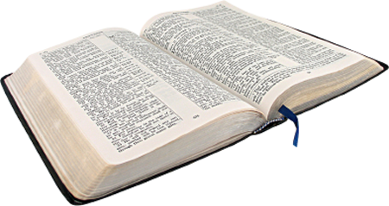
Man is not capable of knowing and understanding God.
“Great is the Lord, and greatly to be praised; and His greatness is unsearchable.”
Psalm 145:3

Slide 5
Man is not capable of knowing and understanding God.
“For My thoughts are not your thoughts, nor are your ways My ways, says the Lord.
For as the heavens are higher than the earth, so are My ways higher than your ways, and My thoughts than your thoughts.”
Isaiah 55:8-9

Slide 6
Man is not capable of knowing and understanding God.
“Oh, the depth of the riches both of the wisdom and knowledge of God! How unsearchable are His judgments and His ways past finding out!”
Romans 11:33

Slide 7
Man is expected to know the Lord!
David told Solomon to know God (1 Chron. 28:9).
The knowledge of God is more desirable to God than sacrifice (Hosea 6:6).
The Galatians are said to have come to know God (Gal. 4:8-9).

Slide 8
There are severe consequences to NOT knowing the Lord!
Pharaoh asked, “Who is the Lord? ...I do not know the Lord” (Ex. 5:2).
The generation after Joshua “did not know the Lord” (Jud. 2:10).
The sons of Eli “did not know the Lord” (1 Sam. 2:12).
Israel did “not know the Lord” (Hosea 5:4).

Slide 9
There are severe consequences to NOT knowing the Lord!
“In flaming fire taking vengeance on those who do not know God, and on those who do not obey the gospel of our Lord Jesus Christ.”
2 Thess. 1:8

Slide 10
The task appears to be impossible, yet it is essential that we know the Lord!
We cannot know the Lord on our own, by our own wisdom or observations.
We can know what God has chosen to reveal about Himself.
“The secret things belong to the Lord our God, but those things which are revealed belong to us and to our children forever, that we may do all the words of this law” (Deut. 29:29).

Slide 11
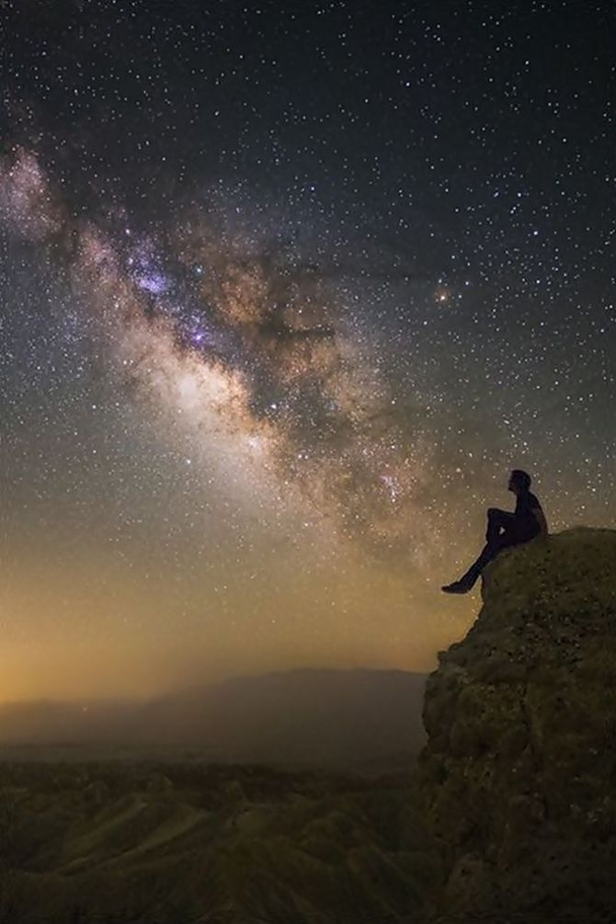
1. God’s Creation
“The heavens declare the glory of God; and the firmament shows His handiwork.
Day unto day utters speech, and night unto night reveals knowledge.”
Psalm 19:1-2

Slide 12
1. God’s Creation
“For since the creation of the world His invisible attributes are clearly seen, being understood by the things that are made, even His eternal power and Godhead, so that they are without excuse.”
Romans 1:20

Slide 13
1. God’s Creation
“Nevertheless He did not leave Himself without witness, in that He did good, gave us rain from heaven and fruitful seasons, filling our hearts with food and gladness.”
Acts 14:17

Slide 14
1. God’s Creation
God is all-powerful.
God loves beauty and variety.
God is the author of order and design.
God is good to His creation.

Slide 15
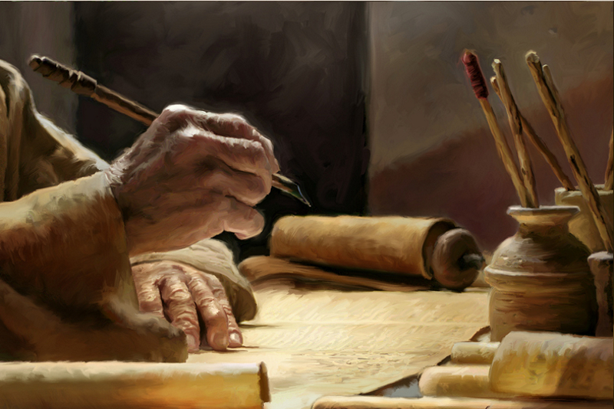
2. God’s Word
God has revealed His mind to man through words given by His Spirit (1 Cor. 2:9-13).
The Holy Spirit gave these words to the prophets and apostles (John 16:12-13; 2 Pet. 1:19-21).
All Scripture is given by the inspiration of God (2 Tim. 3:16).

Slide 16
3. God’s Son

Slide 17
3. God’s Son
“If you had known Me, you would have known My Father also; and from now on you know Him and have seen Him.”
Philip said to Him, “Lord, show us the Father, and it is sufficient for us.”
Jesus said to him, “Have I been with you so long, and yet you have not known Me, Philip? He who has seen Me has seen the Father; so how can you say, ‘Show us the Father’”?
John 14:7-9

Slide 18
3. God’s Son
“He is the image of the invisible God, the firstborn over all creation” (Col. 1:15).

Slide 19
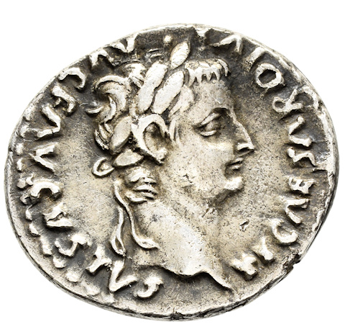
3. God’s Son
“He is the image of the invisible God, the firstborn over all creation” (Col. 1:15).
“Image” is from eikon, from which we get the English word “icon.”
“a likeness, statue, profile, representation, resemblance.”
Jesus is the visible representation and manifestation of God to this physical world.

Slide 20
We can know the Lord!
God has revealed Himself to mankind through…
His Creation
His Word
His Son
Do you know the Lord?

