Slide 2
Do What You Can With What You Have Where You Are
Mark 14:3-9

Slide 3
Do What You Can…
Opportunity
“Therefore, as we have opportunity, let us do good to all, especially to those who are of the household of faith” (Gal. 6:10).
“meanwhile praying also for us, that God would open to us a door for the word, to speak the mystery of Christ, for which I am also in chains” (Col. 4:3).

Slide 4
Do What You Can…
Opportunity
Ability

Slide 5
Do What You Can…
Opportunity
Ability
“And to one he gave five talents, to another two, and to another one, to each according to his own ability; and immediately he went on a journey” (Matt. 25:15).

Slide 6
Do What You Can…
Opportunity
Ability
“And to one he gave five talents, to another two, and to another one, to each according to his own ability; and immediately he went on a journey” (Matt. 25:15).
Opportunity + Ability = Responsibility

Slide 7
Do What You Can…
Opportunity
Ability
Opportunities and Abilities Increase with Use
Matthew 25:20-23, 28-29

Slide 8
Do What You Can…
How are we doing what we can?
Our Best - Rom. 12:1-2
With Zeal - Titus 2:14
With God’s Authority - Col. 3:17
To God’s Glory - 1 Cor. 10:31

Slide 9
With What You Have…
We possess different talents and abilities, but they are needed and have a place in the Lord’s work.
Romans 12:6-8
1 Corinthians 12:12-25

Slide 10
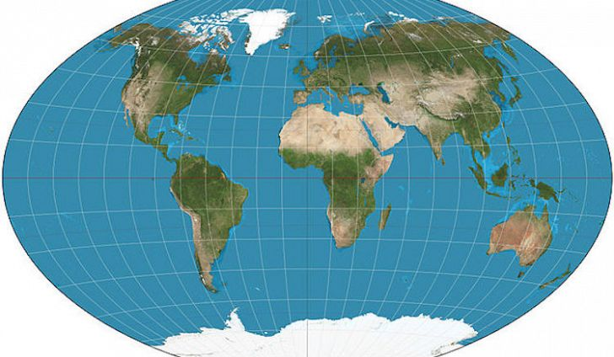
Where You Are

Slide 11
Where You Are
“But by the grace of God I am what I am…” (1 Cor. 15:10)
By the grace of God I am WHERE I am.
Where you live, work, go to school, shop, eat, play, etc.

Slide 12
Do What You Can With What You Have Where You Are
God demands nothing more.
God expects nothing less.

