Slide 2
Some Facts About
First Peter

Slide 3
1. Suffering Has A Source
Sometimes we suffer for doing wrong.
1 Pet. 2:20; 4:15
The faithful Christian will also suffer for righteousness’ sake.
1 Pet. 3:13-14; 4:4, 14-16
All suffering comes from a common source: Satan - 1 Pet. 5:8.

Slide 4
2. Suffering Serves A Purpose

Slide 5
2. Suffering Serves A Purpose
“In this you greatly rejoice, though now for a little while, if need be, you have been grieved by various trials,
that the genuineness of your faith, being much more precious than gold that perishes, though it is tested by fire, may be found to praise, honor, and glory at the revelation of Jesus Christ.”
1 Peter 1:6-7

Slide 6
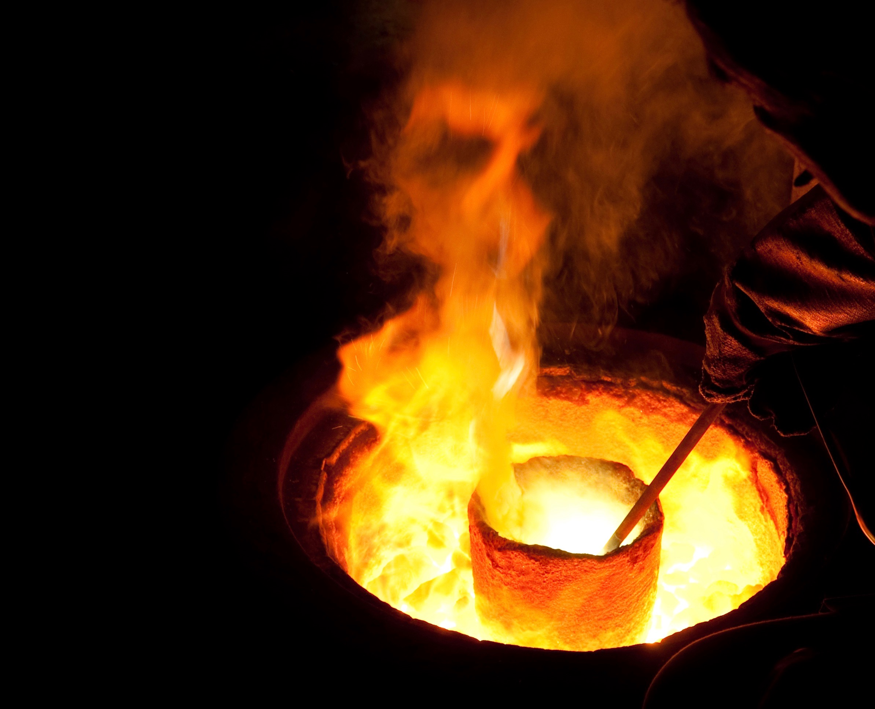
“That the genuineness of your faith, being much more precious than gold that perishes, though it is tested by fire, may be found to praise, honor, and glory at the revelation of Jesus Christ.”
1 Pet. 1:7, NKJV

Slide 7
“After you have suffered for a little while, the God of all grace, who called you to His eternal glory in Christ, will Himself perfect, confirm, strengthen and establish you.”
1 Pet. 5:10, NASU

Slide 8
“After you have suffered for a little while, the God of all grace, who called you to His eternal glory in Christ, will Himself perfect, confirm, strengthen and establish you.”
1 Pet. 5:10, NASU

Slide 9
“After you have suffered for a little while, the God of all grace, who called you to His eternal glory in Christ, will Himself perfect, confirm, strengthen and establish you.”
1 Pet. 5:10, NASU

Slide 10
“After you have suffered for a little while, the God of all grace, who called you to His eternal glory in Christ, will Himself perfect, confirm, strengthen and establish you.”
1 Pet. 5:10, NASU

Slide 11
3. Suffering is Shared
We are sharing with Christ in His sufferings...
Because we are following Christ - John 15:18-21
Was first experienced by Christ - Heb. 2:17-18; 4:15
Is felt by Christ - Acts 22:4-7

Slide 12
3. Suffering is Shared
We are joined by other Christians in these sufferings.
“Resist him, steadfast in the faith, knowing that the same sufferings are experienced by your brotherhood in the world.”
1 Pet. 5:9

Slide 13
4. Suffering Must Be Endured
1 Peter 2:20-23

Slide 14
“For to this you were called, because Christ also suffered for us, leaving us an example, that you should follow His steps.”
1 Pet. 2:21

Slide 15
4. Suffering Must Be Endured
Take it patiently - v. 20
Did not revile in return - v. 23
Did not threaten - v. 23
Committed Himself to God - v. 23

Slide 16
4. Suffering Must Be Endured
Take it patiently - v. 20
Did not revile in return - v. 23
Did not threaten - v. 23
Committed Himself to God - v. 23
“Therefore let those who suffer according to the will of God commit their souls to Him in doing good, as to a faithful Creator” (1 Pet. 4:19).

Slide 17
What does First Peter teach us about suffering?
Suffering Has A Source
Suffering Serves A Purpose
Suffering is Shared
Suffering Must Be Endured

