Slide 2
Do We Appreciate Our Bible? 2 Timothy 3:15-17

Slide 3
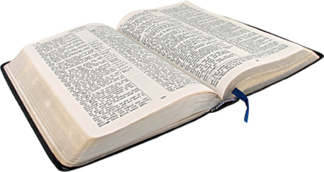
“All Scripture”
“Scripture” is what the Bible calls itself.
2 Peter 3:16; 1 Tim. 5:18; Luke 10:7

Slide 4
“Inspired By God”
Literally means “God-breathed.”
2 Peter 1:20-21
1 Corinthians 2:9-13

Slide 5
“Profitable”
Makes us “wise for salvation” (v. 15).
“Profit” cannot be obtained without “investment.”

Slide 6
“Doctrine”
Teaching.
The Bible has something to teach us.

Slide 7
“Reproof”
Shows us what is wrong.
Convicts us of the sins in our life and convinces us that these things need to change.
John 3:19-20
Hebrews 4:12

Slide 8
“Correction”
“to make straight again”
Tells us how to make things right.
2 Corinthians 13:5

Slide 9
“Instruction In Righteousness”
“Righteousness” is being ‘wise’ about what is ‘right.’
Not only does it tell us what is wrong, the Bible also tells us what is right.
Titus 2:11-14
Hebrews 5:13

Slide 10
“Complete, Thoroughly Equipped For Every Good Work”
“Every” - all there is. Nothing is lacking.
The Bible identifies these good works (Matt. 7:21-23).
And equips us to perform these good works (Eph. 4:11-13).

Slide 11
Do We Appreciate Our Bible? 2 Timothy 3:15-17

