Slide 2
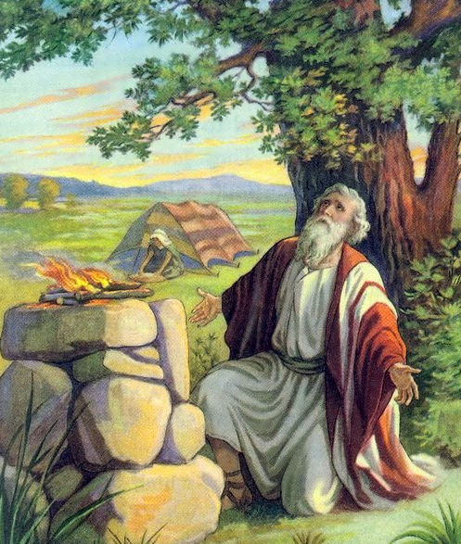
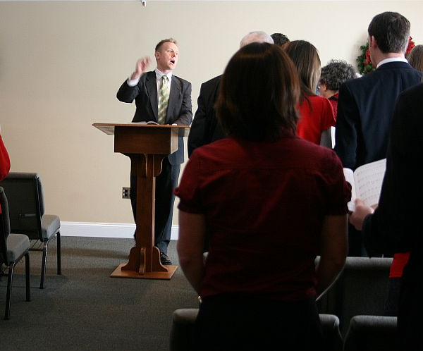
Things We Need To Know About Worshiping God
John 4:19-24

Slide 3
What Is Worship?
“to adore or pay divine honors to as deity; to reverence with supreme respect and veneration” (Webster’s Dictionary).
Worship is something we do, but more importantly, it is something that we do to or towards God.

Slide 4
What Is Worship?
God is worthy of our worship.
“Give unto the Lord the glory due to His name; worship the Lord in the beauty of holiness” (Ps. 29:2).
God seeks those who will worship Him.
This worship must be in spirit and in truth (John 4:23-24).
This worship must be acceptable to God before He will receive it (Gen. 4:4-5).

Slide 5
1. We Must Worship Only God
Exodus 20:1-6
Jeremiah 25:4-7
Matthew 4:10

Slide 6
2. We Must Worship God the Way He Instructs
Abel’s offering was respected, Cain’s was not (Gen. 4:4-5).
Nadab and Abihu were destroyed for offering strange fire (Lev. 10:1-2).

Slide 7
2. We Must Worship God the Way He Instructs
Patriarchal Age - God spoke directly to the heads of the families (Job. 42:7-9).
Law of Moses - God gave specific instructions regarding Israel’s worship (Heb. 8:5).
Church - the Lord and His apostles have given instructions regarding worship.
singing, prayers, Lord’s Supper, giving, preaching

Slide 8
2. We Must Worship God the Way He Instructs
Unacceptable worship was not allowed to go uncorrected (1 Cor. 11-14).
Lord’s Supper (11:17-34).
Conduct in the assembly (14).

Slide 9
2. We Must Worship God the Way He Instructs
We cannot offer God what we want and expect that God will be pleased (2 Kings 5:11; Is. 55:8-9).
We cannot follow the traditions, doctrines, or commands of men and expect that God will be pleased (Matt. 15:9; Col. 2:18-23).

Slide 10
3. We Must Offer Our Best
God would not accept their sacrifices because they were not their best (Mal. 1:8).
They had to offer the best (Lev. 22:19-25).
Abel offered the firstborn of his flock and their fat (Gen. 4:4).
David would not offer a sacrifice to God that did not cost him anything (2 Sam. 24:21-24).

Slide 11
3. We Must Offer Our Best
We are under a better covenant, established on better promises (Heb. 8:6), granting us a better hope (7:19), secured with a better sacrifice (9:23).
What makes us think we aren’t required to give God our best today?!

Slide 12
4. Worship Must Be Offered With Clean Hands and a Pure Heart

Slide 13
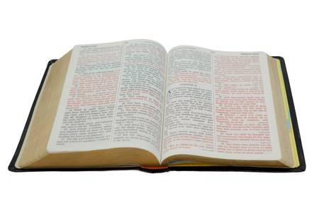
4. Worship Must Be Offered With Clean Hands and a Pure Heart
“Who may ascend into the hill of the Lord? Or who may stand in His holy place? He who has clean hands and a pure heart, who has not lifted up his soul to an idol, nor sworn deceitfully.”
Psalm 24:3-4

Slide 14
4. Worship Must Be Offered With Clean Hands and a Pure Heart
“Draw near to God and He will draw near to you. Cleanse your hands, you sinners; and purify your hearts, you double-minded.”
James 4:8

Slide 15
4. Worship Must Be Offered With Clean Hands and a Pure Heart
“Let us draw near with a true heart in full assurance of faith, having our hearts sprinkled from an evil conscience and our bodies washed with pure water.”
Hebrews 10:22

Slide 16
4. Worship Must Be Offered With Clean Hands and a Pure Heart
“If I regard iniquity in my heart, the Lord will not hear” (Psalm 66:18).
“The sacrifice of the wicked is an abomination to the Lord, but the prayer of the upright is His delight” (Proverbs 15:8).
Isaiah 1:10-17
1 Samuel 15:18-23

Slide 17
5. Worship Must Come From Our Heart

Slide 18
5. Worship Must Come From Our Heart
“pour out your heart before Him” (Ps. 62:8).
“I will praise You, O Lord my God, with all my heart, and I will glorify Your name forevermore” (86:12).
“I will praise You with my whole heart” (138:1).

Slide 19
5. Worship Must Come From Our Heart
God knows when our heart is not in it!
“These people draw near to Me with their mouth, and honor Me with their lips, but their heart is far from Me.”
Matthew 15:7

Slide 20
Offering Acceptable Worship To God
Must Worship Only God
Must Be Offered the Way God Instructs
Must Be Our Best
Must Be Offered With Clean Hands and a Pure Heart
Must Come From the Heart

