Slide 2
Assurance in Prayer
Isaiah 38:1-8

Slide 3
Prayers Are Heard and Answered

Slide 4
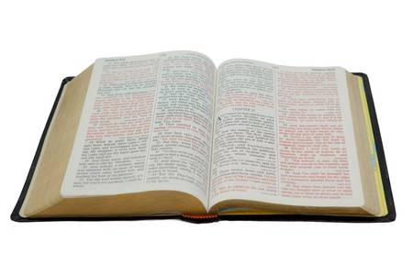
Prayers Are Heard and Answered
I sought the Lord, and He heard me, and delivered me from all my fears…
This poor man cried out, and the Lord heard him, and saved him out of all his troubles.
Psalm 34:4, 6

Slide 5
Prayers Are Heard and Answered
If you abide in Me, and My words abide in you, you will ask what you desire, and it shall be done for you.
John 15:7

Slide 6
Prayers Are Heard and Answered
Confess your trespasses to one another, and pray for one another, that you may be healed. The effective, fervent prayer of a righteous man avails much.
James 5:16

Slide 7
Prayers Are Heard and Answered
Now this is the confidence that we have in Him, that if we ask anything according to His will, He hears us.
And if we know that He hears us, whatever we ask, we know that we have the petitions that we have asked of Him.
1 John 5:14-15

Slide 8
Examples of Prayers Being Heard and Answered
Daniel - Dan. 9:20-23
The Apostles - Acts 4:31
Cornelius - Acts 10:1-4
Paul - 2 Cor. 12:8-9
The suffering saints - Rev. 5:8; 6:9-11

Slide 9
We Must Walk By Faith
The word of God gives us our faith (Rom. 10:17).
The things written aforetime give us hope and understanding (Rom. 15:4).
Prayer is an exercise of faith (Luke 18:1-8).

Slide 10
How God Works in Our World
Every good blessing comes from God (Acts 17:25; James 1:17).
God blesses all mankind in a general way (Matt. 5:45).
Time and chance happen to everyone (Eccl. 9:11).
God works through His providence to answer our prayers today (Gen. 45:4-11).
God answers prayers conditionally.
2 Cor. 12:8-9; 1 John 5:14-15; Rom. 10:1

Slide 11
…the effective, fervent prayer of a righteous man avails much.
Elijah was a man with a nature like ours, and he prayed earnestly that it would not rain; and it did not rain on the land for three years and six months.
And he prayed again, and the heaven gave rain, and the earth produced its fruit.
James 5:16-18

