Slide 2
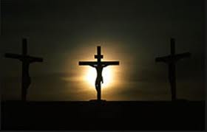
Who Do You Say That I Am?
Matt. 16:13-18
Some Thought Jesus was:
- John the Baptist
- Elijah
- Jeremiah
“Thou art the Christ, the Son of the Living God.”

Slide 3
Who Do You Say That I Am?
Matt. 16:13-18
Who do you say that I am:
- Friend / Comforter
“O Woman, Great is your Faith!”
– Matt. 15:28

Slide 4
Who Do You Say That I Am?
Matt. 16:13-18
Who do you say that I am:
- Friend / Comforter
- Servant / Leader
John 13:1-20

Slide 5
Who Do You Say That I Am?
Matt. 16:13-18
Who do you say that I am:
- Friend / Comforter
- Servant / Leader
- Teacher
“GO into all the world and proclaim the Gospel to all the World.”
- Mark 16:15

Slide 6
Who Do You Say That I Am?
Matt. 16:13-18
Who do you say that I am:
- Friend / Comforter
- Servant / Leader
- Teacher
- Savior
“Thou art the Christ, the Son of the Living God.”

