Slide 2
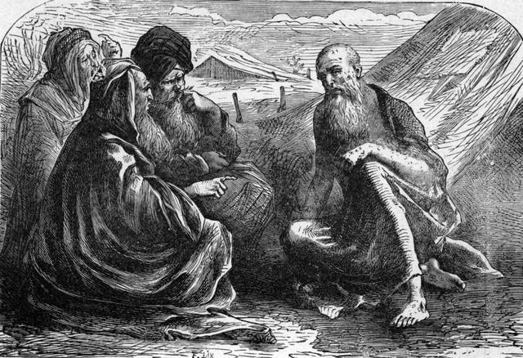
The Suffering of Job

Slide 3
Job’s Initial Suffering
He lost his wealth, children in one day (1:13-19).
He lost his health (2:7-8).
sleepless nights; cracked skin full of worms (7:4-5)
pain in his bones (30:17, 30)
lasted for months (7:3)
He lost his social standing (17:6; 30:1-11).
He lost the support of his wife and family (2:9; 19:13-19).

Slide 4
Job’s Suffering at the Hands of His Friends
Job’s three friends came to mourn with him and comfort him (2:11-13).
Job expressed his great sorrow. He wished he had never been born (chapter 3).
This begins three cycles of speeches between Job and his three friends which make up the bulk of the book.

Slide 5
Job’s Suffering at the Hands of His Friends
Job’s three friends held tightly to a false understanding of the working of God in the affairs of man.
They believed blessings and sufferings in this life were directly related to a man’s moral character.
People suffer because they have sinned against God (4:7-9).
Since Job was suffering greatly, the only logical conclusion for them was that he was a great sinner.

Slide 6
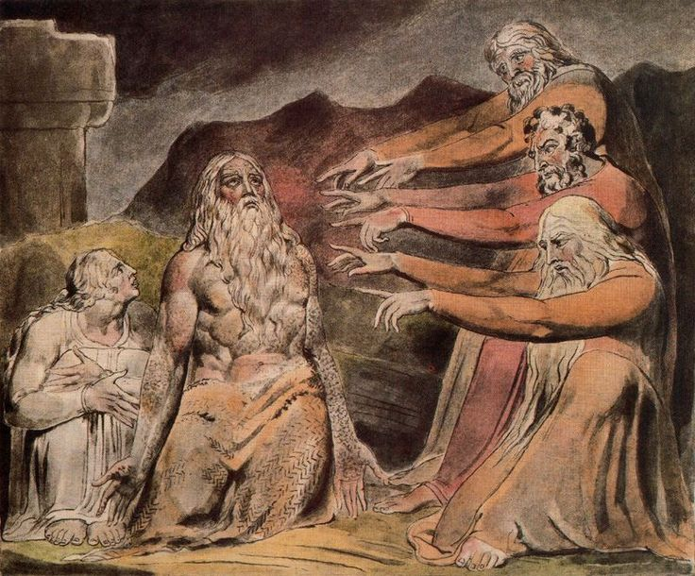
Job’s Suffering at the Hands of His Friends
Job has forgotten God and is a hypocrite (8:13).
He has trusted in riches (8:15).
He has a crafty, deceitful tongue (15:5-6).
He is abominable and filthy; drinking iniquity like water (15:16).
He has abused the poor (22:6-9).

Slide 7
Job’s Suffering at the Hands of His Friends
Bildad says Job’s children have died because of their sin (8:4).
He then insinuates that Job’s children have died because Job is a great sinner (18:19).
Zophar claims Job is getting off easy:
“Know therefore that God exacts from you less than your iniquity deserves” (11:6).

Slide 8
Job’s Suffering at the Hands of His Friends
Bildad says Job’s children have died because of their sin (8:4).
He then insinuates that Job’s children have died because Job is a great sinner (18:19).
Zophar claims Job is getting off easy:
“Know therefore that God exacts from you less than your iniquity deserves” (11:6).
“But you forgers of lies, you are all worthless physicians. Oh, that you would be silent, and it would be your wisdom!” (13:4-5)
“Miserable comforters are you all!” (16:2)

Slide 9
Helping Those Who Are Hurting
Job needed the presence of his friends (2:11-13).
Job needed to talk (Job 3).
Job needed kindness from his friends (6:14).
2 Cor. 1:3-4
Rom. 12:15; Gal. 6:2
Job needed his friends to pray for him (16:21).
James 5:16

