Slide 2
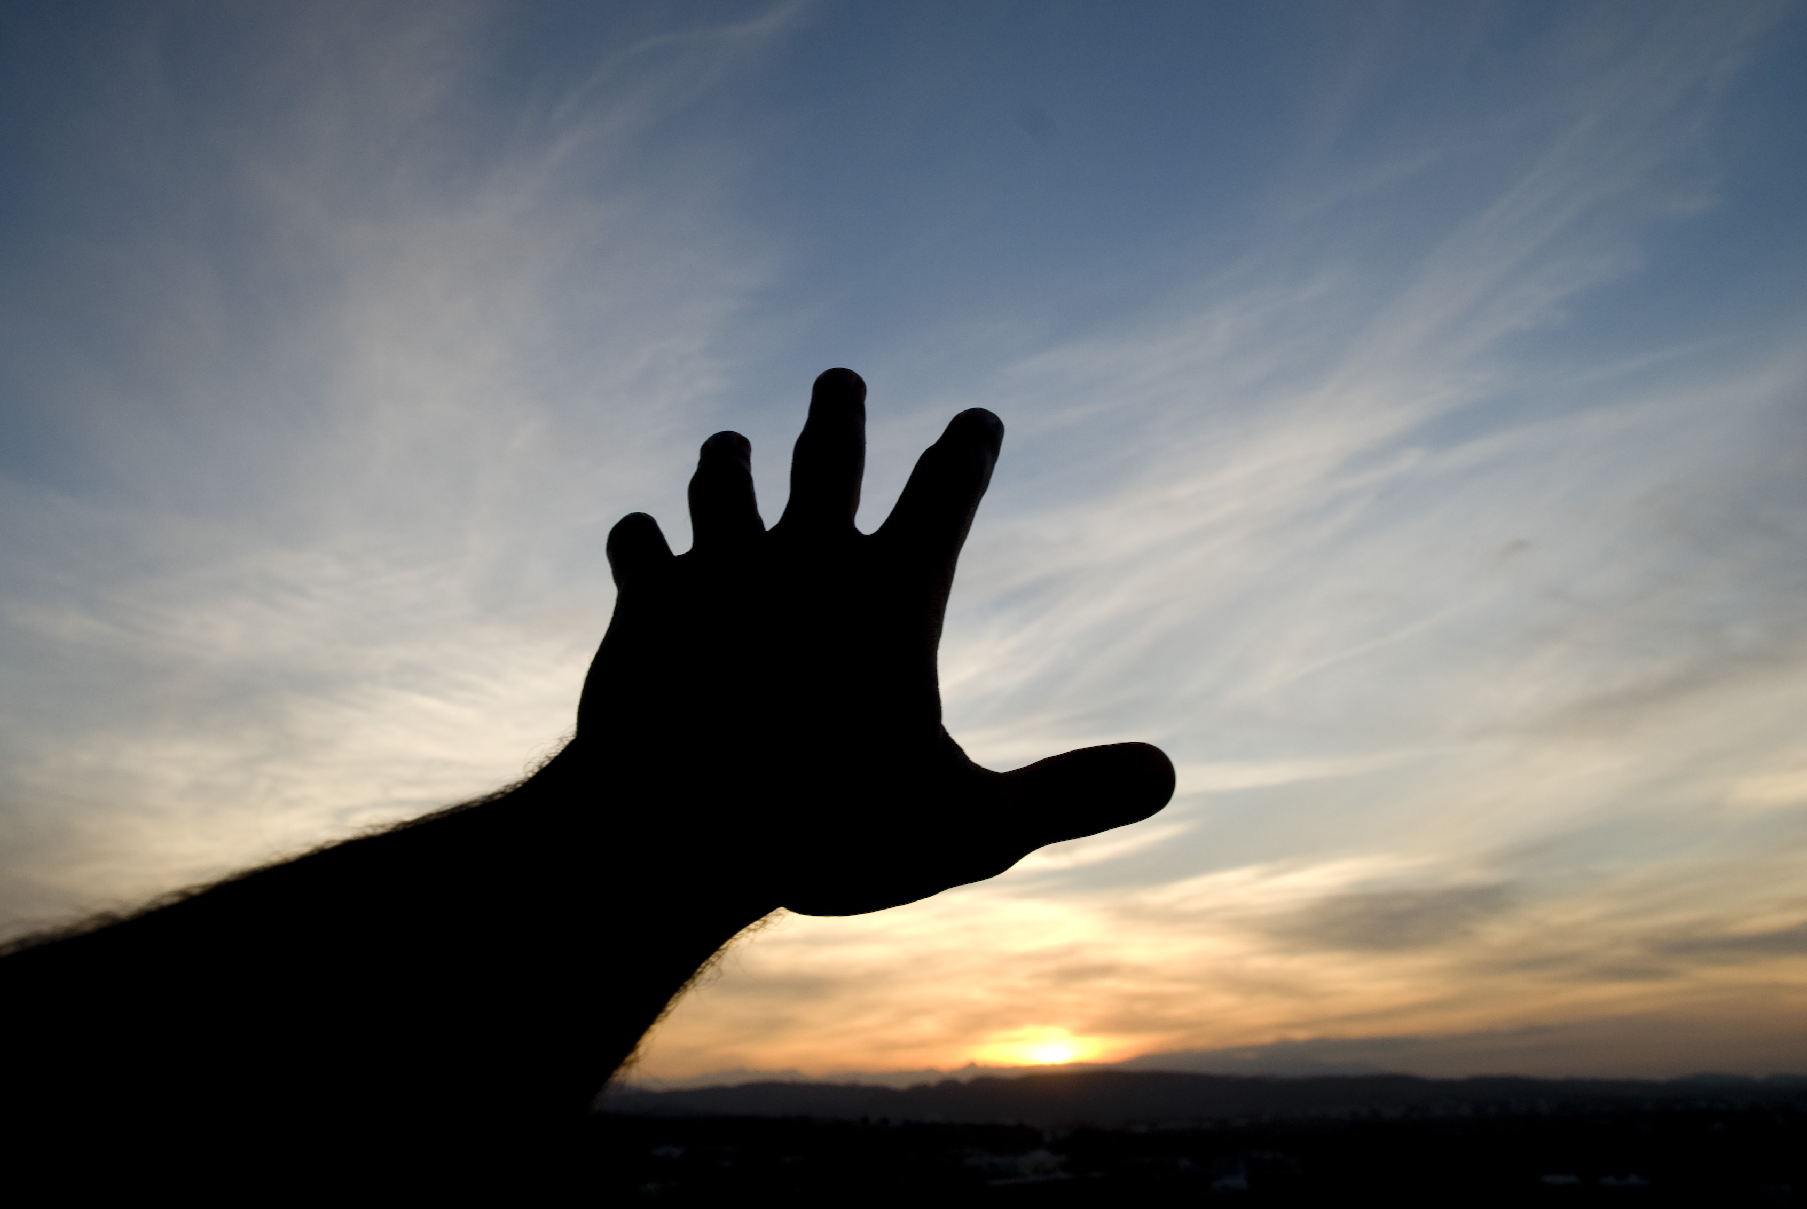
Draw near to God,
and He will draw
near to you
James 4:8

Slide 3
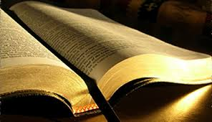
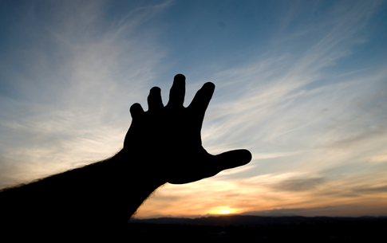
Drawing Near
to God
Balance Bible Study
First, We Must Perceive the Bible Correctly.
• We must perceive the Bible as God’s Word
Emmett F. Fields, Atheist &Bible Critic
The very fact of this debate (whether or not the Bible is God’s Word), or any debate about the Bible, is irrefutable proof that the Bible cannot be "the word of God."

Slide 4
Drawing Near
to God
Balance Bible Study
First, We Must Perceive the Bible Correctly.
• We must perceive the Bible as God’s Word
1 Thessalonians 2:13 (ESV)
13 And we also thank God constantly for this, that when you received the word of God, which you heard from us, you accepted it not as the word of men but as what it really is, the word of God, which is at work in you believers.

Slide 5
Drawing Near
to God
Balance Bible Study
First, We Must Perceive the Bible Correctly.
• We must perceive the Bible as God’s Word
2 Timothy 2:15 (NIV)
15 Do your best to present yourself to God as one approved, a worker who does not need to be ashamed and who correctly handles the word of truth.

Slide 6
Drawing Near
to God
Balance Bible Study
First, We Must Perceive the Bible Correctly.
• We must perceive the Bible as God’s Word
• We must perceive the Bible as being fully inspired
2 Timothy 3:16 (NKJV)
16 All Scripture is given by inspiration of God, and is profit-able for doctrine, for reproof, for correction, for instruction in righteousness,

Slide 7
Drawing Near
to God
Balance Bible Study
First, We Must Perceive the Bible Correctly.
Max Lucado
“For me, for years, Christianity was a moral code. It is now becoming a love affair. For years there were rules and regulations, now it’s a relationship.”
• We must perceive the Bible as God’s Word
• We must perceive the Bible as being fully inspired
• We must perceive the Bible as a book of law

Slide 8
Drawing Near
to God
Balance Bible Study
Glen Owen
“Nobody has any right to preach anything other than the Gospel of pure grace. We are saved by grace plus nothing. You are saved by faith period. There is nothing you can do to be saved. There are no rules; there are no regulations in serving Jesus Christ.”
First, We Must Perceive the Bible Correctly.
• We must perceive the Bible as God’s Word
• We must perceive the Bible as being fully inspired
• We must perceive the Bible as a book of law

Slide 9
Drawing Near
to God
Balance Bible Study
First, We Must Perceive the Bible Correctly.
Romans 8:2 (ESV)
2 For the law of the Spirit of life has set you free in Christ Jesus from the law of sin and death.
• We must perceive the Bible as God’s Word
• We must perceive the Bible as being fully inspired
• We must perceive the Bible as a book of law

Slide 10
Drawing Near
to God
Balance Bible Study
First, We Must Perceive the Bible Correctly.
1 Corinthians 9:21 (ESV)
21 To those outside the law I became as one outside the law (not being outside the law of God but under the law of Christ) that I might win those outside the law.
• We must perceive the Bible as God’s Word
• We must perceive the Bible as being fully inspired
• We must perceive the Bible as a book of law

Slide 11
Drawing Near
to God
Balance Bible Study
First, We Must Perceive the Bible Correctly.
Webster’s Collegiate Dictionary
“a rule of conduct or action prescribed or formally recognized as binding or enforced by a controlling authority.”
• We must perceive the Bible as God’s Word
• We must perceive the Bible as being fully inspired
• We must perceive the Bible as a book of law

Slide 12
Drawing Near
to God
Balance Bible Study
Second, We Must Probe the Bible Consistently.
2 Timothy 2:15 (NIV, ESV, RSV, NRSV)
15 Do your best to present yourself to God as one approved…
2 Timothy 2:15 (NKJV, NASB, ASV, Etc.)
¹⁵ Be diligent to present yourself approved to God…
2 Timothy 2:15 (KJV) ¹⁵ Study to shew thyself approved unto God…

Slide 13
Drawing Near
to God
Balance Bible Study
Second, We Must Probe the Bible Consistently.
Romans 10:17 (ESV)
17 So faith comes from hearing, and hearing through the word of Christ.

Slide 14
Drawing Near
to God
Balance Bible Study
Second, We Must Probe the Bible Consistently.
The Average Will Spend...
1 year looking for misplaced objects?
2 years on the internet
4 years doing housework?
51/2 years driving a car
71/2 years listening to the radio
10 years in front of television
70 days reading the Bible

Slide 15
Drawing Near
to God
Balance Bible Study
Second, We Must Probe the Bible Consistently.
Matthew 6:33 (ESV)
33 But seek first the kingdom of God and his righteousness, and all these things will be added to you.

Slide 16
Drawing Near
to God
Balance Bible Study
Second, We Must Probe the Bible Consistently.
The Complete Biblical Library Greek-English Dictionary
“To seek in this way is to diligently, earnestly, and tenaciously search after something, sparing no effort or expense, for the sought object is valued to the highest degree. Likewise, believers are to seek God in the same way.”

Slide 17
Drawing Near
to God
Balance Bible Study
Third, We Must Practice the Bible Constantly.
James 4:17 (NKJV)
17 Therefore, to him who knows to do good and does not do it, to him it is sin.

Slide 18
Drawing Near
to God
Balance Bible Study
Third, We Must Practice the Bible Constantly.
Joshua 1:8 (ESV)
8 This Book of the Law shall not depart from your mouth, but you shall meditate on it day and night, so that you may be careful to do according to all that is written in it. For then you will make your way prosperous, and then you will have good success.

Slide 19
Drawing Near
to God
Balance Bible Study
First, We Must Perceive the Bible Correctly
Second, We Must Probe the Bible Consistently
Third, We Must Practice the Bible Constantly

