Slide 2
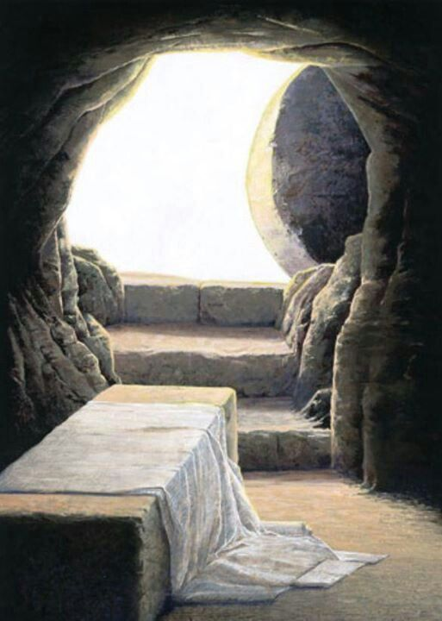
The Significance of the Lord’s Resurrection
Luke 24:1-12

Slide 3
The Resurrection Is Important!
It was a part of the gospel that was preached to the world (1 Cor. 15:3-4).
It was a subject of OT prophecy, a part of God’s scheme of redemption (Acts 2:24-31).
It was witnessed and proclaimed by many people (Acts 2:32; 1 Cor. 15:5-8).
Many sermons in Acts emphasize the resurrection.

Slide 4
1. Proves Jesus is the Son of God

Slide 5
1. Proves Jesus is the Son of God
Concerning His Son Jesus Christ our Lord, who was born of the seed of David according to the flesh, and declared to be the Son of God with power according to the Spirit of holiness, by the resurrection from the dead.
Romans 1:3-4

Slide 6
1. Proves Jesus is the Son of God
Jesus claimed He was going to rise from the dead (Luke 24:6-7).
Moses set forth the test of a true prophet (Deut. 18:18-22).
When Jesus raised from the dead, it proved He was who He claimed to be.
His enemies understood this (Matt. 27:62-64).

Slide 7
2. Proves the Validity of Our Faith
1 Corinthians 15:12-19
Gospel preaching is empty (v. 14).
Our faith is empty (v. 14).
The apostles were liars (v. 15).
We are still in our sins (v. 17).
The dead have perished (v. 18).
Christians are the most pitiful people in the world (v. 19).

Slide 8
3. Proves Jesus’ Power Over Satan
And I will put enmity between you and the woman, and between your seed and her Seed; He shall bruise your head, and you shall bruise His heel.
Genesis 3:15
Inasmuch then as the children have partaken of flesh and blood, He Himself likewise shared in the same, that through death He might destroy him who had the power of death, that is, the devil.
Hebrews 2:14

Slide 9
4. Proves Jesus’ Power Over Sin and Death
Whom God raised up, having loosed the pains of death, because it was not possible that He should be held by it.
Acts 2:24

Slide 10
4. Proves Jesus’ Power Over Sin and Death
Jesus is the firstborn from the dead (Col. 1:18) in that He rose from the dead to die no more (Rom. 6:9).
Jesus has authority over death and the realm of the dead (Rev. 1:18).
Jesus is Lord over all by His death and resurrection (Rom. 14:9).

Slide 11
5. Proves Our Victory Over Satan, Sin, and Death
Jesus said to her, “I am the resurrection and the life. He who believes in Me, though he may die, he shall live. And whoever lives and believes in Me shall never die. Do you believe this?”
John 11:25-26

Slide 12
5. Proves Our Victory Over Satan, Sin, and Death
Who has saved us and called us with a holy calling, not according to our works, but according to His own purpose and grace which was given to us in Christ Jesus before time began,
but has now been revealed by the appearing of our Savior Jesus Christ, who has abolished death and brought life and immortality to light through the gospel.
2 Timothy 1:9-10

Slide 13
5. Proves Our Victory Over Satan, Sin, and Death
The sting of death is sin, and the strength of sin is the law.
But thanks be to God, who gives us the victory through our Lord Jesus Christ.
1 Corinthians 15:56-57

Slide 14
Because He Lives…
I KNOW Jesus is the Son of God!
I KNOW my faith is real!
I KNOW Jesus has power over Satan!
I KNOW Jesus has power over sin and death!
I KNOW I have victory over Satan, sin, and death!

