Slide 2
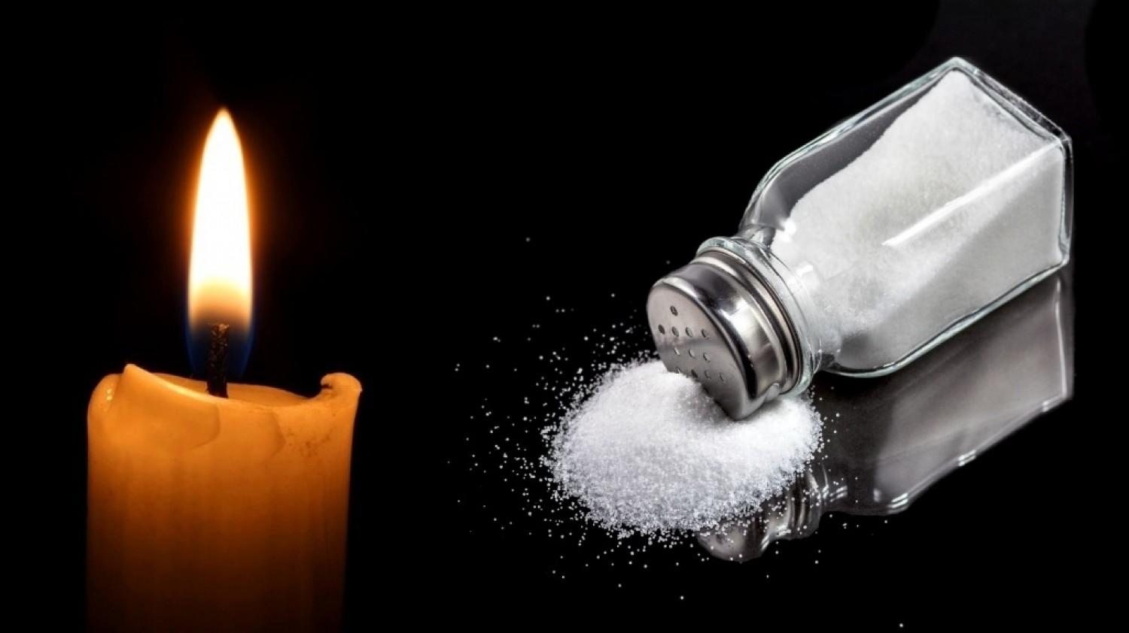
Be Salt and Light
Matthew 5:13-16

Slide 3
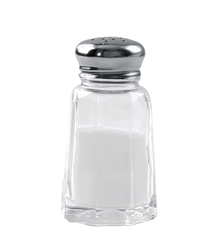
1. SALT
Salt is a Preservative
Gen. 18:22-33; Jer. 5:1
Salt Enhances Flavor
Job 6:6; Col. 4:5-6; Matt. 5:9, 43-48
Salt Creates Thirst
Acts 11:22-24; John 1:43-46

Slide 4
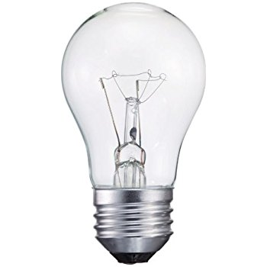
2. LIGHT
Light Reveals and Illuminates
Psalm 119:130
Light Provides Guidance
Psalm 119:105
Light Drives Away Darkness
John 3:19-20
Light Attracts Those Wanting To Come Out Of Darkness
John 3:21; Luke 19:10

Slide 5
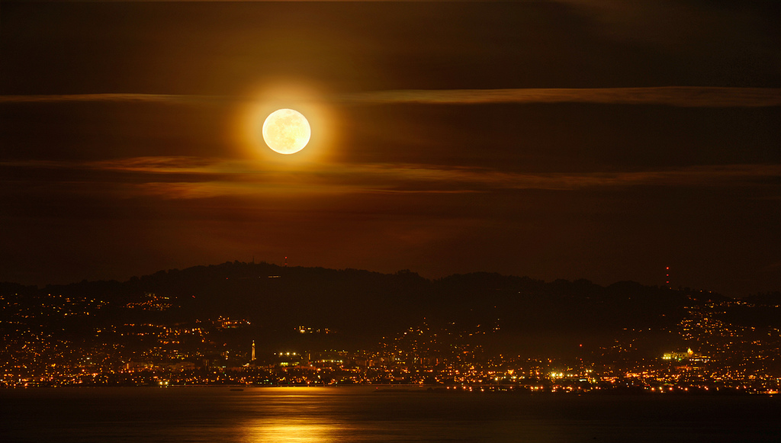

Slide 6
We Must Protect Our Influence

Slide 7
We Must Protect Our Influence
“Salt is good; but if the salt has lost its flavor, how shall it be seasoned?
It is neither fit for the land nor for the dunghill, but men throw it out. He who has ears to hear, let him hear!”
Luke 14:34-35

Slide 8
We Must Protect Our Influence
“Nevertheless the solid foundation of God stands, having this seal: ‘The Lord knows those who are His,’ and, ‘Let everyone who names the name of Christ depart from iniquity.’”
2 Timothy 2:19

Slide 9
We Must Protect Our Influence
“But Daniel purposed in his heart that he would not defile himself…”
Daniel 1:8

Slide 10
We Must Protect Our Influence
“A good name is to be chosen rather than great riches, loving favor rather than silver and gold.”
Proverbs 22:1

Slide 11
Be Salt and Light
Matthew 5:13-16

