Slide 2
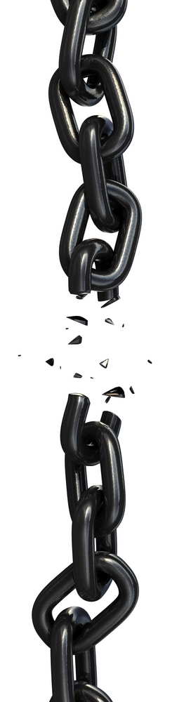
Our Faith Can Fail
Luke 22:32

Slide 3
Failure of Faith is a Reality

Slide 4
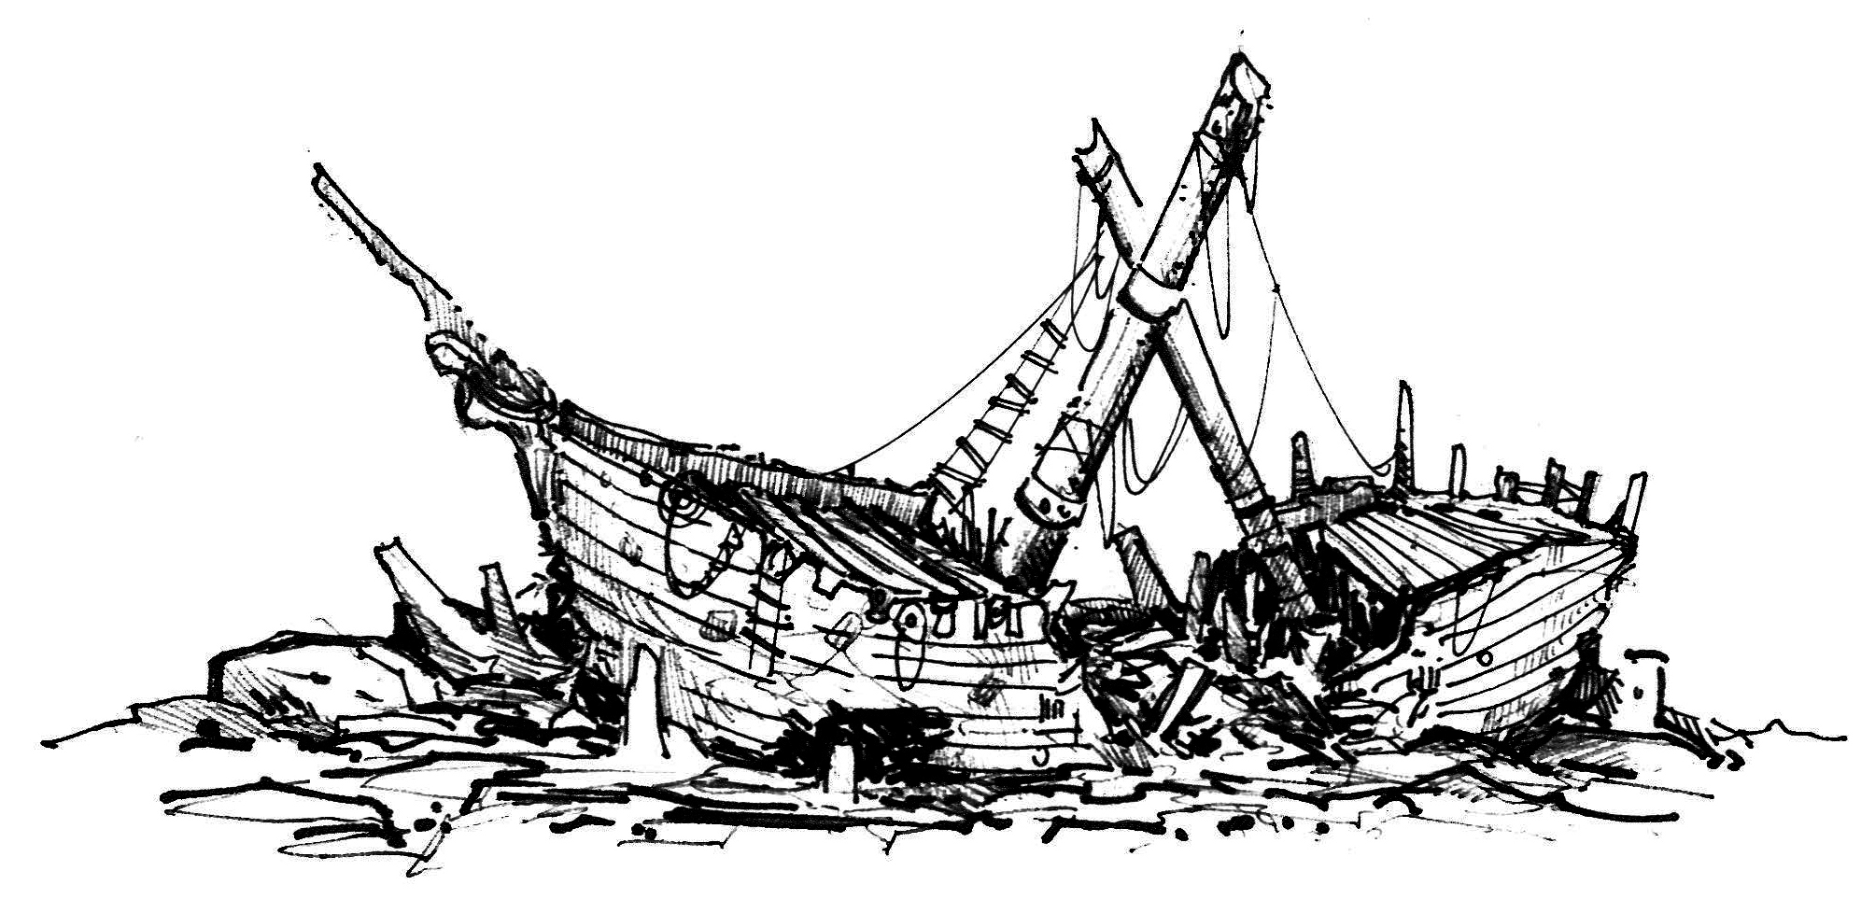
Failure of Faith is a Reality
Suffer Shipwreck - 1 Tim. 1:19

Slide 5
Failure of Faith is a Reality
Suffer Shipwreck - 1 Tim. 1:19
Properly trained, the conscience is the Christian’s rudder.
When we have lost respect for the truth and for our conscience, we have disengaged our spiritual rudder.
Without our spiritual rudder, we are “lost at sea,” subject to waves, and will eventually be thrown against the rocks.

Slide 6
Failure of Faith is a Reality
Suffer Shipwreck - 1 Tim. 1:19
Depart from the Faith - 1 Tim. 4:1

Slide 7
Failure of Faith is a Reality
Suffer Shipwreck - 1 Tim. 1:19
Depart from the Faith - 1 Tim. 4:1
“Depart” is translated from aphistemi, which means to instigate a revolt, to desert or defect.
Our English word “apostatize” comes from this word.

Slide 8
Failure of Faith is a Reality
Suffer Shipwreck - 1 Tim. 1:19
Depart from the Faith - 1 Tim. 4:1
Denied the Faith - 1 Tim. 5:8

Slide 9
Failure of Faith is a Reality
Suffer Shipwreck - 1 Tim. 1:19
Depart from the Faith - 1 Tim. 4:1
Denied the Faith - 1 Tim. 5:8
When one purposefully fails to fulfill the obligations his faith has placed upon him, he has denied the faith.

Slide 10
Failure of Faith is a Reality
Suffer Shipwreck - 1 Tim. 1:19
Depart from the Faith - 1 Tim. 4:1
Denied the Faith - 1 Tim. 5:8
Cast Off Their First Faith - 1 Tim. 5:11-12

Slide 11
Failure of Faith is a Reality
Suffer Shipwreck - 1 Tim. 1:19
Depart from the Faith - 1 Tim. 4:1
Denied the Faith - 1 Tim. 5:8
Cast Off Their First Faith - 1 Tim. 5:11-12
“to abandon, to set aside”
This is a purposeful action; casting aside their faith to pursue passions and sin.

Slide 12
Failure of Faith is a Reality
Suffer Shipwreck - 1 Tim. 1:19
Depart from the Faith - 1 Tim. 4:1
Denied the Faith - 1 Tim. 5:8
Cast Off Their First Faith - 1 Tim. 5:11-12
Strayed from the Faith - 1 Tim. 6:10

Slide 13
Failure of Faith is a Reality
Suffer Shipwreck - 1 Tim. 1:19
Depart from the Faith - 1 Tim. 4:1
Denied the Faith - 1 Tim. 5:8
Cast Off Their First Faith - 1 Tim. 5:11-12
Strayed from the Faith - 1 Tim. 6:10
apoplanao – “to wander”
“Planet” comes from this word.
Originally referred to the heavenly bodies that wandered against the fixed background of the stars.

Slide 14
How To Prevent a Failure of Faith
Realize We Can Fail - 1 Cor. 10:12; 1 Pet. 5:8
Feed Our Faith
Rom. 10:17; 1 Pet. 2:2; 1 Tim. 4:6; Ps. 1:1-3
Exercise Our Faith
1 Tim. 4:7-8; Heb. 5:12-14; Matt. 13:12
Strengthen Our Faith
Eccl. 4:9-12; Heb. 3:12-13; 10:24-25
Protect Our Faith
Against False Doctrine - 1 Tim. 4:1
Against Sin - 1 Tim. 1:19; 5:8, 11-13; 6:10

Slide 15
How To Prevent a Failure of Faith
Realize We Can Fail - 1 Cor. 10:12; 1 Pet. 5:8
Feed Our Faith
Rom. 10:17; 1 Pet. 2:2; 1 Tim. 4:6; Ps. 1:1-3
Exercise Our Faith
1 Tim. 4:7-8; Heb. 5:12-14; Matt. 13:12
Strengthen Our Faith
Eccl. 4:9-12; Heb. 3:12-13; 10:24-25
Protect Our Faith
Against False Doctrine - 1 Tim. 4:1
Against Sin - 1 Tim. 1:19; 5:8, 11-13; 6:10
Suffer Shipwreck - 1 Tim. 1:19
Depart from the Faith - 1 Tim. 4:1
Denied the Faith - 1 Tim. 5:8
Cast Off Their First Faith - 1 Tim. 5:11-12
Strayed from the Faith - 1 Tim. 6:10

Slide 16
How To Prevent a Failure of Faith
Realize We Can Fail
Feed Our Faith
Exercise Our Faith
Strengthen Our Faith
Protect Our Faith
“Be faithful until death, and I will give you the crown of life.” Revelation 2:10

