Slide 2
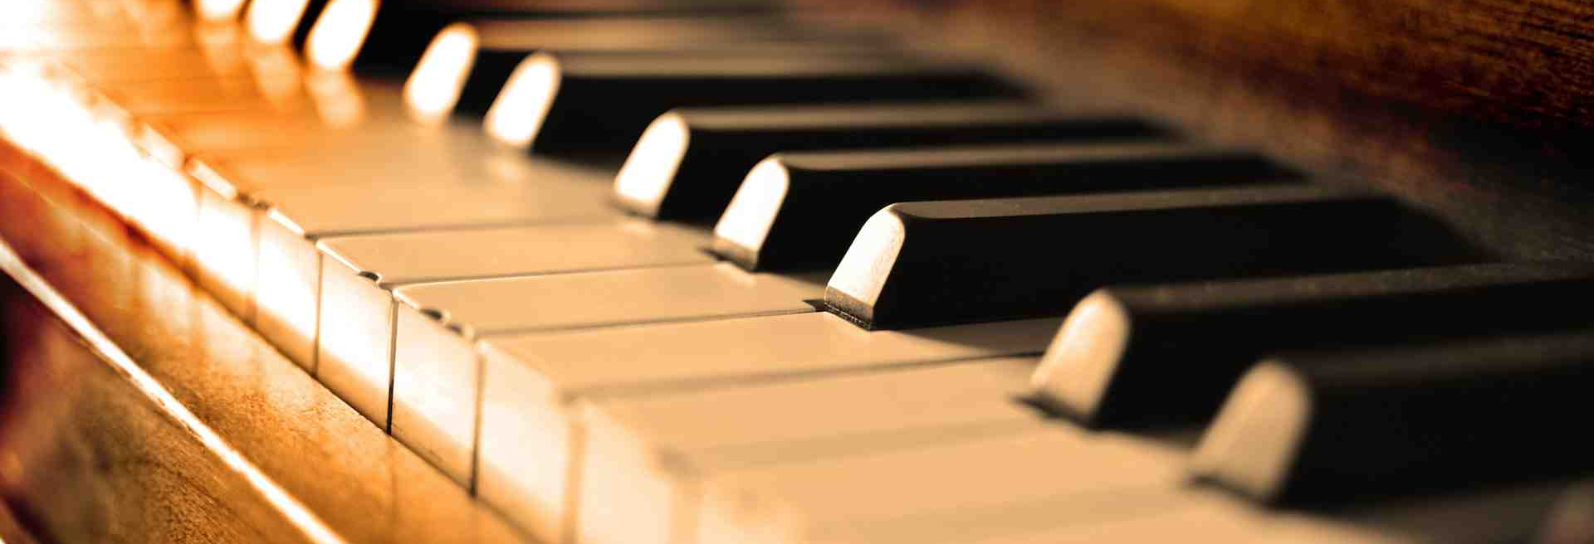
Why We Oppose the Use of Musical Instruments in Worship

Slide 3
1. We Are Told To Sing

Slide 4
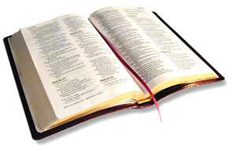
1. We Are Told To Sing
Matthew 26:30
Mark 14:26
Acts 16:25
Romans 15:9
1 Corinthians 14:15
Ephesians 5:19
Colossians 3:16
Hebrews 2:12, 13:15
James 5:13

Slide 5
1. We Are Told To Sing
“Whoever transgresses and does not abide in the doctrine of Christ does not have God…” (2 John 9)

Slide 6
1. We Are Told To Sing
“sing”
“Whoever transgresses and does not abide in the doctrine of Christ does not have God…” (2 John 9)

Slide 7
1. We Are Told To Sing
musical instruments
“sing”
“Whoever transgresses and does not abide in the doctrine of Christ does not have God…” (2 John 9)

Slide 8
2. Instruments Are Not Authorized

Slide 9
2. Instruments Are Not Authorized
“Show me where the Bible says, ‘Thou shalt not use instruments?’”

Slide 10
2. Instruments Are Not Authorized
“Show me where the Bible says, ‘Thou shalt not use instruments?’”
“Where does the Bible say that we can use musical instruments?”

Slide 11
2. Instruments Are Not Authorized
Hebrews 7:12-14 - silence of Scripture is prohibitive, not permissive.
Genesis 6:14-16 - gopher wood automatically excluded all other types of wood.
Numbers 19:2 - animal specified by God automatically excluded all other animals.
“Singing” automatically excludes all other types of music.

Slide 12
3. Historical Evidence Argues Against the Use of the Instrument
“The use of organs in churches is ascribed to Pope Vitalian (657-672)… The attitude of the churches toward the organ varies… The Greek church disapproved the use of organs. The Latin church introduced it pretty generally, but not without the protest of eminent men, so that even in the Council of Trent a motion was made, though not carried, to prohibit the organ at least in the mass.”
Schaff, History of the Christian Church, vol. 4, p. 4309

Slide 13
3. Historical Evidence Argues Against the Use of the Instrument
“…as a general rule, the use of instruments in worship was condemned. Many of the fathers, speaking of religious song, make no mention of instruments; others like Clement of Alexandria and St. Chrysostom, refer to them only to denounce them.”
Edwin Dickinson, History of Music in the Western Church, p. 54

Slide 14
3. Historical Evidence Argues Against the Use of the Instrument
“Musical instruments, in celebrating the praises of God would be no more suitable than the burning of incense, the lighting up of lamps, and the restoration of the other shadows of the law. The papists, therefore, have foolishly borrowed this, as well as many of other things, from the Jews. Men who are fond of outward pomp may delight in that noise, but the simplicity which God recommends to us by the apostle is far more pleasing to Him.”
John Calvin, founder of Presbyterian Church

Slide 15
3. Historical Evidence Argues Against the Use of the Instrument
“It has been proved, by an appeal to historical facts, that the church, although lapsing more and more into defection from the truth and into a corruption of apostolic practice, had no instrumental music for twelve hundred years; and that the Calvinistic Reformed Church ejected it from its services as an element of Popery, even the Church of England having come very nigh to its extrusion from her worship.”

Slide 16
3. Historical Evidence Argues Against the Use of the Instrument
“The historical argument, therefore, combines with the Scriptural and the confessional to raise a solemn and powerful protest against its employment by the Presbyterian Church. It is heresy in the sphere of worship”
John Girardeau (Presbyterian)
“Instrumental Music,” p. 179

Slide 17
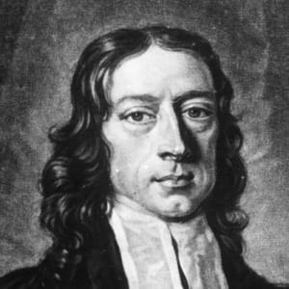
3. Historical Evidence Argues Against the Use of the Instrument
“I have no objection to instruments of music in our chapels, provided they are neither heard nor seen.”
John Wesley, founder of Methodist Church
Clarke’s Commentary, vol. 4, p. 684

Slide 18
3. Historical Evidence Argues Against the Use of the Instrument
“What a degradation to supplant the intelligent song of the whole congregation by the theatrical prettinesses of a quartette, the refined niceties of a choir, or the blowing off of wind from inanimate bellows and pipes! We might as well pray by machinery as praise by it.”
Charles Spurgeon, Baptist (1833-1892)

Slide 19
3. Historical Evidence Argues Against the Use of the Instrument
The word “a cappella” is a strong argument against the use of musical instruments in worship.
It comes from a Latin word that literally means “in chapel style.”
ad – according to
capella – chapel
This is the kind of music one would find in the chapel as God was being worshipped.

Slide 20
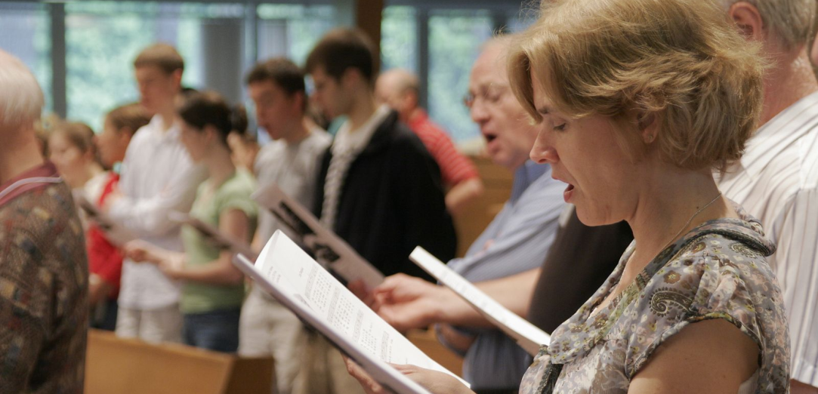
Why We Oppose Instrumental Music in Worship To God
It is not authorized in the New Testament.
We are told to “sing.” Anything else is beyond the limitations of the doctrine of Christ.
In addition to the teaching of Scripture, secular history argues strongly against the use of the instrument.

