Slide 2
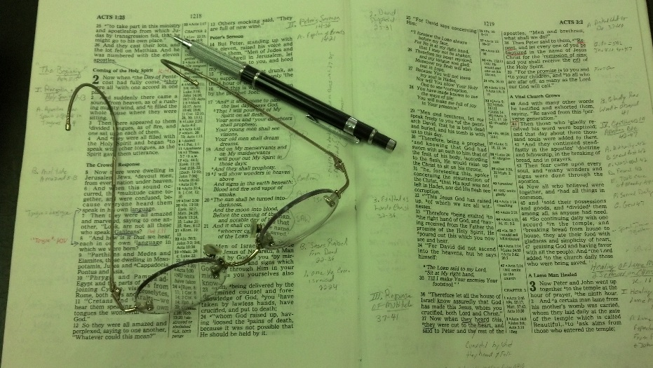
Topics
Wednesday: Will Christ Reign on Earth for 1000 Yrs?
Thursday: The Seduction of Joseph
Friday: Selling and Stirring

Slide 3
Gospel Message
Is A
Redemptive Message

Slide 4
The
Blood
Of
Christ

Slide 5
I. The Story of His Crucifixion
Death of a Criminal (Matt. 27:38)
Nails in His Hands (John 20:25)
The Blood Of Christ

Slide 6
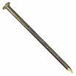
Nails
16d Framing Nail
5-7 in long
3/8 in diameter

Slide 7
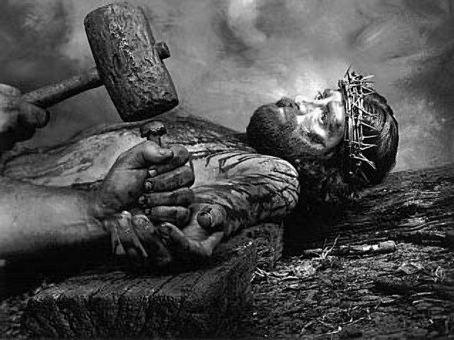

Slide 8
I. The Story of His Crucifixion
“But when they came to Jesus and saw that
He was already dead, they did not break
His legs. But one of the soldiers pierced
His side with a spear, and immediately
blood and water came out.”
(John 19:33-34)
Death of a Criminal (Matt. 27:38)
Nails in His Hands (John 20:25)
Nails in His Feet
Pierced His Side (John 19:34)
The Blood Of Christ

Slide 9
I. The Story of His Crucifixion
II. Why His Blood Was Shed
The Blood Of Christ

Slide 10
A. Sin Demanded That A Price Be Paid
Sin (violation of law) demands a penalty for sin
Man cannot pay
God has always demanded blood sacrifices
Reason: Life is in the blood (Gen. 9:4;Lev. 17:1- 14; Deut. 12:23)
Animal blood will not work (Heb. 10:4)
Perfect Sacrifice - Blood of Christ (1 Pet. 1:19)

Slide 11
B. Saved By The Blood
Remits sin (Matt. 26:28; Heb. 9:22)
Washes (Rev. 1:5)
Cleanses (1 John 1:7)
Redeems (Eph. 1:7; Col. 1:14;1 Pet. 1:18-19)
Forgives (Eph. 1:7; Col. 1:14)
Makes Peace (Col. 1:20)
Makes Nigh (Eph. 2:13)
Sanctifies (Heb. 10:29; 13:12)
Justifies (Rom. 5:9)
Purges Our Conscience (Heb. 9:14)
Reconciles (Col. 1:20; Eph. 2:15-16)

Slide 12
C. His Blood Had To Be Offered
As our High Priest - Offer Blood in Heaven
“Not with the blood of goats and calves, but with His own blood He entered the Most Holy Place once for all, having obtained eternal redemption.” (Heb. 9:12)
“For Christ has not entered the holy places made with hands, which are copies of the true, but into heaven itself, now to appear in the presence of God for us.” (Heb. 9:24)

Slide 13
C. His Blood Had To Be Offered
As our High Priest - Offer Blood in Heaven
Saved by His Life (Resurrected Life)
“who was delivered up because of our offenses, and was raised because of our justification”. (Rom. 4:25)
“... we shall be saved by His life.”. (Rom. 5:10)

Slide 14
I. The Story of His Crucifixion
II. Why His Blood Was Shed
III. For Whom It Was Shed
The Blood Of Christ

Slide 15
All Men
“But we see Jesus, who was made a little lower than the angels, for the suffering of death crowned with glory and honor, that He, by the grace of God, might taste death for everyone” (Heb. 2:9)

Slide 16
All Men
“My little children, these things I write to you, so that you may not sin. And if anyone sins, we have an Advocate with the Father, Jesus Christ the righteous. And He Himself is the propitiation for our sins, and not for ours only but also for the whole world.” (1 John 2:1-2)

Slide 17
All Men
“For the love of Christ compels us, because we judge thus: that if One died for all, then all died.” (2 Cor. 5:14)

Slide 18
All Men
Those Under The Old Test.
“whom God set forth as a propitiation by His blood, through faith, to demonstrate His righteousness, because in His forbearance God had passed over the sins that were previously committed.” (Rom. 3:25)

Slide 19
All Men
Those Under The Old Test.
“And for this reason He is the Mediator of the new covenant, by means of death, for the redemption of the transgressions under the first covenant, that those who are called may receive the promise of the eternal inheritance.”
(Heb. 9:15)

Slide 20
I. The Story of His Crucifixion
II. Why His Blood Was Shed
III. For Whom It Was Shed
IV. The Blood Must Be Applied
The Blood Of Christ

Slide 21
The Blood Applied
For All - But All Not Saved
Matt 7:13-14, 21
13 "Enter by the narrow gate; for wide is the gate and broad is the way that leads to destruction, and there are many who go in by it.
14 Because narrow is the gate and difficult is the way which leads to life, and there are few who find it.
21 "Not everyone who says to Me, 'Lord, Lord,' shall enter the kingdom of heaven, but he who does the will of My Father in heaven.

Slide 22
The Blood Applied
For All - But All Not Saved
Salvation in Christ

Slide 23
Baptized Into
Gal.3:27
1 Cor. 12:13
Redeemed in Him Blood
(Eph. 1:7)
Made Near in Christ by Blood
(Eph. 2:13)
Reconciled in one body by Cross
(Eph. 2:16)

Slide 24
The Blood Applied
For All - But All Not Saved
Salvation in Christ
Blood is What / Obedience is When

Slide 25
Blood
Rev. 1:5
Matt. 26:28
Washed
Remission
of Sins
Baptism
Acts 22:16
Acts 2:38
What
When

Slide 26
I. The Story of His Crucifixion
II. Why His Blood Was Shed
III. For Whom It Was Shed
IV. The Blood Must Be Applied
V. Church Purchased With Blood
The Blood Of Christ

Slide 27
Price Paid For The Church
“Therefore take heed to yourselves and to all the flock, among which the Holy Spirit has made you overseers, to shepherd the church of God which He purchased with His own blood.”
(Acts 20:28)

Slide 28
We’ve Been Purchased
“knowing that you were not redeemed with corruptible things, like silver or gold, from your aimless conduct received by tradition from your fathers, but with the precious blood of Christ, as of a lamb without blemish and without spot.”
(1 Pet. 1:18-19)

Slide 29
We’ve Been Purchased
“Or do you not know that your body is the temple of the Holy Spirit who is in you, whom you have from God, and you are not your own? For you were bought at a price; therefore glorify God in your body and in your spirit, which are God's.”
(1 Cor. 6:19-20)

Slide 30
I. The Story of His Crucifixion
II. Why His Blood Was Shed
III. For Whom It Was Shed
IV. The Blood Must Be Applied
V. Church Purchased With Blood
VI. N.T. Dedicated by Blood
The Blood Of Christ

Slide 31
15 ¶ And for this reason He is the Mediator of the new covenant, by means of death, for the redemption of the transgressions under the first covenant, that those who are called may receive the promise of the eternal inheritance.
16 For where there is a testament, there must also of necessity be the death of the testator.
17 For a testament is in force after men are dead, since it has no power at all while the testator lives.

Slide 32
18 Therefore not even the first covenant was dedicated without blood.
19 For when Moses had spoken every precept to all the people according to the law, he took the blood of calves and goats, with water, scarlet wool, and hyssop, and sprinkled both the book itself and all the people,
20 saying, "This is the blood of the covenant which God has commanded you

Slide 33
I. The Story of His Crucifixion
II. Why His Blood Was Shed
III. For Whom It Was Shed
IV. The Blood Must Be Applied
V. Church Purchased With Blood
VI. N.T. Dedicated by Blood
VII. Memorial of His Blood
The Blood Of Christ

Slide 34
The Lord’s Supper
(A Memorial)
“... Take, eat; this is My body which is broken for you; do this in remembrance of Me.….This cup is the new covenant in My blood. This do, as often as you drink it, in remembrance of Me….For as often as you eat this bread and drink this cup, you proclaim the Lord's death till He comes.”
(1 Cor. 11:23-26)

Slide 35
The Lord’s Supper
(A Memorial)
26 ¶ And as they were eating, Jesus took bread, blessed and broke it, and gave it to the disciples and said, "Take, eat; this is My body."
27 Then He took the cup, and gave thanks, and gave it to them, saying, "Drink from it, all of you.
28 "For this is My blood of the new covenant, which is shed for many for the remission of sins.
(Matt. 26:26-28)

Slide 36
I. The Story of His Crucifixion
II. Why His Blood Was Shed
III. For Whom It Was Shed
IV. The Blood Must Be Applied
V. Church Purchased With Blood
VI. N.T. Dedicated by Blood
VII. Memorial of His Blood
VIII. Show Respect For Blood
By How We Live
The Blood Of Christ

Slide 37
Heb. 10:26-29
26 For if we sin willfully after we have received the knowledge of the truth, there no longer remains a sacrifice for sins,
27 but a certain fearful expectation of judgment, and fiery indignation which will devour the adversaries.
28 Anyone who has rejected Moses' law dies without mercy on the testimony of two or three witnesses.
29 Of how much worse punishment, do you suppose, will he be thought worthy who has trampled the Son of God underfoot, counted the blood of the covenant by which he was sanctified a common thing, and insulted the Spirit of grace?

Slide 38
I. The Story of His Crucifixion
II. Why His Blood Was Shed
III. For Whom It Was Shed
IV. The Blood Must Be Applied
V. Church Purchased With Blood
VI. N.T. Dedicated by Blood
VII. Memorial of His Blood
VIII. Show Respect For Blood
By How We Live
The Blood Of Christ

