Slide 2
Things Parents Provide For Their Children

Slide 3
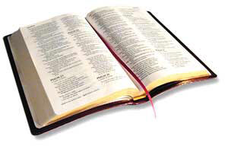
Parents Must Provide
“But if anyone does not provide for his relatives, and especially for members of his household, he has denied the faith and is worse than an unbeliever.”
1 Timothy 5:8, English Standard Version

Slide 4
1. Physical Necessities
1 Timothy 5:8
2 Thess. 3:10
Matt. 6:25-26
Matt. 7:9-11
Prov. 31:15, 21

Slide 5
2. Training and Discipline
Prov. 22:6
Gen. 18:19
Deut. 6:6-9
Eph. 6:4
Discipline must be done in love (Prov. 13:24).
Must be timely (Prov. 19:18).
Bad behaviors must be corrected (Prov. 22:15).

Slide 6
3. Good Example
Matt. 5:16
Phil. 3:17
Matt. 23:3

Slide 7
4. Stability
Luke 2:52
1 Cor. 13:4-7
Eph. 6:4
Mal. 2:13-16

Slide 8
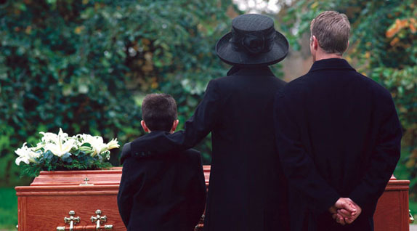
5. Comfort in Our Death
1 Thess. 4:13-18

Slide 9
Parents Must Provide
“But if anyone does not provide for his relatives, and especially for members of his household, he has denied the faith and is worse than an unbeliever.”
1 Timothy 5:8, English Standard Version

