Slide 2
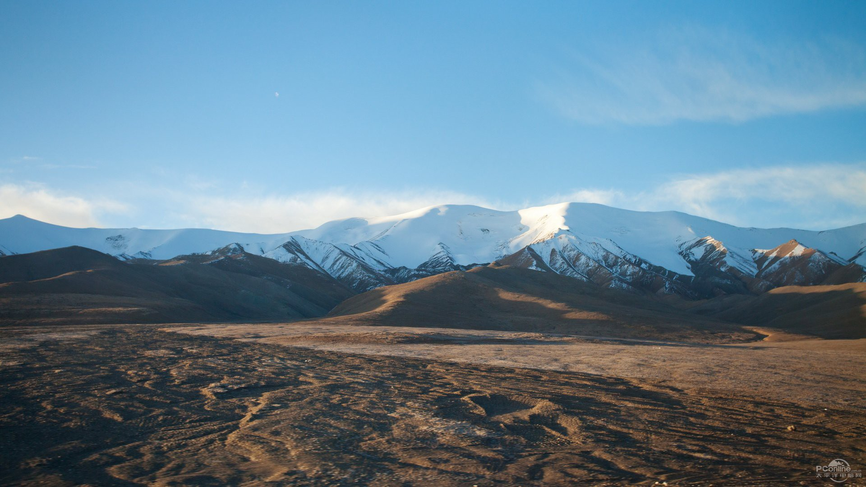
Our Wonderful God
Psalm 139

Slide 3
1. The Wonder of God’s Knowledge vs. 1-6
God knows everything about us.
What we do (v. 2)
What we think (v. 2)
Where we go (v. 3)
What we say (v. 4)
What we need (v. 5)

Slide 4
1. The Wonder of God’s Knowledge vs. 1-6
How God knows everything about us.
“searched” – to penetrate, to examine thoroughly and intimately
“comprehend” – to toss about; by implication to diffuse or to winnow
“acquainted” – to be familiar with; to minister unto, to be serviceable to

Slide 5
1. The Wonder of God’s Knowledge vs. 1-6
David’s response to God’s omniscience.
David was overwhelmed when he tried to understand God’s ability to know him.
“wonderful” – incomprehensible, extraordinary, remarkable
“high” – to be lofty, inaccessible

Slide 6
2. The Wonder of God’s Presence vs. 7-12
God is omnipresent; He is everywhere all the time.
There is no place David can go to escape the presence of God.
God’s omnipresence will either comfort us or terrify us (Heb. 4:13).

Slide 7
3. The Wonder of God’s Power vs. 13-18
God is omnipotent; He has all power.
His power is seen in the design of the human body.
David describes the development of a baby within the mother’s womb.

Slide 8
3. The Wonder of God’s Power vs. 13-18
We exist because God gave us life.
He formed our body, made us what we are.
He gave us our talents and abilities.
He prepared a place and purpose for the living of our life.
Instead of denying God’s existence, authority, and purpose for our life, we should praise and worship God (v. 14, 17-18).

Slide 9
4. The Wonder of God’s Judgment vs. 19-24
It is only right that God judge and punish those who are wicked (vs. 19-20).
David wants God to know that He hates the things God hates (vs. 21-22).
David’s primary concern is to be right in the eyes of God (vs. 23-24).

Slide 10
Lessons from Psalm 139
We must realize God is not our equal.
We must be careful about what we allow into our heart and out of our mouth.
We cannot hide our sins from God.
We must have the proper attitude towards sin and wickedness.
We have been fearfully and wonderfully made for a purpose; we must live up to it.
We will be judged by God.

